Slide 1
EXPO.e Connectivity
Be Unstoppable with EXPO.e

Slide 2
Why your customers demand world-class connectivity
$2.42m is the predicted VPLS market worth by 2025, with CAGR growth of 19.5% from 2020-2025
65% of enterprises will have implemented SD-WANs by 2025, compared with 30% in 2020
20-25% is the increase in the capacity of UK networks per year due to the increasing demands for online services, mobile data, increased productivity and new applications
Cloud The increase in use of Cloud platforms means the ethernet and switch router market is expected to see significant growth
60% of SD-WAN customers will implement a SASE solution by 2024 compared with 35% in 2020
Notes:
.

Slide 3
Customer Challenges
Businesses are purchasing different internet services from multiple suppliers, leading to increased complexity from billing, contract, and SLA’s.
If a business operates entirely online, sharing bandwidth with consumer peaks, can translate into slow internet and consequently revenue loss.
Cloud computing services are growing and businesses are becoming more and more interconnected, remote working and collaboration cannot be possible without a fast and reliable internet access.
Businesses rely on their internet to complete critical business activities. Any outages can be very costly, so they need robust connections through a supplier they can trust.
Security is a key area of concern for businesses. The public internet is not 100% safe – cyberattacks are on the rise and the number of successful breaches is increasing dramatically.

Slide 4
What is Smart Wires with EXPO.e?
EXPO.e’s offers a range of connectivity options through our Smart Wires Service. Smart Wires brings the customer’s site on-net to EXPO.e’s network, providing access to the internet, WAN, and any other managed services and applications within our portfolio.
The result is optimal control and scalability, reduced operational costs, and an accelerated path to the Cloud, with the highest standard of cyber security inherent in the design of every solution.
Smart Wires Broadband – SoGEA
Single Order Generic Ethernet Access (SoGEA) enables your customer to purchase entry level Ethernet without the need of the phone line.
With SoGEA, customers can save money as well as simplify the ordering process over ordering FTTC and a separate PSTN line.
Our SoGEA offering can offer maximum theoretical speeds hitting 80Mbps download and 20Mbps upload.
Smart Wires – EoF
Ethernet over Fibre is an end-to-end fibre connection that allows high speeds and low-latency to support business for optimum productivity and efficiency. Offering symmetrical speeds up to 10Gbps with bearer sizes at 100Mbps, 1Gbps and 10Gbps.
This connection and speeds ensure your customer is supported now, and in the future, with infrastructure to enable an increase in Cloud adoption and the ability to access multiple services over a single access circuit with our Smart Wires.
Smart Wires Broadband – SoTAP / (SoADSL)
Single Order Transitional Access Product (SoTAP) is a transitional copper product, for premises where fibre is not available and an ADSL type of service is required.
With SoTAP your customers receive both, broadband and IP Phone services, save money as well as simplify the ordering process over ordering ADSL and a separate PSTN line.
Smart Wires – 4G / 5G
We partner with one of Europe's leading IoT and M2M connectivity platform providers, Wireless Logic, to deliver a range of SIM’s that can be used both nationally and internationally.
The SIM’s are connected through to our Private APN, ensuring privacy to our customer’s data and have inbuilt security and ‘always on’ capabilities, ensuring maximum connectivity for your customers.
EXPO.e have dual NNIs into two of Wireless Logic’s DC’s, offering a secure end-to-end cellular proposition.
Smart Wires – FTTP
Fibre to the Premise (FTTP), also known as Full Fibre Broadband, allows you to have faster download speeds of up to 1Gpbs without the need of a Phone line rental. FTTP is a direct route fibre connection from the exchange to the premises via fibre optic cables. FTTP does not require a PSTN, allowing businesses to connect directly to the internet.
FTTP gives the customer a faster and more reliable connection, ideal for accessing cloud-based applications and high-quality video conferencing services.
Smart Wires – Microwave Access
Our Microwave Access solution allows business to have Ethernet services up to 5Gbps over the air using line of sight technology. Last mile connectivity is delivered via microwaves.
A microwave link is established between Exponential-e's PoP and the customer site, which allows the internet access to be transmitted over air. This is finally converted into a cable at the customer site through the use of a router.

Slide 5
Complementary Connectivity Solutions
EXPO.e’s connectivity portfolio brings together a comprehensive range of leading-edge solutions, designed, delivered, and managed by leading experts, supported by robust SLAs, and built on our self-owned, enterprise-class network.
The result is optimal control and scalability, reduced operational costs, and an accelerated path to the Cloud, with the highest standard of cyber security inherent in the design of every solution.
An industry-leading SD-WAN solution
Drawing on EXPO.e’s years of experience as a UK pioneer in software-defined connectivity - delivered as a fully managed service.
Secure Access Service Edge (SASE)
Combining leading-edge networking and zero-trust cyber security in a Cloud-based solution, to provide optimal control, protection, and visibility.
Managed LAN and WiFi
Our LAN and WiFi solution places your customers’ IT infrastructure in safe hands. With 20+ years of experience in managed Network solutions and a 24/7/365 UK support desk, we are highly skilled and available to keep their business running.
5i – Our Own Fibre Network
We are laying our own dark fibre in London with a focus on 10Gb to Unlimited bandwidths. This means we can offer good commercials, flexibility with Wayleaves, and additional tailored and bespoke services. We are already in 20+ key buildings and locations
.

Slide 6
Multiple Services Over the Same Pipe
Cost-effective and easy to manage - Our Smart Wires technology allows you to split your connection into multiple secure VLAN’s to deliver several services over the same pipe, to converge data, voice, video, and application traffic.
VPLS enables multiple services over a single access circuit, thus bringing true convergence of triple play onto the WAN, keeping these services separate from each other to optimise security.
Limited disruption – The EDD’s allow us to hand off different services as separate virtual circuits across one physical circuit, enabling us to guarantee end-to-end quality of service on all of our circuits. As a result, any faults that occur can be quickly located and fixed, limiting disruption to daily activities.
https://youtu.be/1znMq2XObu0
Note for Marketing – Link is from the SEP in Sharepoint, video needs rebranding if that’s possible?

Slide 7
WAN - VPLS
Our ethernet-based (Layer 2) virtual circuits can be configured over Smart Wires Services to establish connectivity between sites, configured as either Point-to-Point (E-Pipe) or as Point-to-Multipoint (VPLS).
Point-to-Point – E-Pipe
Cost-effective way to connect two customer sites
This E-Pipe provides the required bidirectional data transfer capability between the two locations
Makes the Ethernet interfaces connected at both ends appear on the same LAN segment.
Point-to-Multipoint – VPLS
Combines the capabilities and flexibility of a Local Area Network (LAN) and implements it over a wide area network (WAN)
This is through the creation of a completely private Layer 2 virtual switch to which customers can connect all of their offices in order to gain any-to-any connectivity across multiple sites.
VPLS enables multiple services such as Cloud and Voice / UCaaS -CCaaS, over a single access circuit.
Your customers can use the capabilities of VPLS as a building block to converge their services on our Service Creation Platform
Our VPLS is backed by stringent end-to-end SLAs whilst also ensuring low latency between sites
This ensures reduced complexity and administration and easier network planning and cost control

Slide 8
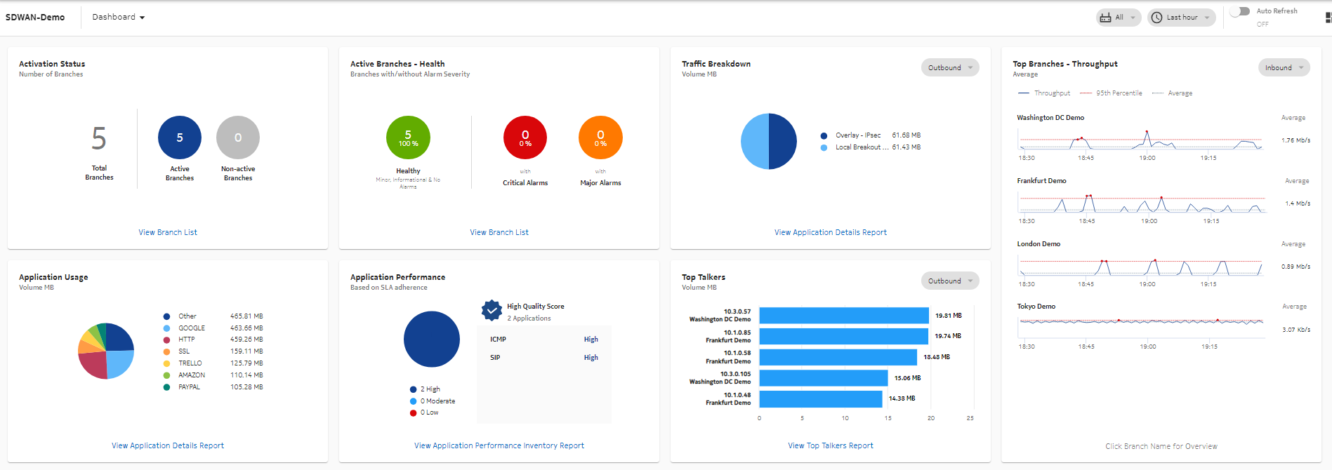
SD-WAN
Our SD-WAN solution is a virtualised, fully managed service to provide your customers with the flexibility to securely connect any service, any application, and any employee or partner, regardless of location.
SD-WAN provides a secure unified connectivity service over any transport technology, enabling centralised management and operations, with full control and visibility of application performance.
SD-WAN allows network administrators to programmatically initialise, control, change and manage network behaviour dynamically.
Real-time analytics to generate reports for policies set in the network to give greater visibility into the application performance, to easily diagnose issues and make strategic changes based on usage – all through a single pane of glass
This gives enterprises the ability to seamlessly connect branch offices, data centres, and Cloud resources on a global scale.

Slide 9
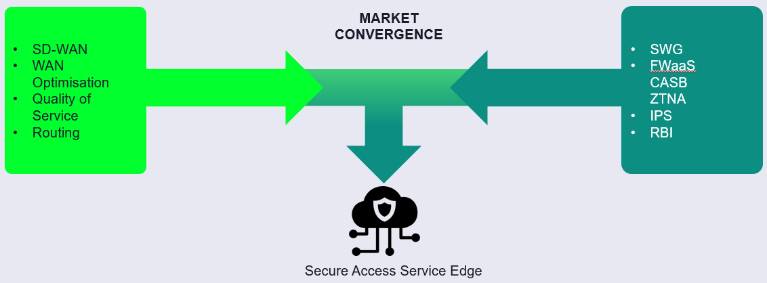
SASE
“Secure Access Service Edge (SASE) delivers converged network and security as a service capabilities, including… SD-WAN, SWG, CASB, NGFW, and zero trust network access (ZTNA). SASE supports branch office, remote worker and on-premises secure access use cases. SASE is primarily delivered as a service and enables zero trust access based on the identity of the device or entity, combined with real-time context and security and compliance policies.”

Slide 10
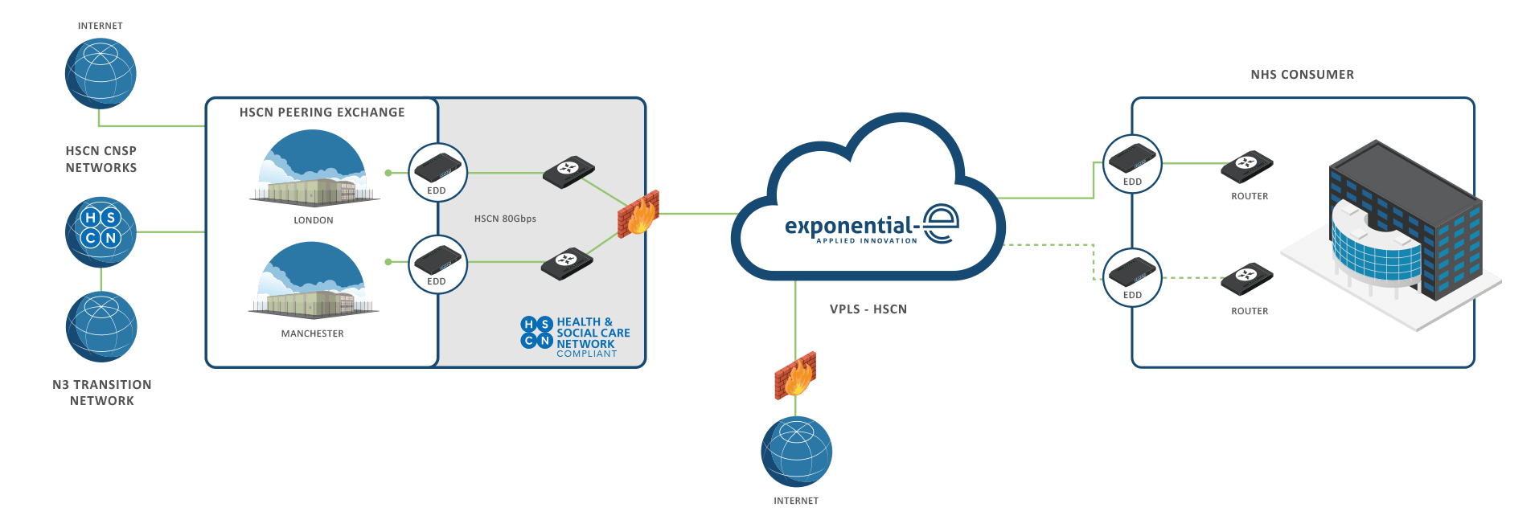
EXPO.e & the HSCN Network
Improving Health
The Health and Social Care Network (HSCN) network is a core component of NHS Digital's drive to improve health through the better use of data and technology, transforming the quality and reducing the cost of health and care service
Next Generation
The HSCN is the next generation national private network for health and care organisations. HSCN is a single logical network, delivered by multiple suppliers, it is a completely reimagined and reengineered successor to the N3 network, providing reliable, efficient, flexible, and cost-effective connectivity for end-users
Secure & Reliable
HSCN provides a secure and reliable mechanism for end users to access and exchange electronic information, anywhere, anytime and across any device and, in turn, facilitates greater collaboration and service sharing to drive greater efficiencies, increased clinical innovation, and improved patient outcomes.
HSCN Connect – An EXPO.e Product
HSCN Connect is an EXPO.e product that will provide NHS-approved private sector customers with access to the HSCN peering exchange network. It consists of managed CPE or CGNAT (centralised), and bandwidth into the HSCN Peering network. HSCN Connect is available in bandwidths from 1 Mbps to 1 Gbps.

Slide 11
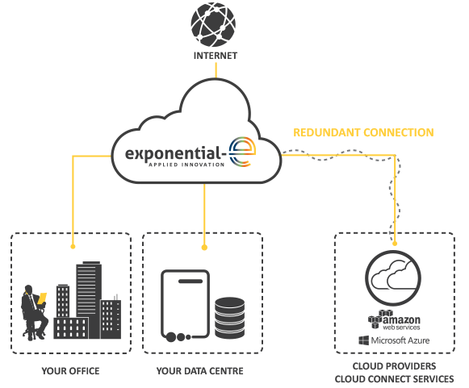
EXPO.e & Cloud Connect
High Performance
A dedicated private connection to Cloud assets that improves Network performance, increasing bandwidth throughput and providing overall cost saving.
Highly Scalable,
Highly Flexible
Choose from multiple bandwidths, providing the flexibility to scale-up your customers’ business demands.
Redundant Connection
Secure & Reliable
Cloud Connect allows EXPO.e to provide secure, low latency and inherently redundant connections to the Cloud Service Providers (CSPs) of the customer’s choice.
Connect to Multiple CSP’s
Cloud Connect allows end customers to connect to multiple public CSP’s via a dedicated network connection from the customer’s premises, including AWS, Microsoft Azure, Microsoft Office 365, and Google.

Slide 12
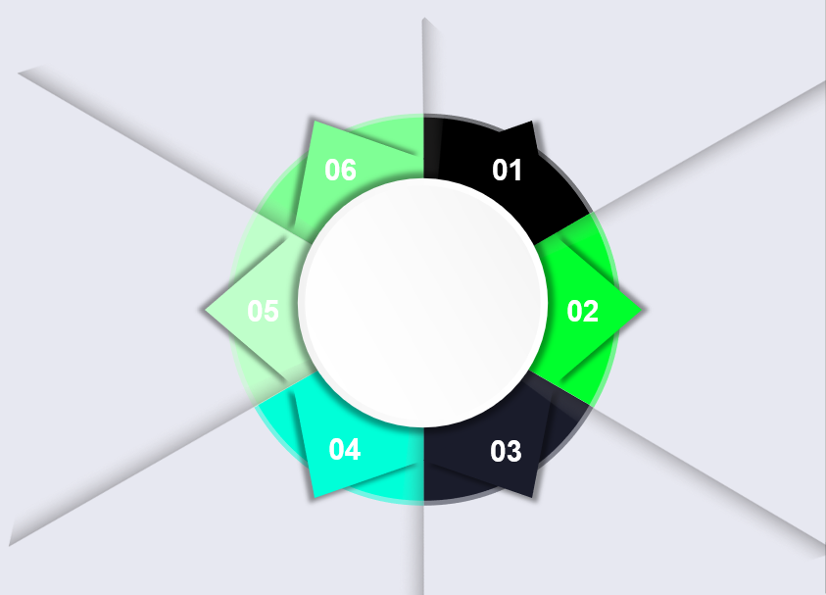
Features & Benefits
Intelligent, Self-healing Network: Our network can detect and remediate outages and failures without any human intervention, allowing for real-time fixes and
maximum uptime
Business-only Network: Our business-only network is not affected by consumer peaks in demand, so traffic is always prioritised
Scalable Capacity: Your customers can choose fixed bandwidth speeds from 10Mbps to 10Gbps business internet over our 100GigE core network, for guaranteed uncontended connectivity
Cloud-ready Internet: Our high-performance network provides the fast and steady Internet access required to access Cloud applications, allowing for the best possible user experience
Features
& Benefits
Highly Available Support: Our Smart Wires services are backed up by strict Service Level Agreements and 24/7x365 technical support
Enhanced Security: All of our internet and network services include free DDoS (Distributed Denial of Service) alerting

