Slide 1
UCaaS Reporting powered by Akixi
Partner Enablement

Slide 2
Why Expo with Akixi reporting
Resilience The Akixi BI Reporting Suite has a dedicated resilient connection into the Expo infrastructure, backed by robust SLA’s
Training and Adoption
We offer training whether its your sales and technical staff, to end-user training for your customers
Our Partnership Statement
A partnership to strengthen your portfolio, with little internal investment needed
Deliver commercial efficiency to retain partner margins
Enable you to focus on delivering the best possible experience and service to your customers
Industry leading Net Promoter Score of 92 for the last 3 month average
06
01
Professional Services
Whether you’re a reseller or referral partners, our team of UC engineering and provisioning teams are here for you
Flexibility
The Akixi portfolio can be tailored to your solution needs with our modular licensing structure.
05
02
04
03
Sell with approach
We’re here to support you, through the sales cycle
Self Service portals give you the control and management of your customers reporting needs

Slide 3
Our UCaaS Network
Multi-carrier resilience
High Availability
Geo diverse SBCs / PoPs
Enterprise Carrier Grade Architecture
Intergrated reporting and integration suite of tools
Enfield Virtus
Arc Farn.

Slide 4
Qualification & Customer Challenges
For any UCaaS opportunity, it is important to understand the current challenges and reason that the customer is looking to enhance or migrate their current services. This helps bring value to the solution, generates more revenue and creates a sticky solution.
Customer Challanges:
Every customer needs to understand what their call count is,
Access to a real-time snapshot view of their calling operations
To understand who and when customers are trying to call.
With a Fully remote or hybrid workforce, built on cloud technology, all companies need to maximize customer calling engagement from anywhere.
Many businesses use several apps to bring together their UCaaS solution, which is harder to monitor / support, and manage as a result, this delivers a poor user experience.
The lack of monitoring and optimization of key daily metrics
Clearly Identifying necessary areas for improvement
Optimize in real time to improve business performance
Voice related data can be complex and difficult to understand.
To build the solution, you will be looking at:
What is the key issues to demand change of solution?
How large is the problem, number of locations that need to be consider?
What is their daily, weekly, monthly call traffic?
Are they looking to monitor inbound / outbound sales performance? (Reporting, Recording, CRM Integration)
To build the solution, you will be looking at:
What is the key issues to demand change of solution?
How large is the problem, number of locations that need to be consider?
What is their daily, weekly, monthly call traffic?
Are they looking to monitor inbound / outbound sales performance? (Reporting, Recording, CRM Integration)

Slide 5
Did you know?
By 2024, 3 out of 4 enterprise employees will not use a desk phone. It has more than doubled since 2020 when it was just 30%
90% of businesses say their industry has become more competitive over the last 5 years1
71% of customer conversations happen over the phone

Slide 6
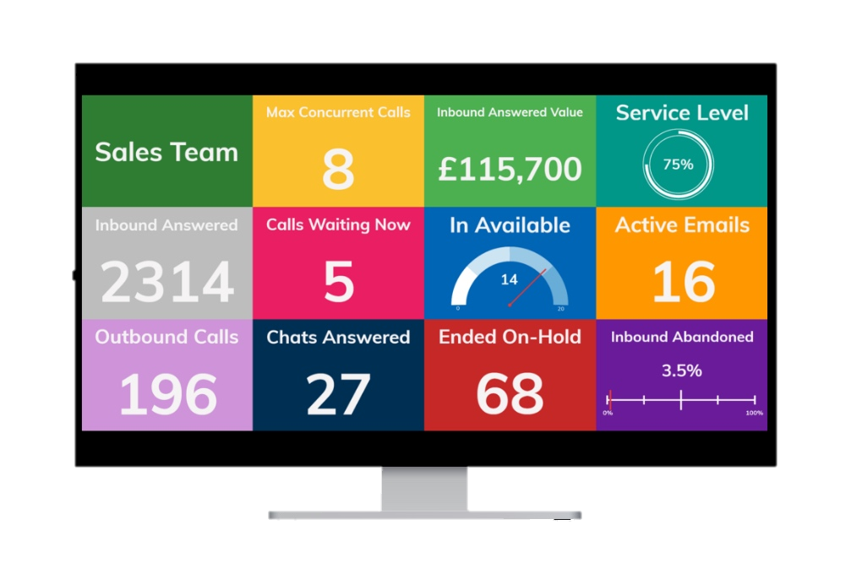
Reporting & Analytics
Akixi provides a range of reporting solutions for small or distributed businesses to dramatically improve customer insight and engagement.
Comprehensive Reporting Suite
Granular Filters to customise your reports
Invaluable insights on business KPIs
Capacity Management with SLA reporting
45% of small business owners plan to buy analytics software in the next year! (Forbes)
Historic, Real Time and Scheduled Reporting
Set thresholds and alerts
Full Dial to Disconnect Reporting
Maximise Revenue with unreturned lost calls
Notes:
Insert a ‘New Slide’ or select ‘Layout’
Exponential - Light Background

Slide 7
Business Insights
Delivering critical, time-relevant data at a glance via six reports
Helping businesses maximize customer engagement​
What’s happening today?
Serve more customers
Recapture lost calls
Increase productivity
Calls overview
Today’s call logs

Slide 8
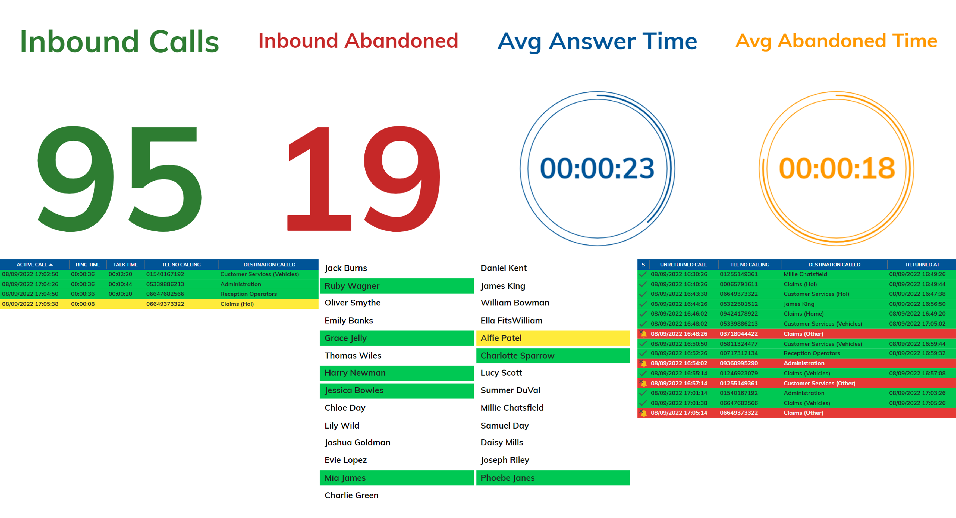
What’s happening today?
Give your customers a real-time snapshot view of their calling operations
Monitor and optimize key daily metrics
Identify necessary areas for improvement
Optimize in real time to improve business performance

Slide 9
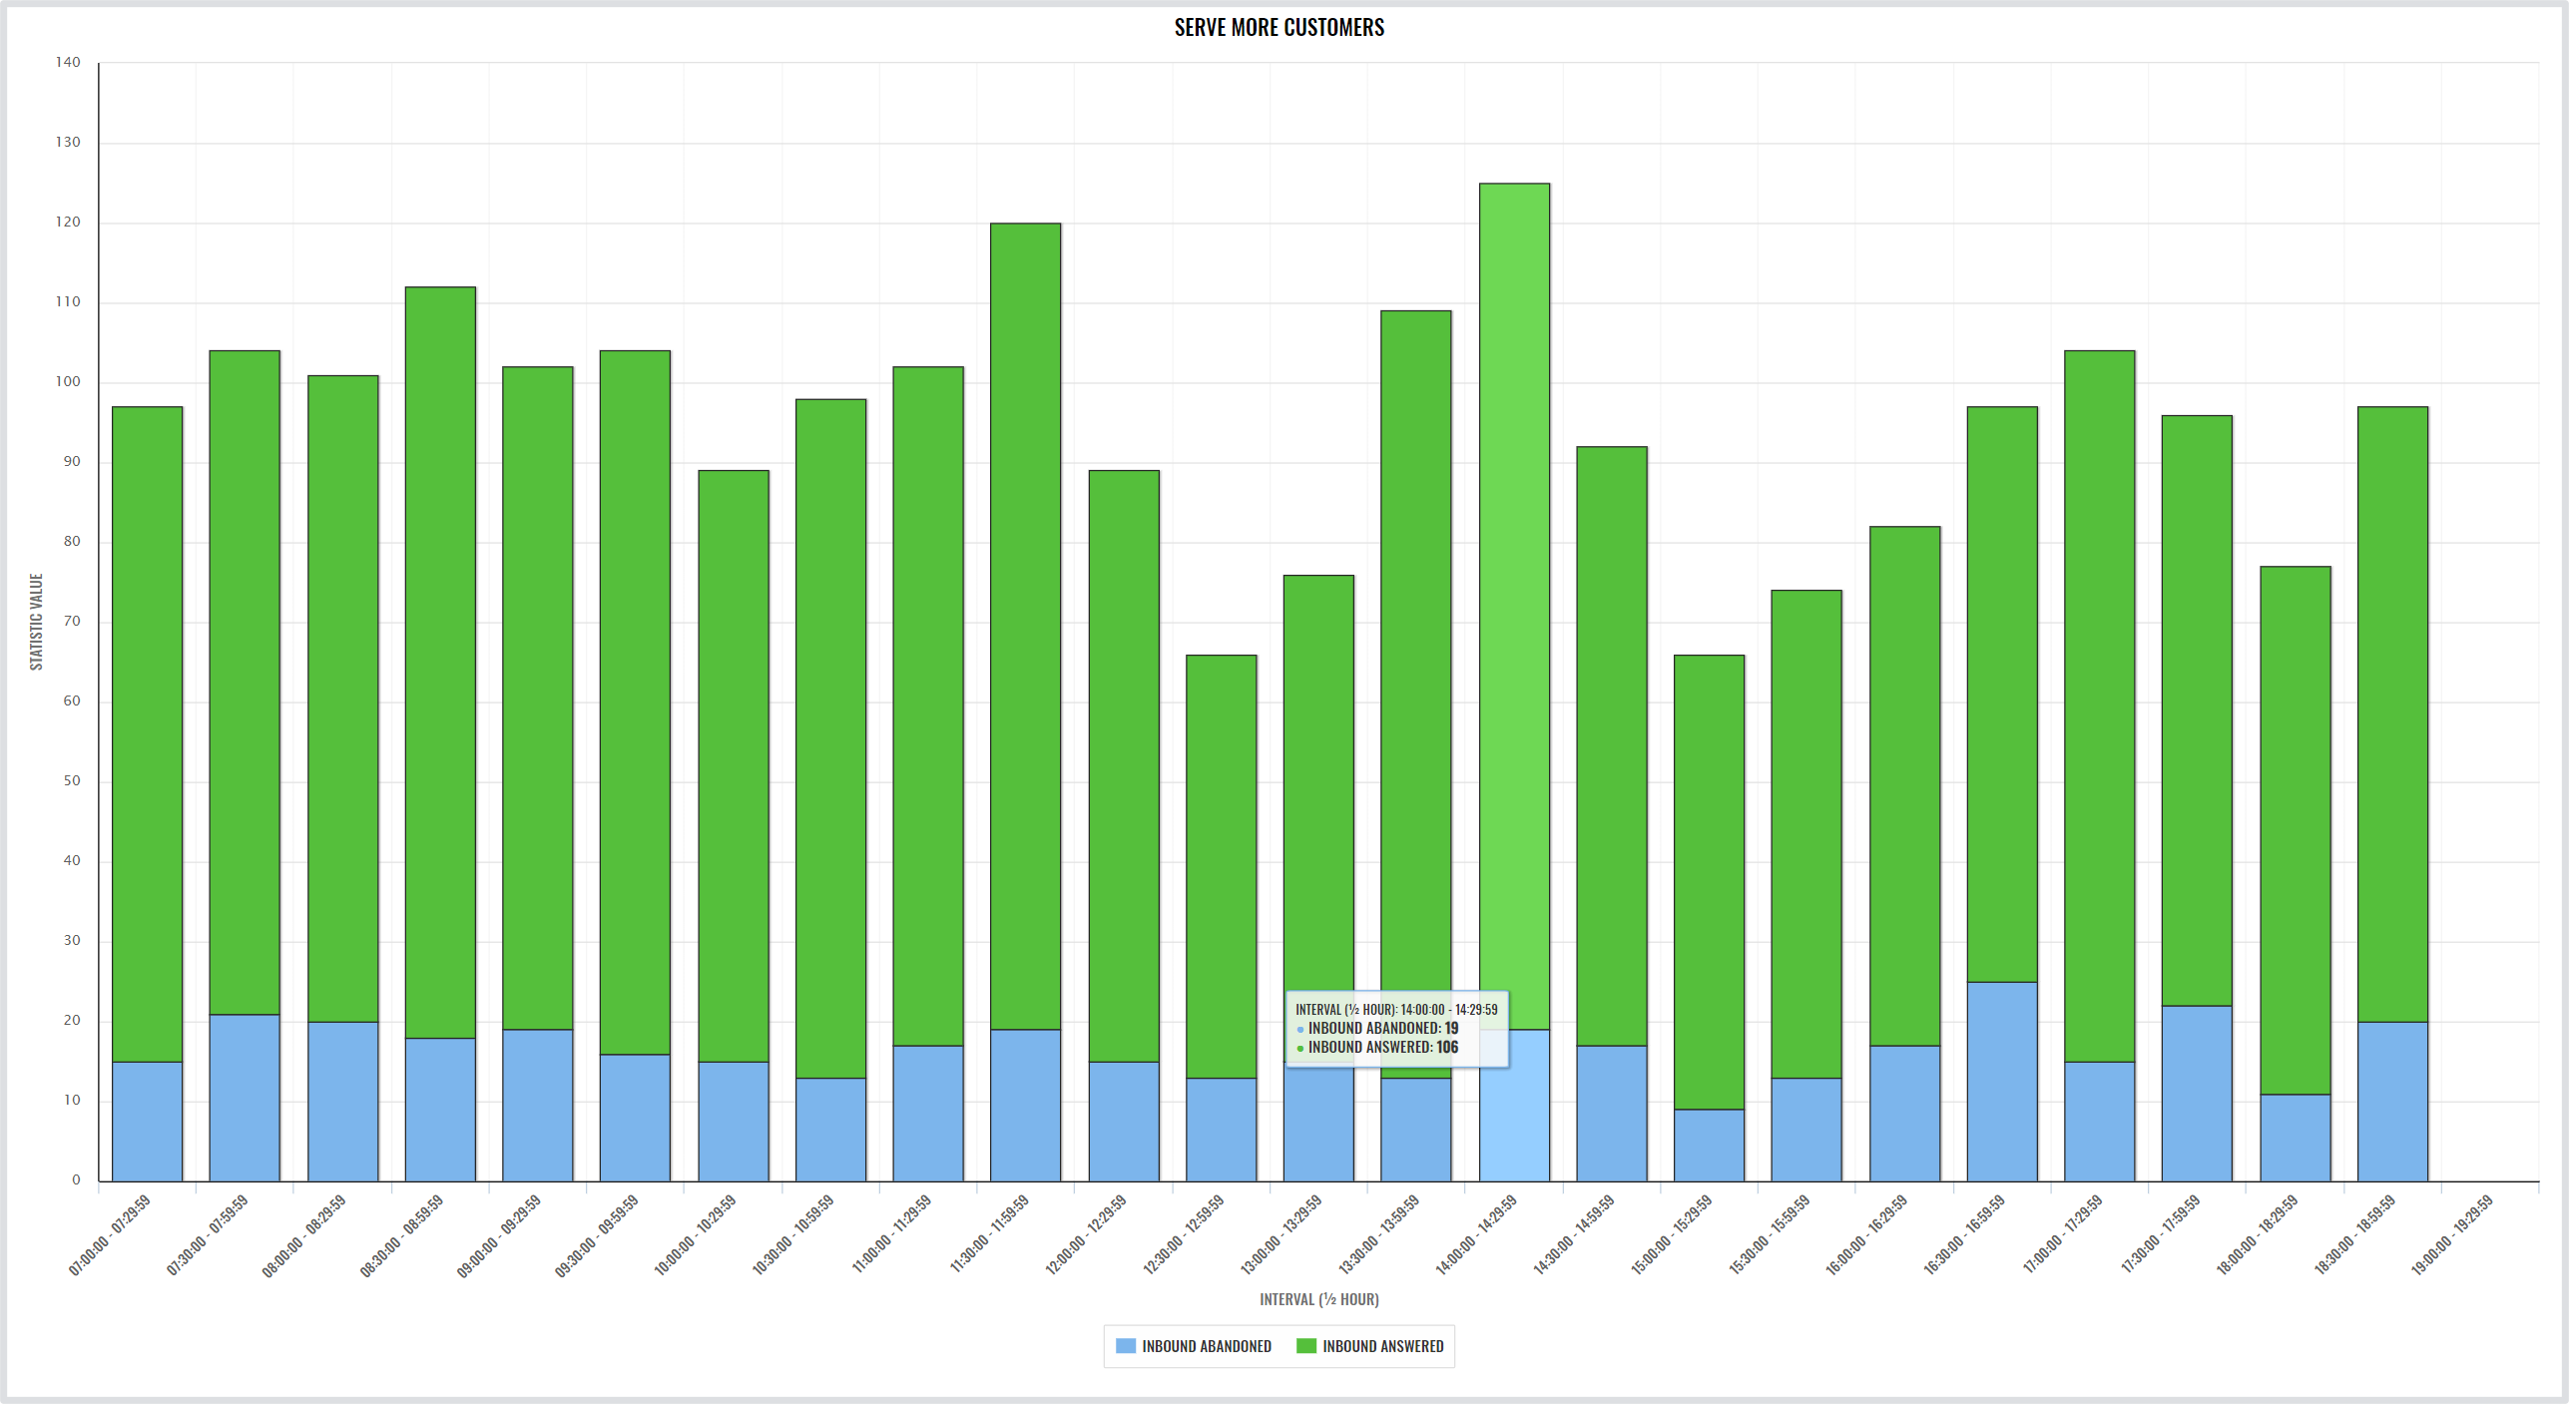
Serve more customers
Help businesses be available when their customers are trying to contact them
Identify peak call times across the day, week, or month
Reallocate resources to cater for times of high demand
Reduce wait times to improve customer experiences

Slide 10
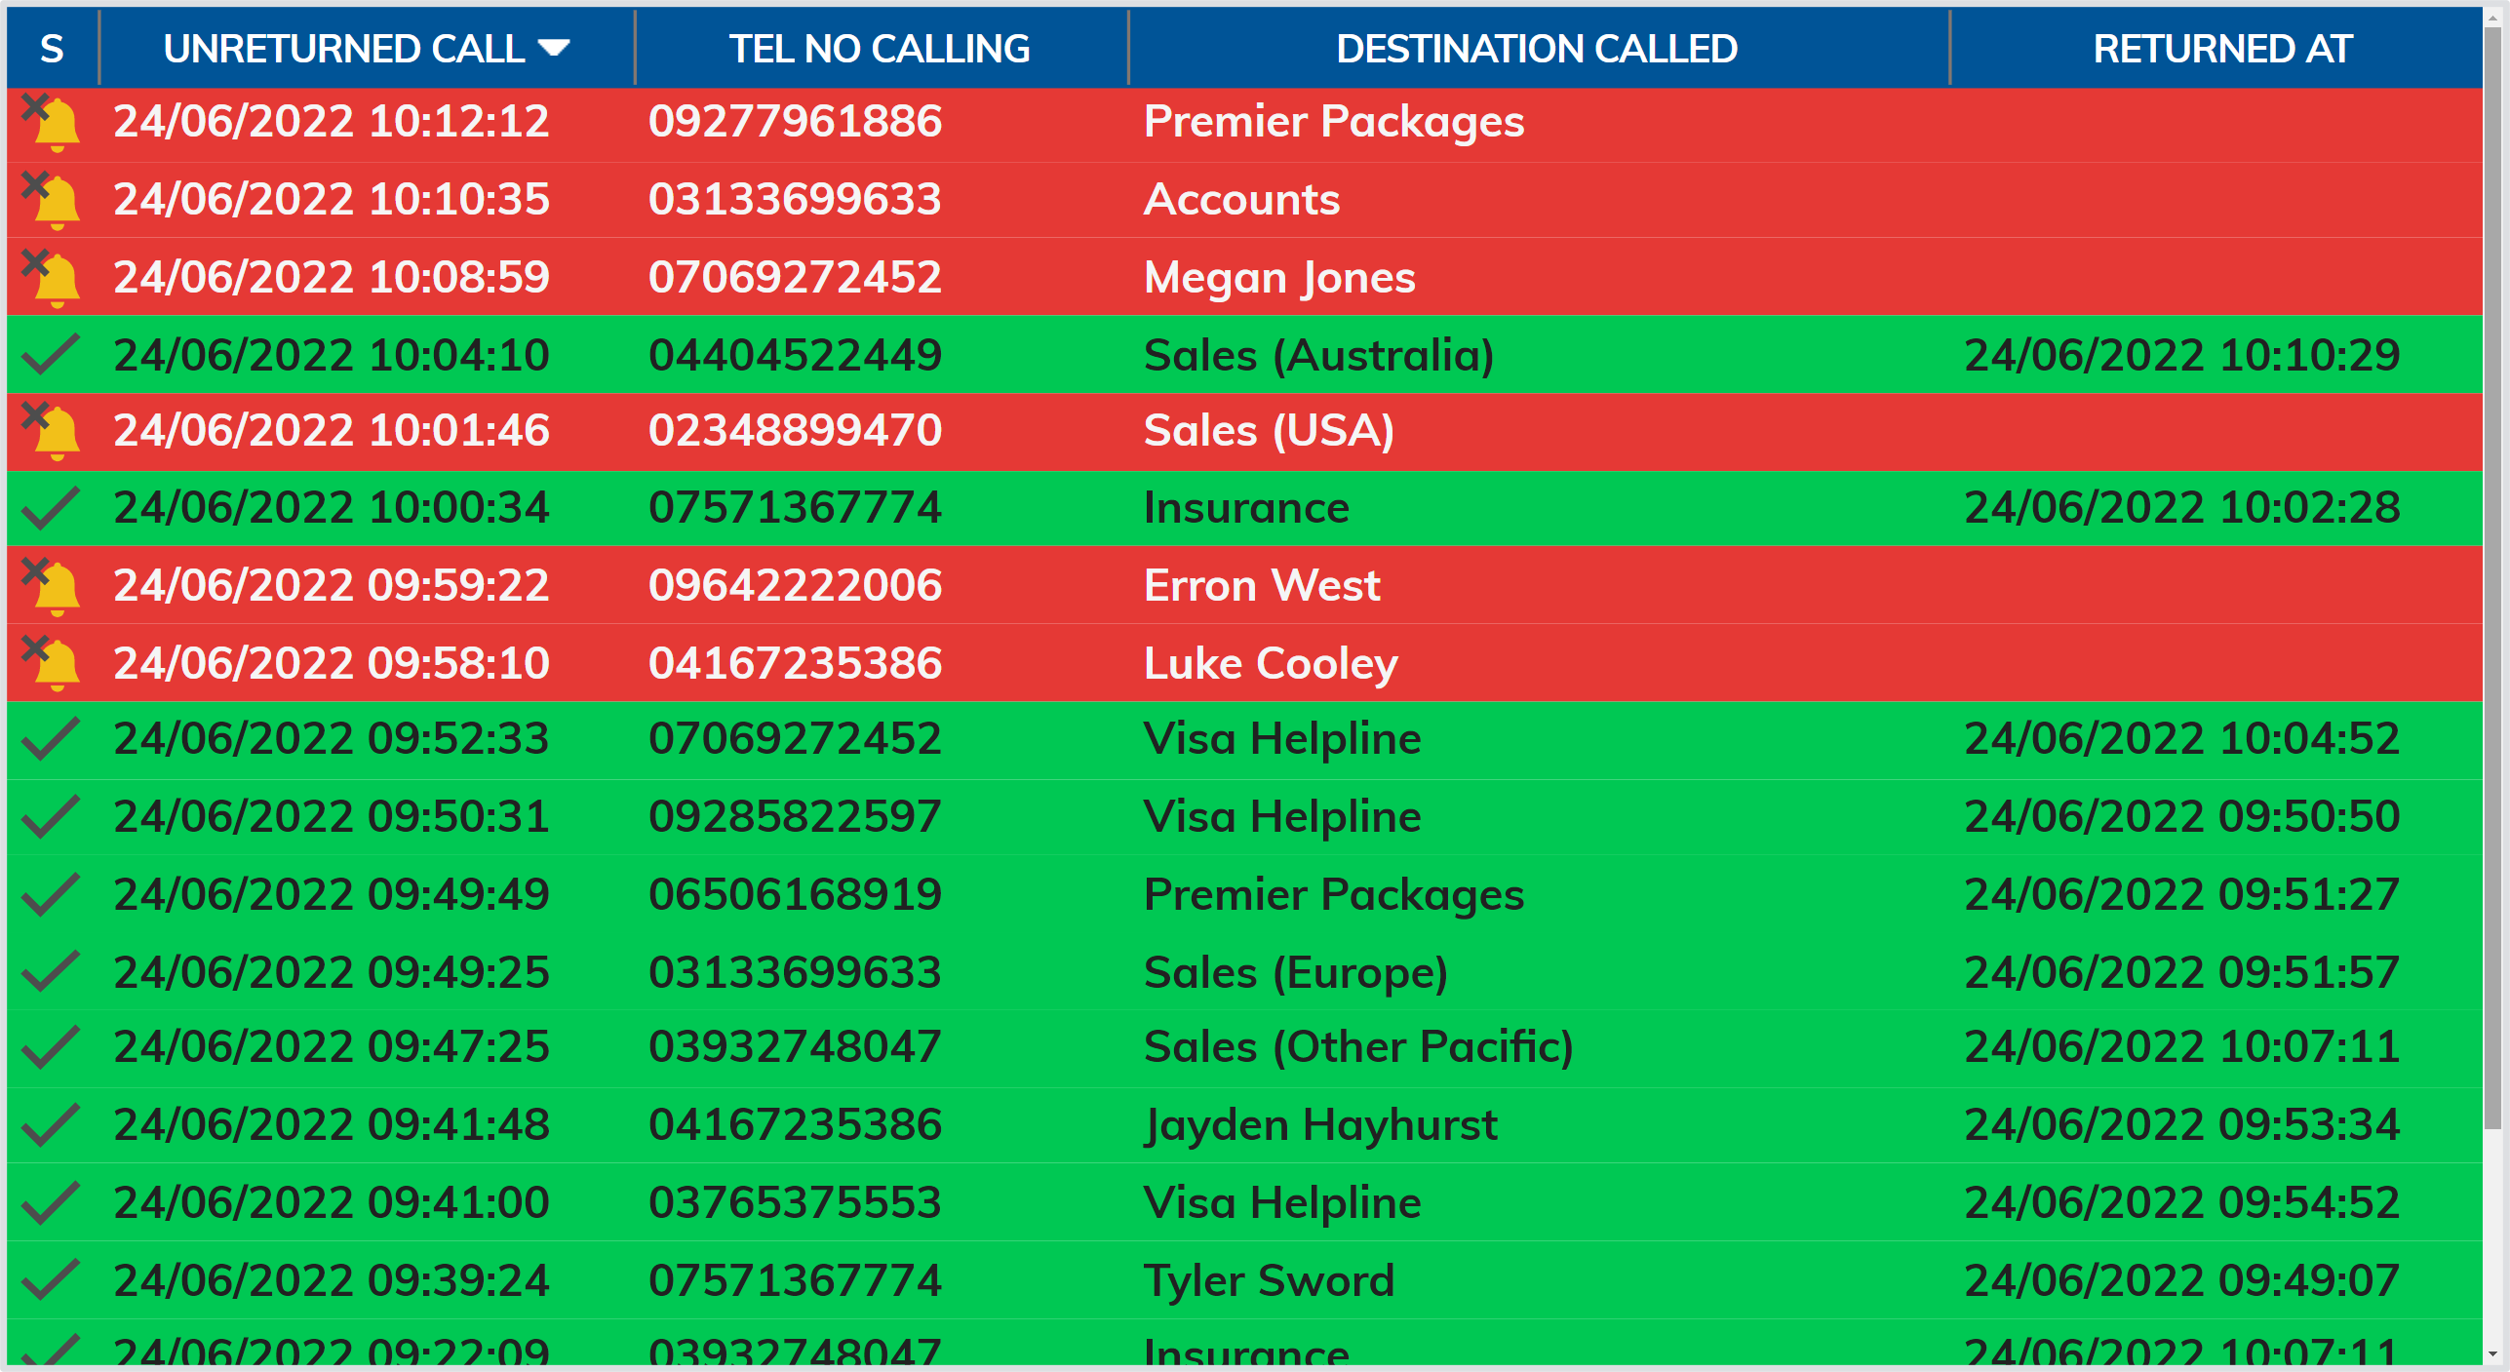
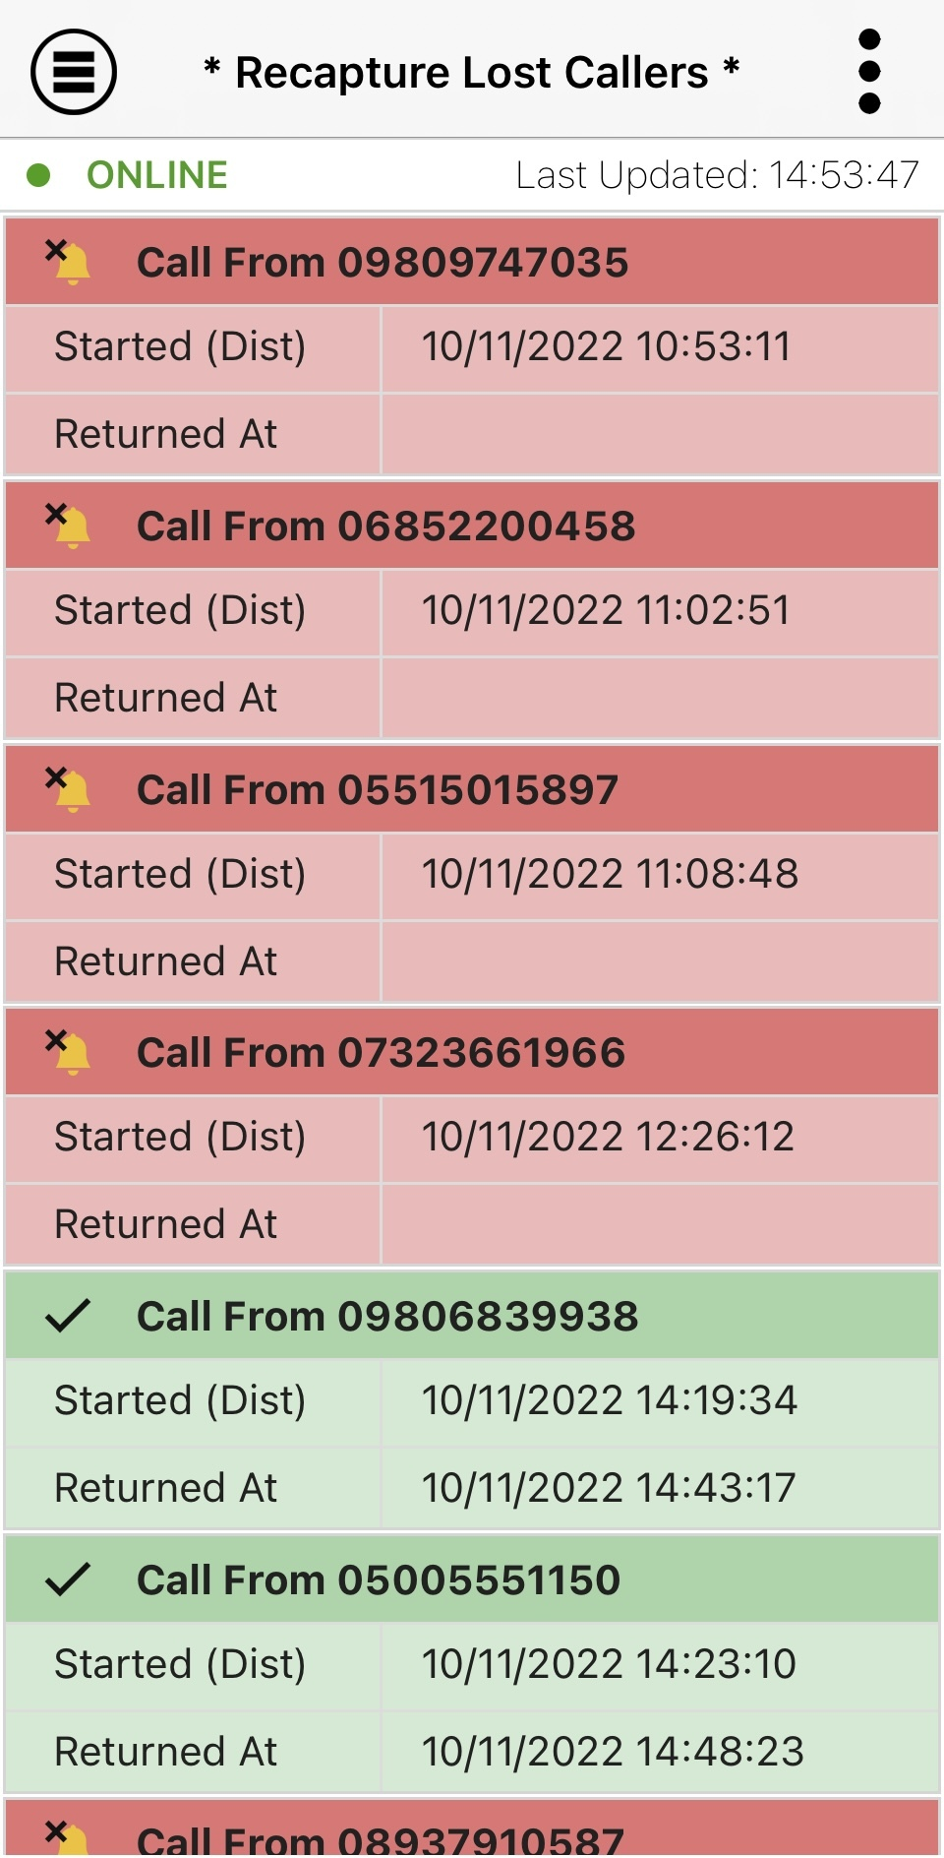
Recapture lost calls
Give your customers a​ second chance to make a positive first impression
Identify dropped calls in real time
Monitor and optimize channels that drop most calls​
Recapture lost calls before they phone a competitor

Slide 11
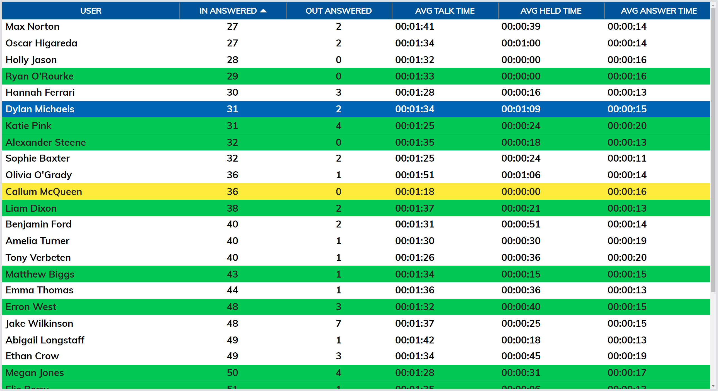
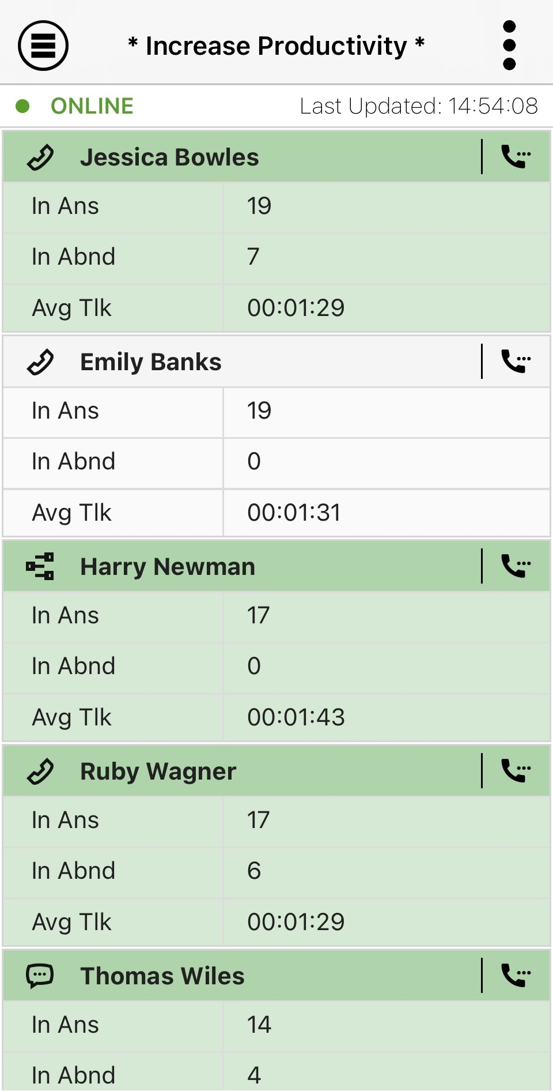
Increase productivity
Empower your Help your customers identity top-performing employees with insight into performance
Identify dropped calls in real time
Monitor and optimize channels that drop most calls​
Recapture lost calls before they phone a competitor

Slide 12
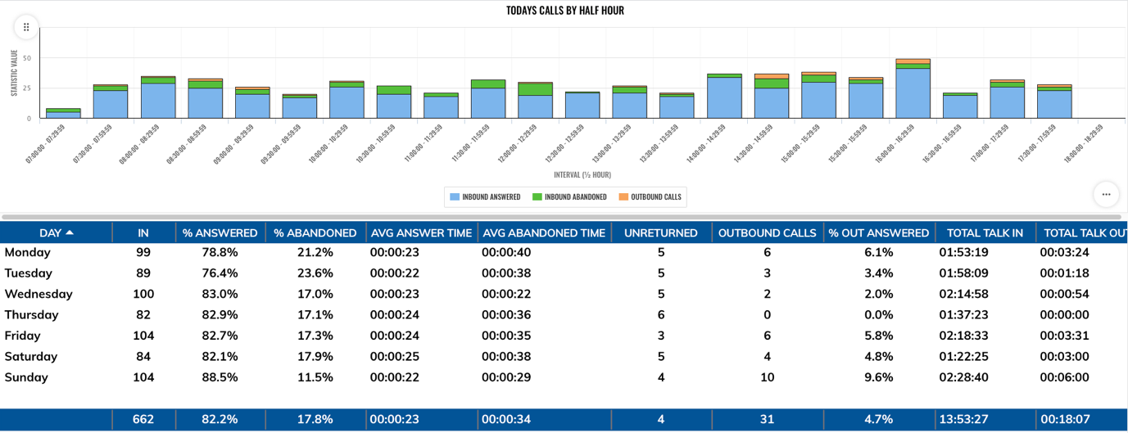
Calls overview
Empower your customers with insight into performance
Assess performance metrics on calls by half hour, hour, day or week
Set achievable targets to encourage productivity​
Explore patterns and trends for ongoing optimization

Slide 13
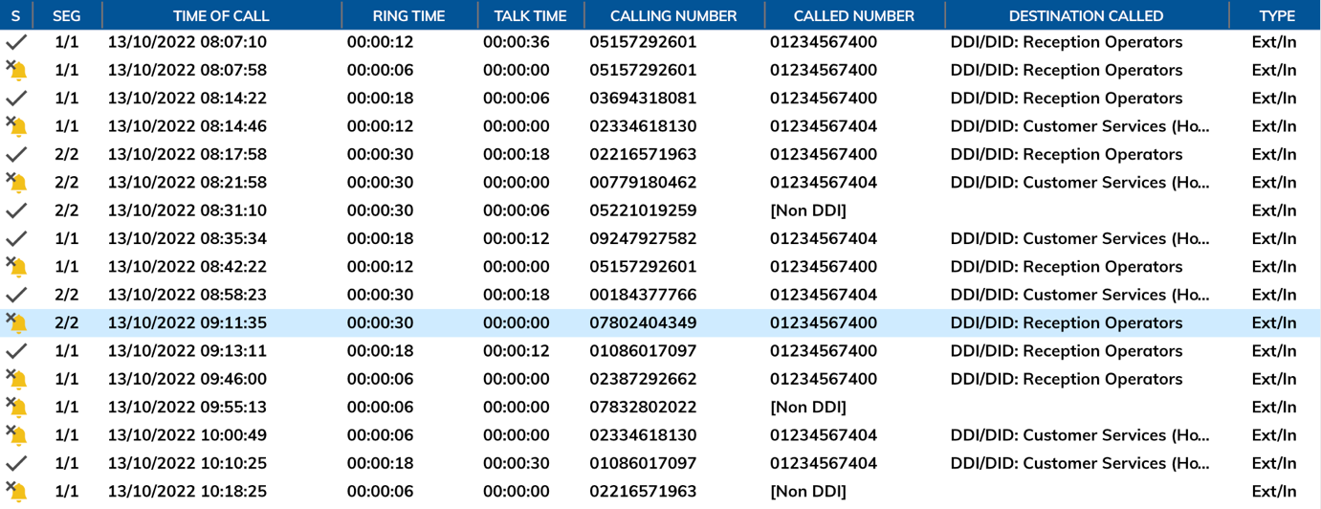
Today’s call logs
Give your customers in-depth insight into call history​
Simplify reporting with comprehensive call logs​
Identify customer pain points, such as long ring time, multiple transfers​
Deep dive into the data to optimize performance​

Slide 14
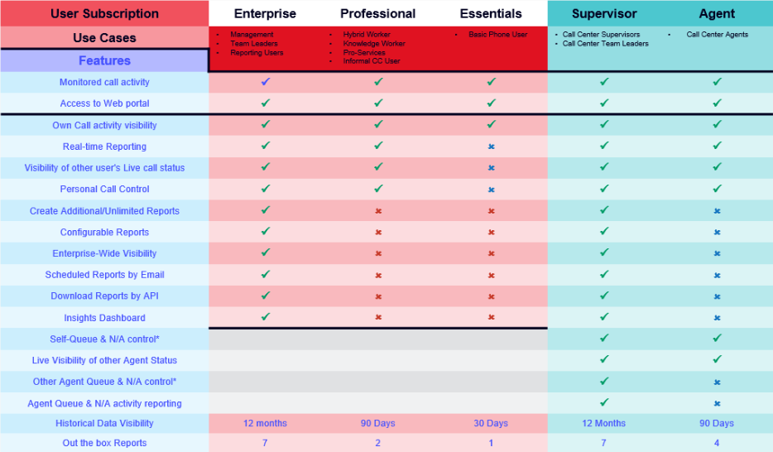
Licensing Matrix
User Subscription | Enterprise | Professional | Essentials | Supervisor | Agent
Use Cases | • Management • Team Leaders • Reporting Users | • Hybrid Worker • Knowledge Worker • Pro-Services • Informal CC User | • Basic Phone User | • Call Centre Supervisors • Call Centre Team Leaders | • Call Centre Agents
Features
Monitored call activity | ü | ü | ü | ü | ü
Access to Web portal | ü | ü | ü | ü | ü
Own Call activity visibility | ü | ü | ü | ü | ü
Activity can be viewed in Real Time by other users | ü | ü | ü | ü | ü
Can see other users in Real Time | ü | ü | X | ü | ü
Personal Call Control | ü | ü | X | ü | ü
Create Additional/Unlimited Reports | ü | X | X | ü | X
Configurable Reports | ü | X | X | ü | X
Enterprise-Wide Visibility | ü | X | X | ü | X
Scheduled Reports by Email | ü | X | X | ü | X
Download Reports by API | ü | X | X | ü | X
Insights Dashboard | ü | X | X | ü | X
Self-Queue & N/A control* |  |  |  | ü | X
Live Visibility of other Agent Status |  |  |  | ü | ü
Other Agent Queue & N/A control* |  |  |  | ü | X
Agent Queue & N/A activity reporting |  |  |  | ü | X
Agent Queue & N/A activity reporting |  |  |  | ü | ü
Historical Data Visibility | 12 months of all users | 90 Days of own | 30 Days own | 12 Months of all users | 90 Days of own

Slide 15
Licensing Matrix
Business Insights
Call Centre Reporting
Enterprise
Professional
Essentials
Supervisor
Agent
Real-time and historical reporting on call activity across an entire Enterprise or group
Call activity can be reported on by other Enterprise Users & Supervisors
Status is visible to all user types with Call Control
Use Cases:
With real time
Management Reporting
Company management
Team leaders
Informal call centre reporting
Professional Services Fee Earners
Real-time visibility of users call environment through 6 reports
Self-Management
Call recapture
Call Activity is reported on by Enterprise Users & Supervisors
Status is visible to all subscribed users
Use Cases:
Knowledge Workers
Hybrid Workers
Informal Call Centre Users
Users have visibility of own 30 day call history
Call activity is reported on by Enterprise Users
Status is visible to all subscribed users
Use Cases:
Standard phone users
Reporting call and agent activity across a call centre or call centre group in real-time and historical
Can also be Call Centre Agent
Call & Agent activity can be reported on
Call Control
Agent and self-queue and availability Control
Status is visible to all subscribed users
Use Cases:
Call Centre Management
Call Centre Team Leaders
Real-time visibility of agents call and queue environment
Self -- Management
Call recapture
Self-queue & availability management
Call & agent Activity is reported on by Supervisors
Status is visible to all subscribed users
Use Cases:
Call Centre Agents
Hybrid Agents

Slide 16
Don’t leave revenue on the table
Increase revenue and margin by providing these additional services to strengthen your solution

Slide 17
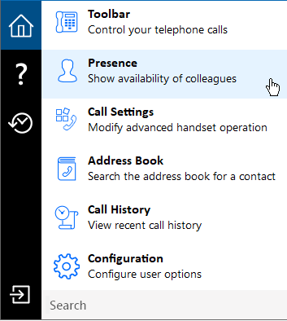
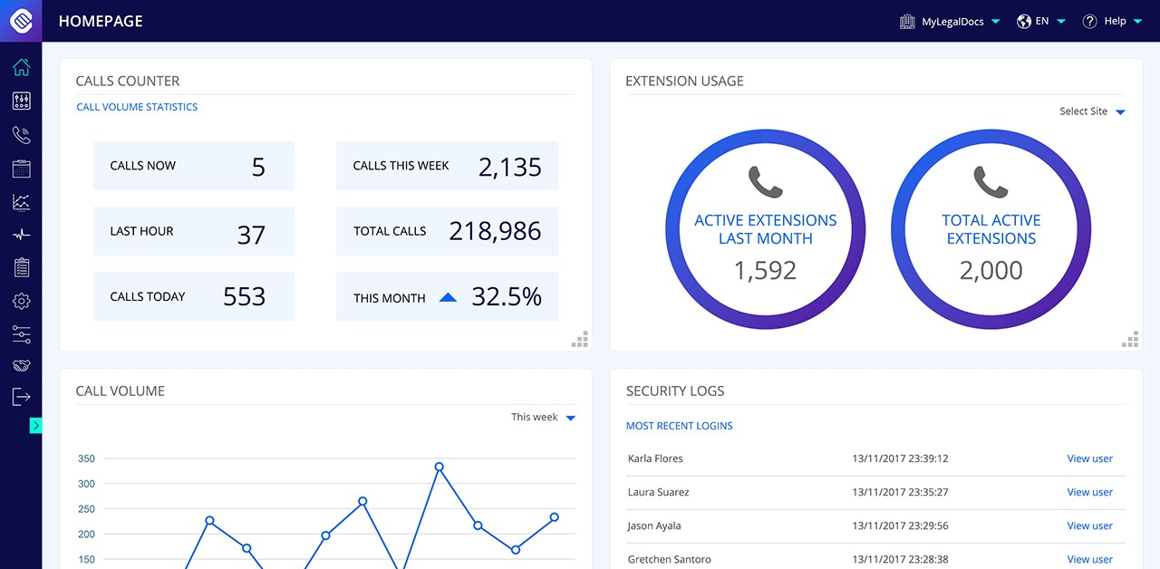
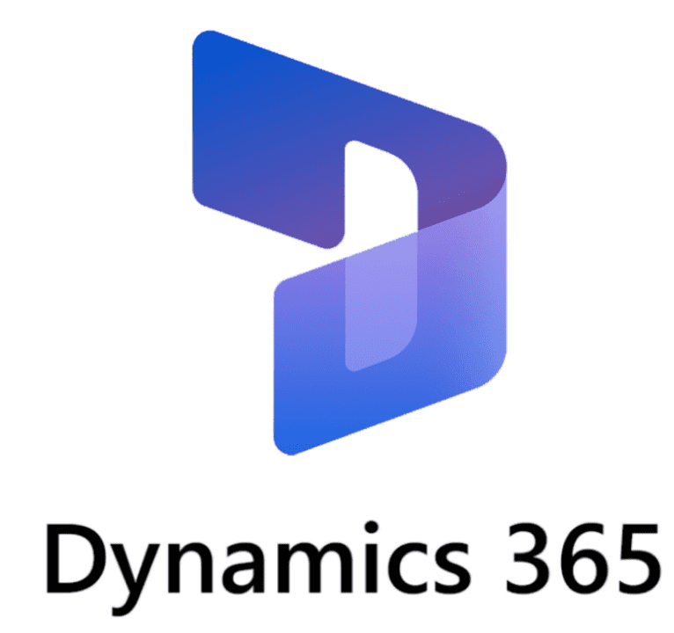
Bridge the gap between your telephony and CRM with GoIntegrator.
CRM Integration
Contact Popping
Auto / Manual
Activity Logging
Address Book Searching across multiple sources
Integrate with over 100 of the leading CRM’s
Boost employee productivity and improve the customer experience!
Click to Dial
Call Control and Presence for deskphone users
MS Teams Presence integration
Add Contacts to CRM from the call window
Notes:
Insert a ‘New Slide’ or select ‘Layout’
Exponential - Light Background

Slide 18
Cara Key Enhancements versus Go Integrator V3
Although Cara and Go Integrator V3 share many features, Cara is not a simple update to GI V3 but is written from the ground up, retaining core features.
Access code based dynamic branding
Microsoft Teams Integration including User Availability in Presence
Extension (BLF) Presence default limits extended from 50 to 250 users
Cloud Contacts directory option
Preferred Device control
SmartBusy - BroadWorks forwarding based on user availability
Add / Edit contact feature
Missed call notification
For Windows clients only:
Integrated Softphone
“AppBar” interface option, in addition to V3 style Tray menu interface
Improved and updated Call Toolbar
Send Callback Email feature
CRM Related Data
Combined Context buttons

Slide 19
Licensing
Platform | Windows |  |  | Mac OS
Features | Solo | Team | Unite | Solo | Team | Unite
Click to Dial | ü | ü | ü | ü | ü | ü
Presence /BLF | ü | ü | ü | ü | ü | ü
Address Book | ü | ü | ü | ü | ü | ü
Call history and Recent Calls | ü | ü | ü | ü | ü | ü
Preview window and missed call notification | ü | ü | ü | ü | ü | ü
Preferred device (Multi-device support) | ü | ü | ü | ü | ü | ü
Call Control | ü | ü | ü | ü | ü | ü
CRM integration (Outlook / Google Contacts / Apple Contacts) | ü | ü | ü | ü | ü | ü
Add Contact / Duplicate Contact | ü | ü | ü | ü | ü | ü
Show contact in edit mode | ü | ü | ü | ü | ü | ü
Call Toolbar and AppBar Mode | ü | ü | ü | X | X | X
Busylight support | ü | ü | ü | X | X | X
Call Settings | ü | ü | ü | X | X | X
First Login wizard | ü | ü | ü | X | X | X
Import v3 Client settings | ü | ü | ü | X | X | X
Combined Text buttons | ü | ü | ü | X | X | X
Search and Call App for MS Teams Client | ü | ü | ü | ü | ü | ü
Show, Add, Pop, CRM contact for call ringing / answered using MS Teams Client | ü | ü | ü | ü | ü | ü
Select MS Teams chat form Cara Presence | X | ü | ü | X | ü | ü
Show peers MS Teams availability | X | ü | ü | X | ü | ü
Smart Busy for MS Teams | X | ü | ü | X | ü | ü
Smart Busy for Zoom | X | ü | ü | X | X | X
Softphone | X | ü | ü | X | ü | X
Custom Events | X | ü | ü | X | ü | ü
Client API | X | X | ü | X | X | ü
Agent Features | X | X | ü | X | X | X
CRM Related Data | X | X | ü | X | X | X
CRM Integrations for all other applications | X | X | ü | X | X | ü
The licenses are a superset of each other - users only ever require one license
Solo
For users needing Click-to-dial, Microsoft Outlook or Google Contact integration or quick access to BroadWorks directories
Team
Includes Microsoft Teams integration, Custom Call Events and Softphone options. Ideal for users needing enhanced presence and unified communication.
Unite
The complete license - includes all features and all available standard CRM integrations plus client API and Call Center features
Click to Dial options differ between Windows and macOS versions
Call control will vary by device type
Outlook Web Access only on macOS
Requires Microsoft Teams direct routing (or similar)
List of Integrations will vary between Windows and macOS versions

Slide 20
CRM Application Integrations
Go Integrator Cara supports an extensive range of CRM Integrations, providing a range of integration features:
Contact Popping
Pop the caller’s contact record within the integrated CRM automatically on incoming call, or manually with a single click
Activity Logging
Manually or automatically create an activity record of a call received within the integrated CRM and allows addition of notes
Add Contact
Add new contacts to the integrated CRM from multiple locations such as the live call Preview window, Call history and missed calls pop up
Caller Preview
Preview who is calling before the call is answered, and view additional caller details, including notes, all from the unobtrusive Caller Preview window
Duplicate Contact
Add an existing contact’s details from one integrated CRM to another integrated CRM
Click to Dial
With a single click, dial a contact’s phone number from within your integrated CRM
Address Book
Search the contact directories of multiple integrated CRMs simultaneously, and call or pop a contact from the results

Slide 21
Microsoft Teams Integration Summary by User
Cara supports a range of integration features with Microsoft Teams dependent on user license level and services available to the Teams user.
For Cara Solo, Team and Unite users:
Show, Add, Pop CRM contact for call ringing / answered using Teams
‘Search and Call’ app for MS Teams
For Cara Team and Unite users:
Show photo / avatar in Cara Presence
Show colleague Teams availability
Publish “In a Call” state to Teams
Open MS Teams chat from Cara Presence
Call through Teams (select Teams as Preferred Device)
Smart Busy call forwarding

Slide 22
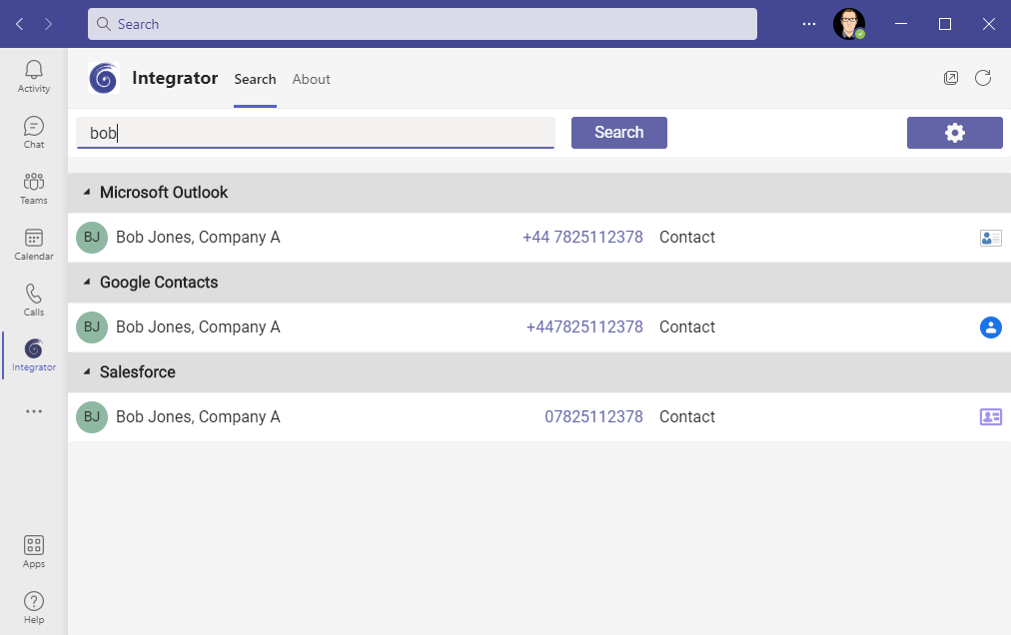
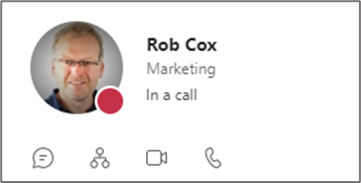
Microsoft Teams Integration - Summary by Service
Available without any Teams Direct Routing service:
Show photo / avatar in Cara Presence Window
Show co-worker Teams availability state
Open Teams chat from Cara Presence
Publish “In a Call” state to Teams
Search and Call app for Teams
Smart Busy call forwarding
Avatar populated automatically from Microsoft Teams
Handset Hook state
Teams Availability
Open Teams chat
Enter name then ‘Search’
Click to open contact
Publish “In a call” state to Teams
Click to dial

Slide 23
Cara Benefits
Increase Customer Satisfaction: ​
Professional handling/transferring of calls​
Quickly identify and return missed calls
More in-depth Integration to CRM systems and business applications​
Increase Efficiency: ​
Reduce call times by faster dialing and caller identification
Increase Staff Productivity and Collaboration: ​
Ideal for businesses with high volume inbound/outbound calls​
Integration to CRMs and other applications​
Contact adding, searching and “popping”, click-to-dial​
See the availability of co-workers (through Presence)
Copy and keep consistent contact data between different CRM / Contact applications

Slide 24
Important selling points
Go Integrator Cara is a high value complimentary product for the BroadWorks platform at a competitive price point
It is straightforward to install and configure and, in most cases, this can be carried out by the end-customer without support
End-customers can “try before buying” using a 30-day trial license, available to a new user immediately after download
Akixi can provide you with pre-sales, support and installation services
REMEMBER: CRM INTEGRATION WILL HELP YOU SELL BROADWORKS SEATS

