Slide 1
Feature Matrix
Business Insights
Call Centre Reporting
Enterprise
Professional
Essentials
Supervisor
Agent
Real-time and historical reporting on call activity across an entire Enterprise or group
Call activity can be reported on by other Enterprise Users & Supervisors
Status is visible to all user types with Call Control
Use Cases:
With real time
Management Reporting
Company management
Team leaders
Informal call centre reporting
Professional Services Fee Earners
Real-time visibility of users call environment through 6 reports
Self-Management
Call recapture
Call Activity is reported on by Enterprise Users & Supervisors
Status is visible to all subscribed users
Use Cases:
Knowledge Workers
Hybrid Workers
Informal Call Centre Users
Users have visibility of own 30 day call history
Call activity is reported on by Enterprise Users
Status is visible to all subscribed users
Use Cases:
Standard phone users
Reporting call and agent activity across a call centre or call centre group in real-time and historical
Can also be Call Centre Agent
Call & Agent activity can be reported on
Call Control
Agent and self-queue and availability Control
Status is visible to all subscribed users
Use Cases:
Call Centre Management
Call Centre Team Leaders
Real-time visibility of agents call and queue environment
Self -- Management
Call recapture
Self-queue & availability management
Call & agent Activity is reported on by Supervisors
Status is visible to all subscribed users
Use Cases:
Call Centre Agents
Hybrid Agents

Slide 2
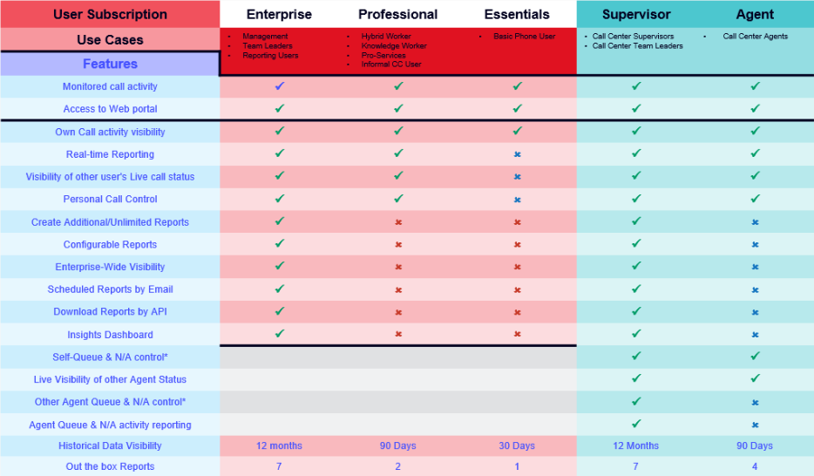
Feature Matrix
User Subscription | Enterprise | Professional | Essentials | Supervisor | Agent
Use Cases | • Management • Team Leaders • Reporting Users | • Hybrid Worker • Knowledge Worker • Pro-Services • Informal CC User | • Basic Phone User | • Call Centre Supervisors • Call Centre Team Leaders | • Call Centre Agents
Features
Monitored call activity | ü | ü | ü | ü | ü
Access to Web portal | ü | ü | ü | ü | ü
Own Call activity visibility | ü | ü | ü | ü | ü
Activity can be viewed in Real Time by other users | ü | ü | ü | ü | ü
Can see other users in Real Time | ü | ü | X | ü | ü
Personal Call Control | ü | ü | X | ü | ü
Create Additional/Unlimited Reports | ü | X | X | ü | X
Configurable Reports | ü | X | X | ü | X
Enterprise-Wide Visibility | ü | X | X | ü | X
Scheduled Reports by Email | ü | X | X | ü | X
Download Reports by API | ü | X | X | ü | X
Insights Dashboard | ü | X | X | ü | X
Self-Queue & N/A control* |  |  |  | ü | X
Live Visibility of other Agent Status |  |  |  | ü | ü
Other Agent Queue & N/A control* |  |  |  | ü | X
Agent Queue & N/A activity reporting |  |  |  | ü | X
Agent Queue & N/A activity reporting |  |  |  | ü | ü
Historical Data Visibility | 12 months of all users | 90 Days of own | 30 Days own | 12 Months of all users | 90 Days of own

Slide 3
Licensing
Platform | Windows |  |  | Mac OS
Features | Solo | Team | Unite | Solo | Team | Unite
Click to Dial | ü | ü | ü | ü | ü | ü
Presence /BLF | ü | ü | ü | ü | ü | ü
Address Book | ü | ü | ü | ü | ü | ü
Call history and Recent Calls | ü | ü | ü | ü | ü | ü
Preview window and missed call notification | ü | ü | ü | ü | ü | ü
Preferred device (Multi-device support) | ü | ü | ü | ü | ü | ü
Call Control | ü | ü | ü | ü | ü | ü
CRM integration (Outlook / Google Contacts / Apple Contacts) | ü | ü | ü | ü | ü | ü
Add Contact / Duplicate Contact | ü | ü | ü | ü | ü | ü
Show contact in edit mode | ü | ü | ü | ü | ü | ü
Call Toolbar and AppBar Mode | ü | ü | ü | X | X | X
Busylight support | ü | ü | ü | X | X | X
Call Settings | ü | ü | ü | X | X | X
First Login wizard | ü | ü | ü | X | X | X
Import v3 Client settings | ü | ü | ü | X | X | X
Combined Text buttons | ü | ü | ü | X | X | X
Search and Call App for MS Teams Client | ü | ü | ü | ü | ü | ü
Show, Add, Pop, CRM contact for call ringing / answered using MS Teams Client | ü | ü | ü | ü | ü | ü
Select MS Teams chat form Cara Presence | X | ü | ü | X | ü | ü
Show peers MS Teams availability | X | ü | ü | X | ü | ü
Smart Busy for MS Teams | X | ü | ü | X | ü | ü
Smart Busy for Zoom | X | ü | ü | X | X | X
Softphone | X | ü | ü | X | ü | X
Custom Events | X | ü | ü | X | ü | ü
Client API | X | X | ü | X | X | ü
Agent Features | X | X | ü | X | X | X
CRM Related Data | X | X | ü | X | X | X
CRM Integrations for all other applications | X | X | ü | X | X | ü
The licenses are a superset of each other - users only ever require one license
Solo
For users needing Click-to-dial, Microsoft Outlook or Google Contact integration or quick access to BroadWorks directories
Team
Includes Microsoft Teams integration, Custom Call Events and Softphone options. Ideal for users needing enhanced presence and unified communication.
Unite
The complete license - includes all features and all available standard CRM integrations plus client API and Call Center features
Click to Dial options differ between Windows and macOS versions
Call control will vary by device type
Outlook Web Access only on macOS
Requires Microsoft Teams direct routing (or similar)
List of Integrations will vary between Windows and macOS versions

