Slide 1
TCaaS Overview
OVERVIEW
Direct Routing lets you connect a supported, portal driven SaaS service built on Microsoft approved Session Border Controller’s (SBC) connecting to Microsoft Teams Phone service. Integrating with Third-party PSTN and complementary additional products and services.
Sell with approach
We’re here to support you, through the Sales/Referral cycle
Comprehensive Capability
Expo-e’s TCaaS service, includes a range of additional complementary solution addressing customer complex needs, typically these include, Compliance recording, Voice AI based analytics, Endpoint management, Video solutions “MTR”
Simplicity & Cost Efficiencies
A fully maintained, continuously up-to-date, cloud-powered platform which reduces costs, offers per-user pricing, has built-in resilience, security and DR
Manage Resources
A single pane of glass view of the multiple ‘working parts’ of a TCaaS platform ensures they are being used as efficiently as possible. These include SIP trunks, gateways, Number management, user “adoption”, endpoint devices and Session Border Controllers (SBCs).
Monitor Call Quality
Often there can be concerns around the quality of voice, video and conference calls. The Expo.e managed Voice service gives comprehensive quality data that can be used for trouble shooting ensuring the highest levels of service delivery.
Drive Profitability
More intuitive, personalised customer interactions create stickiness and enhance customer retention.
Installation
Delivered from the cloud, the installation and configuration of Expo.e TCaaS, provide End to End 24/7 management via the Expo-e management portal.
Professional Services and Consultancy
Our team of TCaaS architects, design engineers and provisioning teams are here for you from day 1 to end of the contract.
Enhanced by Expo-e Consultancy Service offering a side-by-side assistance, designed to help your clients identify a strategic migration path forward and target areas for improvement. providing you the peace of mind that the solution is fit for purpose
Flexibility
Tailor your solution with our modular licensing structure, only paying for what you need, with options to blend our TCaaS packages with an existing CSP services.
Integration
Enhance the capabilities with third-party applications from certified Microsoft software partners within a single service platform.
A robust multi-tenanted solution
Multi-tenant platform, integrated within our own secure private network.
Fully resilient platform
Our TCaaS platform is designed with carrier-grade resilient infrastructure, backed by robust SLA’s, underpinned by multiple UK and European private, Tier 1 carrier connections into Expo-e’s core infrastructure
Complete Management Options
Enables channel businesses to self manage or outsource set-up and management of complex direct routing solutions to a trusted provider.
Training and Adoption
We offer training whether it's your sales and technical staff, to end-user training for your customers.

Slide 2
MS Teams vs Operator Connect vs TCaaS High Level Summary Matrix
 | MS Teams Calling | Operator Connect | Expo Direct Routing Services
PSTN carrier availability | Limited to Microsoft Calling plans. | Using Operator Connect, the list of certified carriers is somewhat limited For locations where this is not possible, businesses may suffer from dropped calls or jitter when internet links become congested. | With Direct Routing, you can integrate virtually any PSTN carrier into your MS team's ecosystem, allowing for local PSTN breakout where it is a regulatory requirement, or more generic options are not available.
Internet-based vs. PSTN-based calling. | Microsoft Cloud Services | PSTN calling delivered via the Microsoft Teams network, which limits the availability depending on customer locations and local PSTN breakout options. | Businesses that have a requirement for access to reliable, redundant and ample internet throughput are great candidates for Direct Routing Services.
Legacy telephony connectivity options. | Not available from Microsoft | Not yet possible using Operator Connect | Businesses that use complex call routing or need integrations with external PBX or legacy PBX systems will gravitate toward Direct Routing
Ease of management vs. granular control | Microsoft Admin Centre only | Operator Connect provides pre-configured solutions from certified telecom operators, simplifying the setup process. Although currently managing Teams users is still done through Microsoft Admin centre. | Our solution includes a comprehensive suite of administration tools via portal service. Enabling partners and customers the ability to manage all elements of the TCaaS service.
Global availability | Limited to Microsoft Teams Calling availability | Currently, Teams Operator Connect is available in 60 different countries. | If business operates in countries that require complex PSTN services then, Direct Routing is the better option. Allowing you to connect to a local voice provider with full-stack replacement everywhere you’re doing business
Call Recording | Limited capabilities - not sufficient for Compliant recording (PCI) or inclusion of certified third-party applications. | Access required to third party applications which are supported by PSTN provider. | Full suite of compliant call recording services integrated into solution. Delivered and managed through Expo-e portal services.
Teams call reporting and analytics | Limited to Admin centre level reporting and analytics | Access required to third party applications which are supported by PSTN provider. | Full suite of reporting and analytic tools integrated into solution. Delivered and managed through Expo-e portal services.
Flexibility | Fixed to Microsoft Ecosystem | Fixed to Microsoft Ecosystem and limited to Operator Connect certified carriers for that country | A more flexible approach giving a greater level of control over your Direct Inward Dial (DID) numbers, dial plan, call flows, call queues and locations. This means you can migrate how you want, when you want, to your Microsoft Teams service.
Hybrid or pure cloud | Cloud only Limited to Microsoft Services | Limited Customisation: Operator Connect offers less flexibility compared to Direct Routing, which limits customisation options. Provider Dependency: Organizations rely on the telecom provider’s capabilities, which can impact service choices based on availability and features. | Sometimes, you need to keep your SBCs and on-prem equipment. If you’re migrating in phases, integrating with analogue devices like elevator phones, supporting multiple UCaaS/CCaaS vendors, need PBX co-dependence, or need local PSTN survivability, Direct Routing allows you to communicate in a hybrid environment.
Support | Microsoft Support services and SLA’s | Operator Connect, support is managed through the service provider and under their SLA, for the telephony services elements. All MS Teams support in via Microsoft standard SLA’s | Expo-e offer Fully or self managed contracts, either way, you’ll get a close working relationship with your voice provider for faster support, migration control, and cost savings.
Security | Based on Microsoft security policies | Operator Connect relies on certified telecom providers that adhere to Microsoft’s stringent security and compliance standards. This ensures a high baseline level of reliability and trust. | Our solutions are fully secure, resilient and managed within our purpose build data centres. The Expo-e solution allows you to maintain control over your telephony infrastructure, which can help meet stringent security and compliance standards
Managed SBC Services | All cloud services no SBC options | Same has MS Teams Calling | Some organisations choose to outsource SBC configuration to managed service providers like Expo-e. This reduces setup complexity and alleviates the burden on internal IT teams. Expo’s managed SBC services simplify the integration process, ensuring seamless communication without the need for in-house expertise

Slide 3
Expo-e TCaaS Features & Benefits
Features & Benefits
Save time and reduce costs
Have a single service for all communication and collaboration needs including inbound/outbound calling, IM, chat, video, file share and more with full integration with the Microsoft ecosystem.
Always-on calling functionality
Drive productivity and responsiveness using highly available Session Border Controllers (SBCs) – within geographically diverse data centres.
Leverage existing investment into Microsoft
Use TCaaS with an O365 E3 with Microsoft Phone System licence or an O365 E5 license for each end user, enabling enterprise calling features and functionality within the Microsoft Teams interface for a rich user experience.
Resiliency
Our solutions are fully secure, resilient and managed within our purpose build data centres.
Fully managed or Channel managed solution
Our on-going 24/7 management and support from UCC specialists completely removes the IT burden from the customer's internal team to make more effective use of resources,
Option for full management or Channel management of the customer’s MS Teams and Office 365 environment, refocusing internal resources on driving developments instead of firefighting.
Portal services enabling single pain of glass visualisation of all resources available within their ecosystem.
Replace older systems
Replace legacy on-premise or hosted telephony platforms, with our Cloud-based direct routing service with built-in flexibility, resilience and anywhere, anytime access across end-user devices.
Performance monitoring
Utilise voice quality metrics to ensure the best possible user experience (UX) and drive user adoption to deliver faster time-to-value on the customer investment.
Bring Your Own-PSTN
Supported through in-country SBC deployments for international projects offering the ability to extend the UCC estate across further sites.
Certified endpoints Management
Provide users with the flexibility of choosing how they want to work – with monitoring overlaid to continually manage call quality.
Solution Options
Dedicated TCaaS – Expo-e recognise that some customers need the added security and isolation of a dedicated service, to address this we offer a fully dedicated design and build within our secure data centres with full resilient fail over and DR options.
Multi-Tenant – For customers looking for a more cost-effective option when considering TCaaS, we offer a shared service option based on our multi-tenanted TCaaS service.
Managed User – Our on-going 24/7 management and support from UCC specialists completely removes the IT burden from the customer's internal team to make more effective use of resources. Expo-e take ownership of the general day to day running of the solution, ideal for customers who have limited IT skills, we handle MACD’s via our customer service desk.
Self-Managed – Where Expo-e builds and manages the TCaaS infrastructure, but the customer is responsible for the management of the day to day working of the system, this includes JLM, MACD’s
Portal access – Ideal for Channel partners who offer a managed services enabling partners or end customer to control users, number management and other day to day tasks
Reporting – Suite of tools designed for the all-monitoring aspects of Voice quality, user adoption, Queue management and delivery services.
Compliant Recording - Organisations today are highly regulated and most need to add a level of compliance to their end user solutions, these include PCI, QA AI Analytics.
Calling Bundles or PAYG – We offer inclusive UK calling bundles on a per user basis.
Endpoint Management – Provides technical support for Endpoints used by Microsoft Teams users. Support covers the fault resolution of Endpoints used in conjunction with the Expo-e TCaaS services for configuration and service issues. – Please note that this component is only available when used together with “Managed User” and supported Endpoints must be purchased from Exponential-e.

Slide 4
Comparing Teams Direct Routing and Operator Connect
Parameter | Expo-e Teams Direct Routing | Operator Connect
Implementation and Setup | Portal services enable the simplification to the setup of SBCs and integrating with existing telephony systems, offers extensive customisation enabling partners and customers to address complex requirements, utilising Expo-e portal services and consultancy services streamlines this process. | Features a simpler but limited setup with pre-configured solutions, allowing for quicker deployment but with potentially less flexibility.
Flexibility and Customization | Provides extensive customisation options that are suitable for organisations with specific telephony needs. | Offers a straightforward integration process but may be limited and less flexible in terms of customisation.
Cost Considerations | More cost-effective for organisations leveraging existing complex infrastructure, compliance, location and integration requirements, which can help reduce overall costs. Offering managed or self-manged options via a partner/customer facing portal enables Expo-e to offer a competitive price point. | Involves service fees to telecom providers, which may affect the total cost and require management of split billing and service management.
Maintenance and Support | Expo-e can provide a fully managed or self-managed services underpinned by its management portal services, which covers not only the TCaaS but also most of the additional applications needed for a rounded view of, Utilisation, Compliance, etc. | Managed support from telecom providers but requires separate management of MS services adding to the maintenance burden on internal IT teams.
Security and Compliance | Provides greater control over security and compliance, which is essential for regulated industries. | Security and compliance are dependent on the telecom provider, but certified providers must adhere to Microsoft’s stringent security standards.
Geographic Availability | Available globally, enabling the capability to utilise local breakout for PSTN provided the necessary infrastructure is in place. | Availability may vary by region based on telecom providers, which can influence decisions for geographically diverse organisations.
Scalability | Offers high scalability, allowing organisations to adjust their telephony solutions as they grow. This flexibility is useful for companies with fluctuating or expanding communication needs. | Scalability depends on the telecom provider’s offerings. While many providers offer scalable solutions, changes in scale may require adjustments through the provider, potentially impacting service levels.
Integration with Existing Systems | Seamlessly integrates with existing telephony infrastructure and other enterprise systems. This integration can be crucial for organisations with complex communication ecosystems. | Integration with existing systems is managed by the telecom provider. This may limit the ability to integrate deeply with certain systems or require additional third-party services to be added and managed.
User Experience | Provides a customisable user experience tailored to organisational needs. This can include bespoke features and configurations, enhancing user satisfaction and productivity. | Offers a more standardised user experience, which may not fully align with specific organisational requirements or preferences.
Disaster Recovery and Business Continuity | Expo-e provide organisations with a managed solution that includes, secure, disaster recovery enabled, and business continuity planned service, enabling us to provide tailored solutions focused on business needs. | Typically includes disaster recovery and business continuity solutions are split between PSTN and Microsoft has part providers of the service, relying on the internal teams to ensure continuity of service. Limitations related to Security must also be considered when reviewing these services options.
Regulatory Compliance | Allows organisations to implement their own compliance measures tailored to specific regulatory requirements, has part of the Expo-e service offering, which is particularly important in heavily regulated industries. | Compliance is managed by the telecom provider, which requires organisations to trust the provider’s adherence to regulations and standards.
Migration Complexity | The inclusion of the Expo-e portal services has enabled complex requirements to be mitigated prior to implementation and managed within the build process by the Expo-e Pre-sales and consultancy services. Post implementation via a user-friendly portal UX solution, enabling the inclusion of user migration, number management and integration with existing systems and infrastructure achievable in a timely manner. | Migration process is geared towards standard solutions due to the pre-configured nature of the solution, limiting the complexity of options available to deploy.

Slide 5
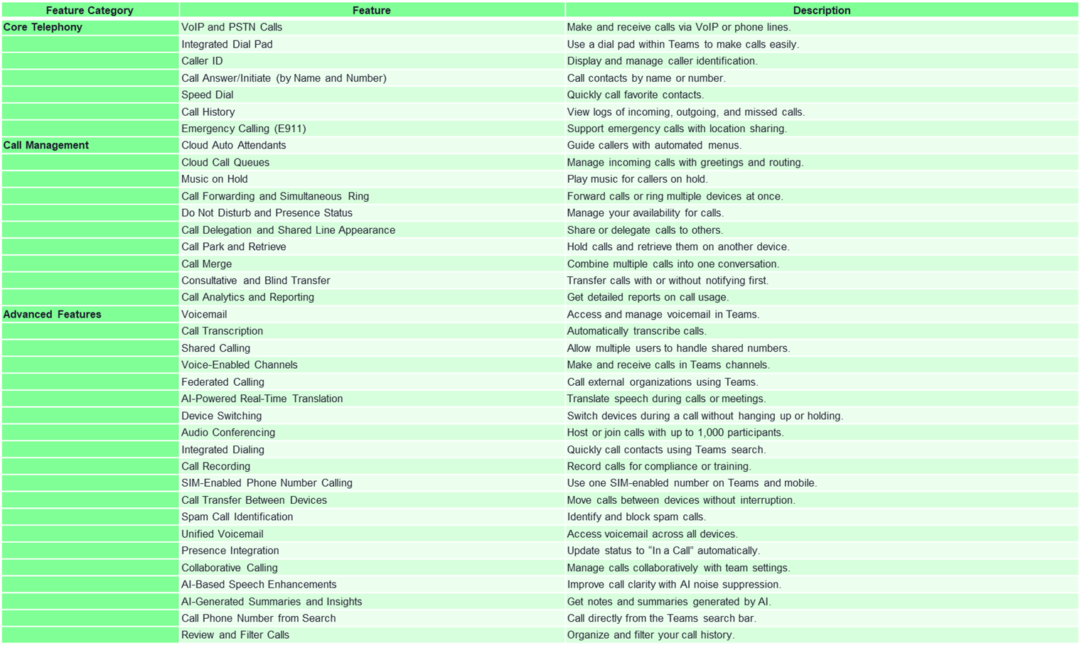
Microsoft Teams Phone feature list

