Slide 1
EXPO.e PC as a Service (PCaaS)
Military Grade Cyber Security with EXPO.e

Slide 2
Windows 11 – Minimum Requirements
Windows 10
CPU Processor: 1 Ghz
RAM: 1-2GB
Storage: 16-20GB
DirectX 9
Display 800 x 600
Windows 11
CPU Pro cessor: 1GHz (2 Cores)
RAM: 4GB
Storage: 64GB
DirectX 12
Display 720p
TPM 2.0
Secure Boot
Internet

Slide 3
Windows 11 – Minimum Requirements
Performance
Windows 11 Minimum Requirements
AI Integration Expectation
Security
Fully Supported OS with Security and Feature Updates
Enhanced Security Integrations
Eliminate End of Support Risk
Cost Optimisation
Avoid Additional Microsoft Support Charges
Avoid Cyber Breach and associated costs
User Satisfaction

Slide 4
Why PCaaS
Traditional / Legacy Device Procurement
Unpredictable Costs
High Capital Expenditure Outlays
High TCO – Ongoing burden on stretched IT & Procurement Teams
Technology Obsolescence
Environmental & Disposal Challenges
PCaaS
Predictable Monthly Pricing
Lifecycle Management including Device Provisioning & Disposal
Improved Sustainability Focus to reduce e-waste
Intune Integrated; improved compliance and security focus
Streamline IT Operations
Future Proofed End User Devices

Slide 5
PCaaS with EXPO.e
Device Provisioning
Configuration Services
Delivery/
Distribution
Ongoing
Support
Lifecycle
Management
Asset
Recovery
Service Delivery Manager
A single point of contact to help coordinating deliverables and provide status updates.

Slide 6
EXPO.e & Dell – Titanium Partnership for Windows 11 Enablement
Zero & Thin Clients
Lightweight Devices
AI/ML Ready Devices
Desktop Devices
Rugged Devices
Accessories – Monitors, Keyboards, Docking Stations,

Slide 7
PCaaS Bundles
 | PCaaS BASIC | PCaaS ENTERPRISE | PCaaS PROTECTED
Device Hardware Leasing | ✓ | ✓ | ✓
Basic Support | ✓ | ✓ | ✓
M365 Licensing | ✘ | ✓ | ✓
M365 Backup | ✘ | ✘ | ✓
Workstation Management Service | Add-on | Add-on | Add-on

Slide 8
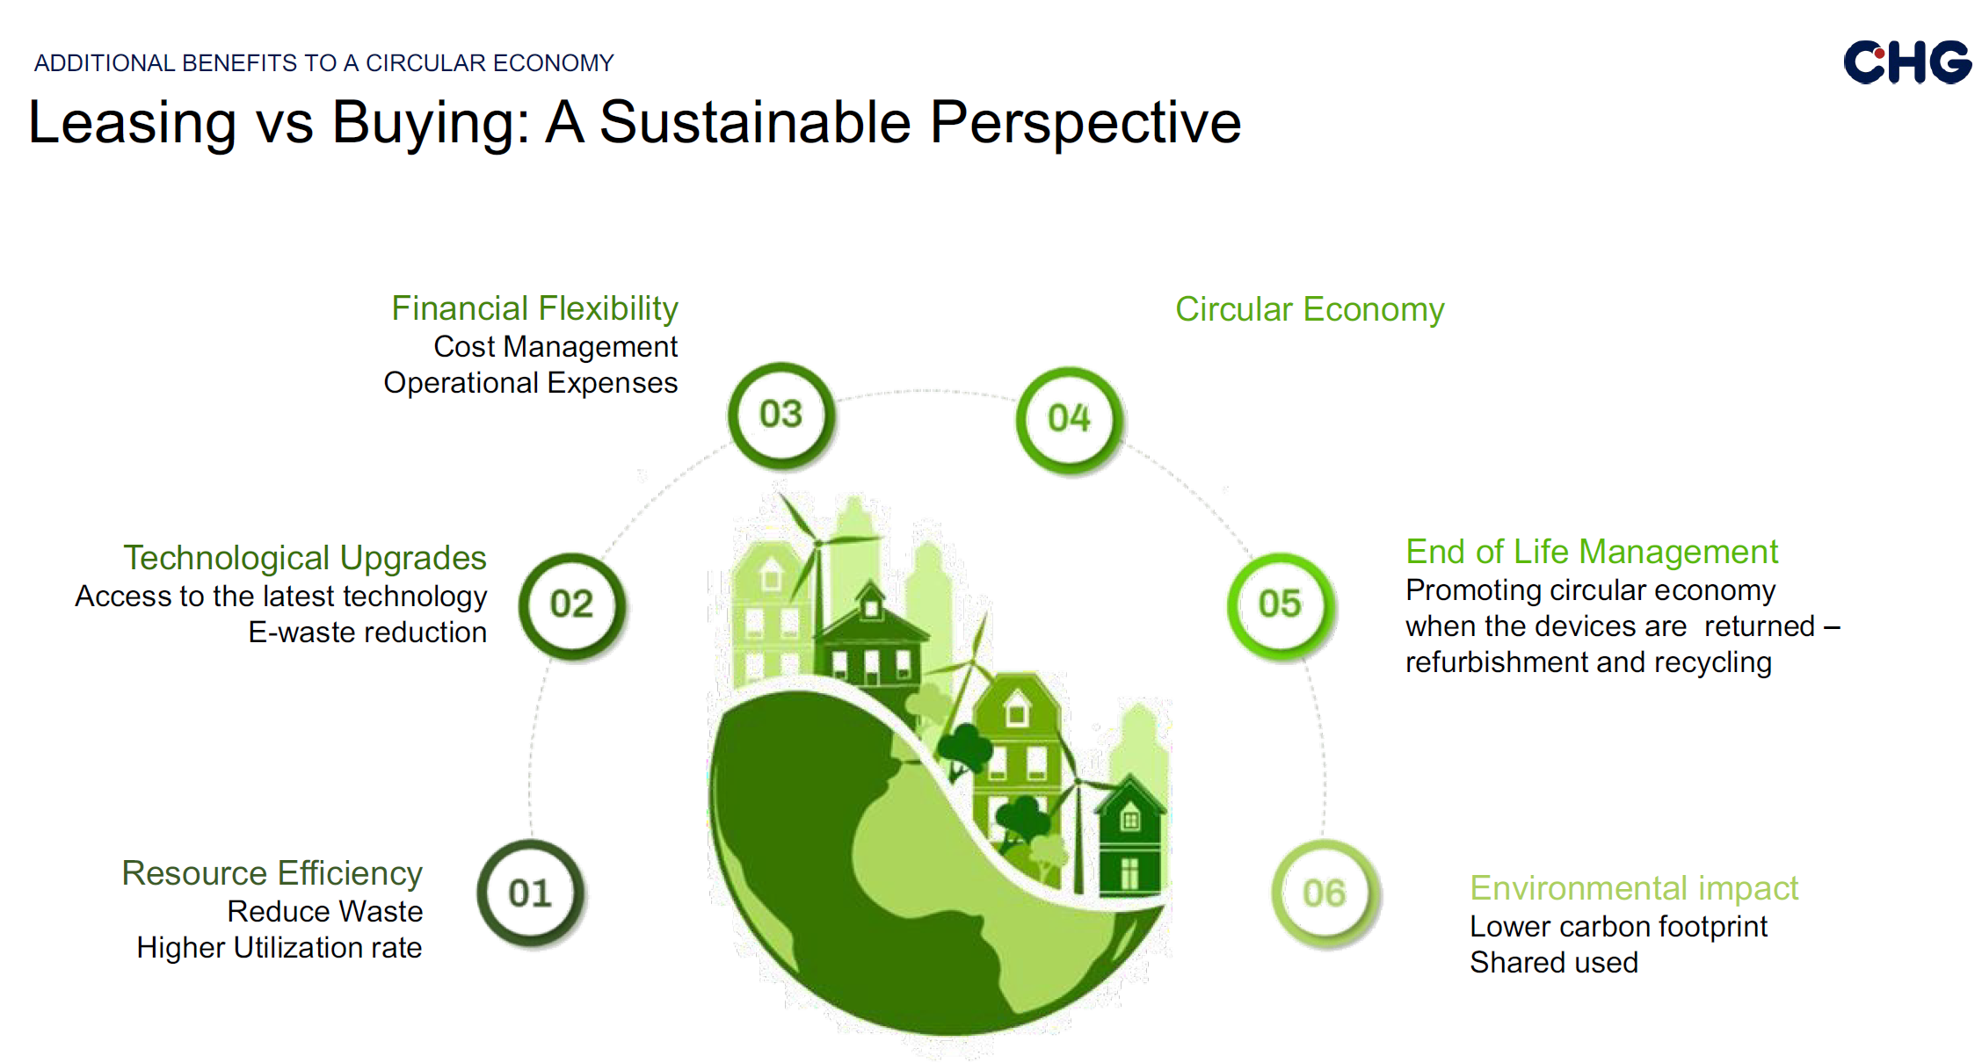
Sustainability Focus

Slide 9
Sustainability Focus

