Slide 1
EXPO.e Cyber Security & CSOC
Cyber threats are constant, resilience must be too

Slide 2




Why cyber security is more critical than ever
Growing volume and sophistication of cyber threats.
The business impact of breaches (financial, reputation, operational).
Increased regulatory pressure and compliance requirements.
The intersection of cybersecurity and emerging technologies (AI, LLMs).
44%
year-over-year increase in global cyber-attacks
Total ransomware payments
$814 million
in 2024
82%
of compliance professionals view cybersecurity as the biggest area of risk
LLM’s are the new Shadow IT creating a new perimeter vector for Cyber Security

Slide 3



Stumbling Block
Tools aren’t enough.
The Problem:
Technology-First
Mindset
Managed Detection &
Response Services
Multi-Factor
Authenticator (MFA)
Focusing only on technology narrows cybersecurity discussions.
Technology solutions are critical but must align with business goals.
Firewalls & Endpoint Security Solutions

Slide 4





Risk Mitigation
Cybersecurity Is Risk Management
Identify
Control
Understand…
risks to reduce them effectively
Mitigate
Align…
tools with business risks to prioritise actions
Secure
Ask…
"Do your security controls protect what matters most?"

Slide 5

Where Do We Fit In?
We are a Managed Service Provider & potential Systems Integrator.
Connectivity
Internet circuits, WANs, LANs, Wi-Fi
PROFESSIONAL SERVICES
MANAGED SERVICES
CONNECTIVITY
Cloud
Public, shared, & private cloud
CLOUD
UNIFIED COMMS
Unified Comms
Contact centers, telephony
CYBER SECURITY
Cyber Security
Firewalls, SASE solutions

Slide 6
Taking a Step Back
The ‘Why’ Behind Cybersecurity
Why does a particular product mitigate specific risks?
Focus on protecting customer business, not just selling products.
Cyber Security Operations
Centre (CSOC)
Managed Firewalls
Managed
Detection and Response (MDR)
Vulnerability Management
SASE Solutions

Slide 7







The Future of Cybersecurity - Predictive and Proactive Defences
Predictive and Proactive Cybersecurity for the Future
Predictive Tools
AI/ML for anticipating future threats and vulnerabilities.
Proactive Defense Strategies
Moving from reactive to proactive cybersecurity models.
Real-Time Threat Intelligence Sharing
Collaborative defense efforts among businesses and governments.
Next-Gen Security Tech
Quantum computing and blockchain in cybersecurity.

Slide 8
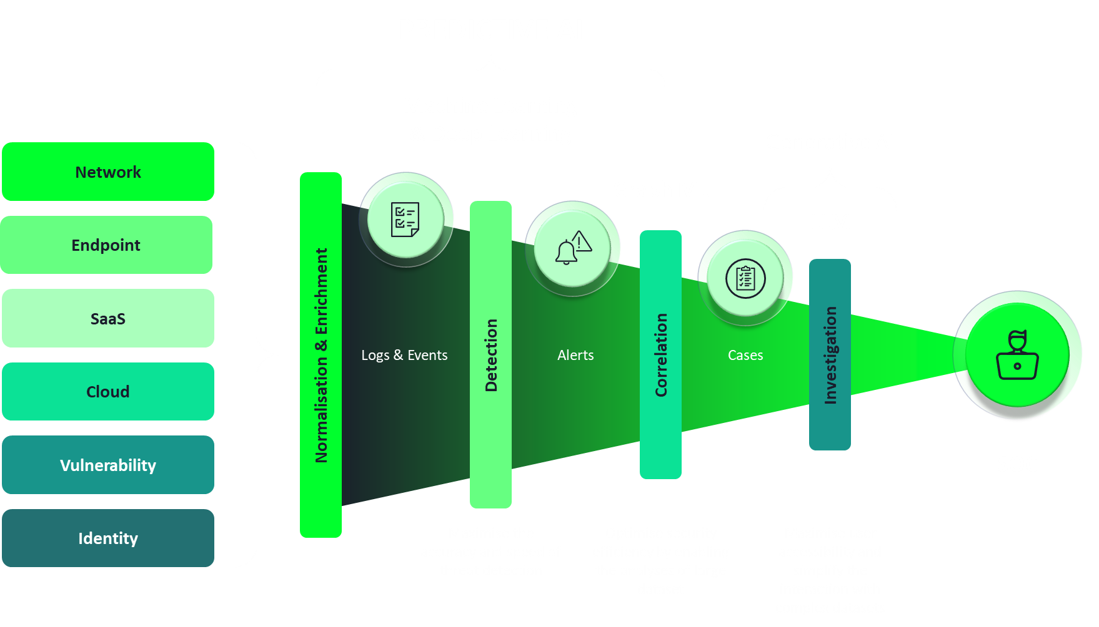
The Role of AI in Cybersecurity
How AI is Transforming Cybersecurity
Threat Detection & Response
AI for anomaly detection, pattern recognition, and behaviour analysis.
Automated Defense
AI-driven response systems to mitigate threats in real-time.
Risk Assessment
AI tools that predict and evaluate risk with high accuracy.
Incident Response
AI-powered incident analysis to reduce response time.

Slide 9



Our CSOC Solution
Add-ons
SIEM: A Unified Security Management (USM) Platform that provides visibility of events across the customer’s network, devices in the cloud, on premise and in remote locations.
Endpoint Detection & Response: Enhanced threat detection and response on endpoints, thanks to the integration with SentinelOne.
Threat Intelligence: Leveraging AI and Threat Intelligence to stay on top of evolving and emerging threats.
Digital Risk Protection Service: Enhanced threat intelligence from FortiRecon to provide a complete view of all potential and imminent internal and external risks.
Threat Detection: Proactive monitoring of the Customer’s estate on a 24x7x365 basis. Incidents are reported on a RAG priority basis and further intelligence is provided in order to support remediation.
Our solution offers secure long-term log retention for the duration of the active subscription, supported by a predictive cost model, with no hidden costs:
Internal Vulnerability Monitoring : Vulnerability scans of the Customer’s estate are performed once a month, with recommendations in remedial actions.
Monitored Compliance: Monitoring of the Customer’s estate compliance based on elected compliance standard controls. A monthly report and a supporting call will explain any technical issues in greater detail.
Costs for long-term log retention
Costs for ingesting logs from other apps
Costs for additional logs while under attack

Slide 10
SOC – Why not build your own?
Build your own SOC
Initial Costs:
Infrastructure: Acquiring hardware, software licenses, and building the physical or virtual SOC space.
Personnel: Hiring and training security experts (analysts, incident responders, etc.).
Process Development: Creating incident response playbooks, policies, and procedures.
Ongoing Costs:
Salaries and Benefits: Payroll for SOC staff.
Maintenance and Upgrades: Regular updates to hardware, software, and tools.
Training: Continuous education for staff.
Operational Costs: Electricity, cooling, and other utilities.
Security Tools and Licenses: SIEM, IDS/IPS, threat intelligence feeds, etc.
Compliance and Auditing: Ensuring adherence to industry standards.
Challenges:
Expertise: Building and retaining a skilled team.
Scalability: Adapting to changing threat landscapes.
Time to Maturity: SOC effectiveness takes time to develop.
Risk: In-house SOC may miss emerging threats
SOC as a Service
Initial Costs:
Subscription Fees: Paying for the service.
Onboarding: Integrating with existing systems.
Ongoing Costs:
Subscription Renewals: Regular payments.
Customization Costs: Tailoring the service to your organization.
Monitoring Fees: Based on data volume and services used.

Slide 11
Vulnerability Management
Vulnerability Scanning
Vulnerability Reporting
Vulnerability Advisory
Cybersecurity Community
AlienVault OTX. TAXII/STIX, SpyCloud, Recorded Future, AlienLabs, Microsoft, FortiRecon
Vulnerability
Scanners
Threat Intelligence
IOC Feeds
Threat Intelligence
Domain Reputation
Threat Intelligence
Dark Web Monitoring
Threat Intelligence
MITRE ATT&CK
Mapping
SOC
DFIR
Incident Response
Forensic Analysis
Continuous monitoring
Threat intelligence correlation
Alert triage and enrichment
Incident escalation
SIEM/XDR management
SIEM/SOAR
Microsoft Sentinel
USM Anywhere (AlienVault)
Deep-dive post detection
Forensics
Full kill-chain reconstruction
Containment, eradication, recovery
Preservation of Evidence
XDR (eXtended Detection and Response)
EDR (Endpoint Detection and Response
Network Infrastructure
NetFlow, PCAP, DNS, NDR, IPS, IDS
Firewall / Security Appliances
Firewalls, CASB, SASE, VPN, WAF, etc
Clients
Windows, MacOS
Mobile
Android, iOS
Servers
Windows, Linux
Identity
(EntraID, AD DS)
Email & Collaboration
(Exchange/Teams/
SharePoint/OneDrive)
Azure, AWS
VMs, Kubernetes, SQL, etc
CASB
SalesForce, ServiceNow, G Suite, Slack, Zoom, etc
SentinelOne
SentinelOne
MS Defender for Identity
MS Defender for 365
MS Defender for Cloud
MS Defender for Cloud Aps
Signals and Telemetry from Customer Assets
MS Defender for Endpoint
MS Defender for Endpoint
MS Defender for Cloud
Vulnerability
Data
Agent-based
(NXLog, Sysmon)
API
File-based
(CSV, JSON, XML)
Syslog
Vulnerability Remediation
Customer Environments and Assets
Remediate
Network Infrastructure | Traditional IT | Identity | Cloud Infrastructure | Email and Collaboration | SaaS Applications | Cloud Security | Network Security | DevSecOps | Other
Firewalls (NGFW, WAF, Host) Routers & Switches (L2, L3, SD-WAN) Wireless Infrastructure (AP’s, Controllers) VPN Gateways (SSL, IPSec, clientless) Load Blancers/ADC DHCP/DNS IoT/OT Gateways (smart building, manufacturing, CNI) | Clients (Windows, MacOS, Linux, VDI, thin client) Servers (Windows, Linux) Mobile Devices (iOS, Android) Virtualisation Hosts (ESXi, Hyper-V) Backup Servers/Appliances Directory Services (AD DS, LDAP, RADIUS) | IAM (EntraID, Okta, ADFS) | IaaS (Azure, AWS, GCP) PaaS Services (App Service, Azure SQL, Lambda, etc) Cloud Control Plane (IAM, Policy, Audit logs) Cloud DevOps (Teraform, CloudFormation, JSON, Bicep) Containers (AKS, EKS) | Microsoft 365 (Exchange Online, SharePoint, OneDrive, Teams) On Prem (Exchange, SharePoint) G-Suite (Gmail, Drive, Docs, Meet) Messaging (Slack, Zoom, Webex) | CRM/ERP (Salesforce, NetSuite, SAP, Workday) ITSM (ServiceNow, Jira BMC) Finance/HR (ADP, SAP, Sage) Legal (DocsOnline, iManage) Project & Collab (Trello) ** Oauth-connected apps) | SASE (CATO, Prisma) SSE CASB (Netskope, zScalar) ZTNA (CloudFlare) VPN SWG Cloud Firewall DNS Filtering | IPS/IDS NDR Inspection Flow Analysis DDoS Protection | Code Repos (GitHub),GitLab, Bitbucket) CI/CD Pipelines (Jenkins, GitHub Actions, GitLab CI) Container Registries (DockerHub, ECR, ACR) Secrets Vaults (Thales, KeyVault, HaskiCorp, AWS Secrets Manager) Infrastructure-as-Code (Terraform, Pulumi, ARM Templates) Artifact Repos (Artifactory, Nexus) 3rd Party Integrations API Gateways | DLP Physical Security (HVAC, CCTV, Door Cards) Compliance Monitoring PAM (CyberArk, BeyondTrust)

Slide 12
NIST – Our Capabilities
Data Discovery and Classification
Identify
  Assists in developing an organisational understanding to managing cybersecurity risk. Enables an organization to focus and prioritize its efforts, consistent with its risk management strategy and business needs.
Governance Risk And Compliance
Backup and Replication Solution
Immutable backups
Air Gapped Backups and Clean Rooms
Risk Management
Asset Management
Endpoint Protection/NGAV
NGFWs/WAFs/Layer 7 Load Balancers
Recover
  Identifies appropriate activities to maintain plans for resilience and to restore any capabilities or services that were impaired due to a cybersecurity Incident. Supports timely recovery to normal operations to reduce the impact from a cybersecurity incident.
Protect
  Appropriate safeguards to ensure delivery of critical infrastructure services. Supports the ability to limit or contain the impact of a potential cybersecurity event.
Email Security Solution
Data Loss Prevention
NIST Cybersecurity Framework
Privileged Access Management(PAM)
Security Service Edge/Secure Access Service Edge (SASE)
Key Management Solution (KMS)
Awareness Training including Phishing investigation service
Managed eXtended Detection and Response
Digital Forensic and Incident Response
ICT Continuity Testing
Red Teaming/Purple teaming
Cyber security operations centre
Vulnerability Management Solution
Respond
  Appropriate activities to take action regarding a detected cybersecurity incident. Supports the ability to contain the impact of a potential cybersecurity incident.
Detect
  Defines the appropriate activities to identify the occurrence of a cybersecurity event. Enables timely discovery of cybersecurity events.
NIDS/HIDS
Exposure Management System
SIEM
Threat Intelligence Solutions
End Point Detection and Response Solution
Penetration Testing
Notes:
New Addition

Slide 13
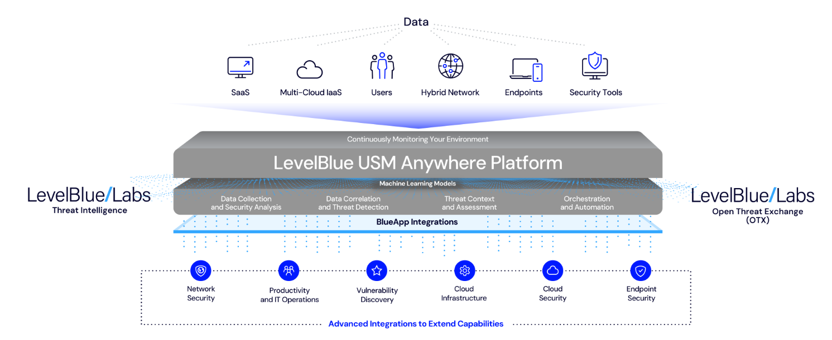
Technical Overview of USM Anywhere
SIEM Architecture
The SIEM is composed of a modular, scalable, two-tier architecture. These core components provide real-time threat detection, event correlation, and security intelligence:
USM Anywhere Cloud
  All data that is collected from the USM Anywhere sensors is sent to the secure cloud over an encrypted channel.
USM Anywhere Sensors and Agents
  The USM Anywhere Sensors have the flexibility to be deployed in several supported versions.
  Once the sensors have been configured and deployed you can use them to scan your environment to discover assets, vulnerabilities and monitor the environment.
  The Agent has a small footprint and provides continuous monitoring of the endpoint.

Slide 14
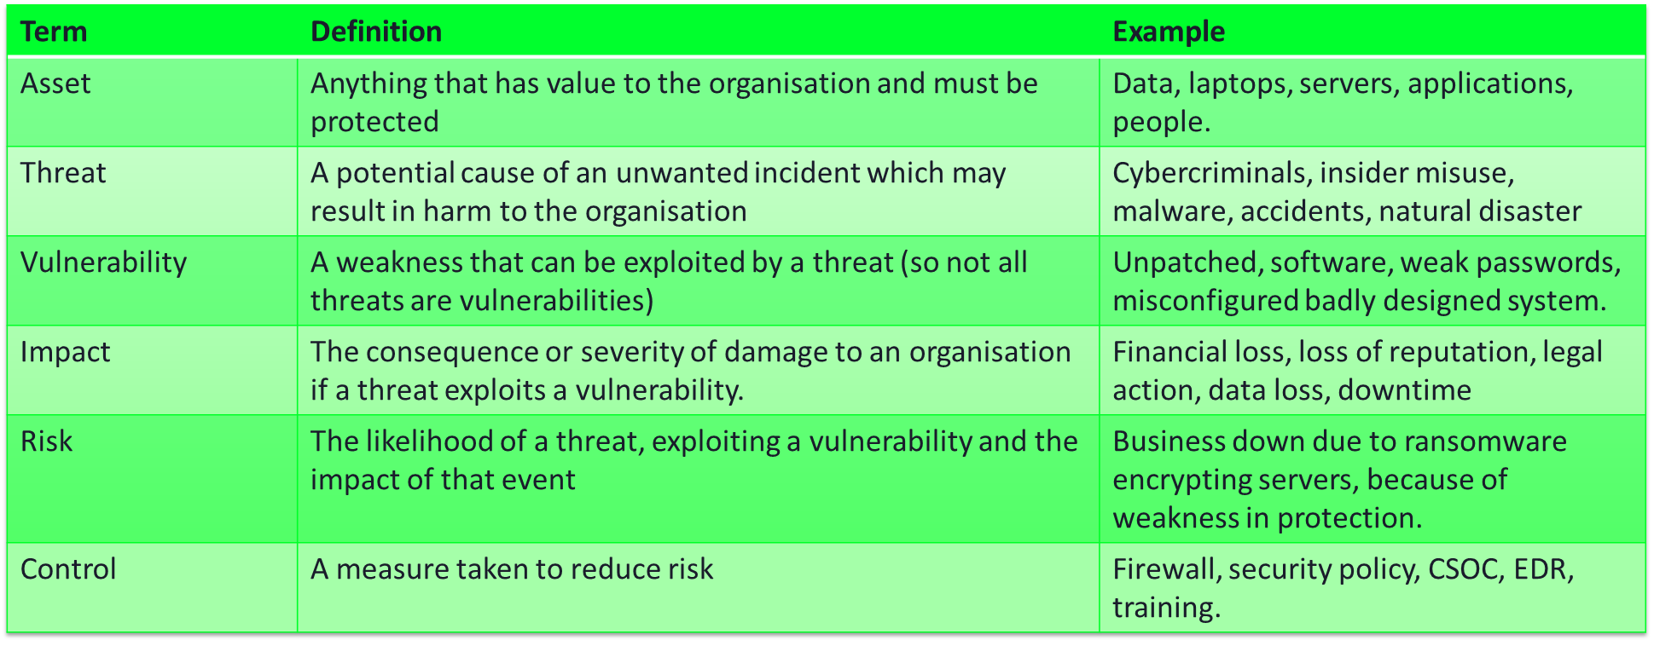
Identifying Risks

Slide 15


What Matters Most
What is your most critical asset?
Asking
the Right
Questions
What would happen if it were compromised?
What if your data was leaked onto the dark web?
How long could your organisation survive if a ransomware attack took everything offline?

Slide 16
Presales – Sales Process
EXPO.e starts conversation with Partner
Partner starts conversation with Customer
Interest generated, Customer wants to know more
EXPO.e Pre-Sales team engaged
Scoping and discussion with CSOC engineer
YES
Quote is accepted by Customer?
Are there any unanswered questions?
Cost is calculated and quote sent to Partner
NO
YES
NO
NO
Is the document exhaustive?
Asset sheet is completed
SoW is created
Handover to PM
Project Starts
Contract signed and SoW shared with Partner
YES

Slide 17
Monitoring & Notification Process
Alarm is triggered by SIEM
Ticket is created
EXPO.e Analysts Team reviews the ticket
Notification is forwarded to the Partner within 60m
Re-Email Partner within 1h.
If no contact is established an additional notification will be sent in 8h.
A last notification will be sent in 72h if no response is provided.
Partner acknowledges the ticket
Partner informs the End Customer
NO
YES
Ticket is closed
Partner requires more information?
Partner is updated via email / phone call
Further investigation will be held by Senior CSOC engineers.
YES
NO

Slide 18

Commercials
Great supplier relationships with preferential supplier pricing
Helping our partners
to win
Negotiated Channel specific discounts that we pass onto you
Deal registration
Potential for incentives
Talk to us – Target Commercials, Customer Budget, Adjust Scope

