Slide 1
[Partner Name]
Be Unstoppable with EXPO.e

Slide 2
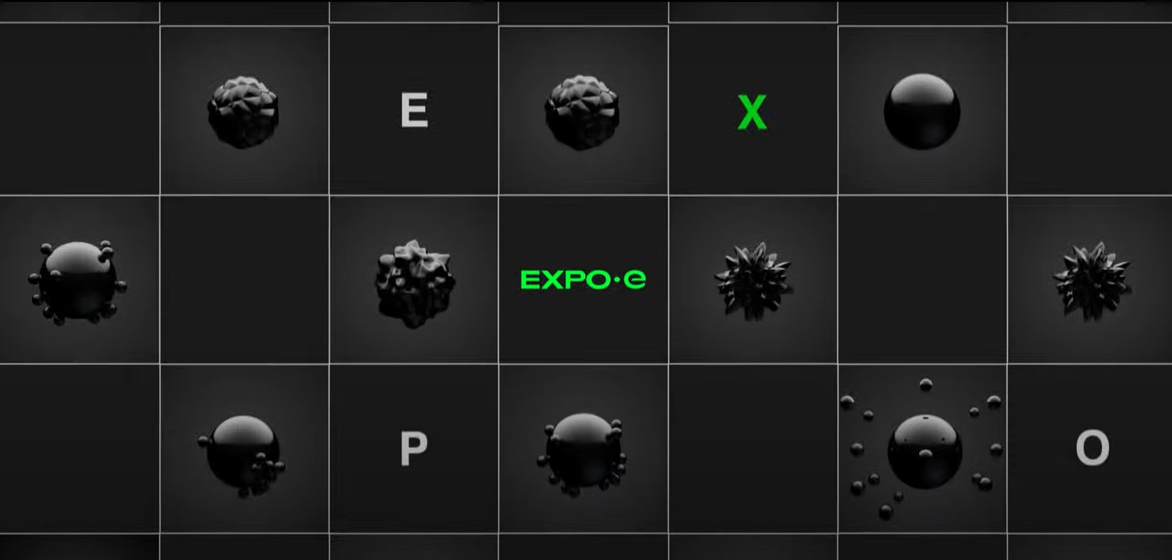

Notes:
https://www.youtube.com/watch?v=Vd2vyTZgs94

Slide 3
Our History & Commitment
A Trusted Pair of Hands

Slide 4





The Exponential-e Group
6.0 - Our Evolution to a Systems Integrator
We are a Managed Service Provider naturally evolving into a Systems Integrator, with over 70+ years of combined group company experience, industry-leading credentials, and deep expertise in delivering
critical national infrastructure across
Blue Light, Defence, Private, Public, Utilities, Enterprise, and Mid-Market sectors.
What sets us apart is our full-stack capability, delivered through our own team and purpose-built, business-only infrastructure, developed over many years.
Our comprehensive portfolio spans
Cloud & AI, Data Centres, Unified Communications & Contact Centre solution, Cyber Security and Networking - all seamlessly integrated and supported by our Professional and Managed Services teams.
This is backed by our world-class customer service, demonstrated by our unique industry-leading ‘live real time’ Net Promoter Score (86) and 9 ISOs / International management accreditations, ensuring continuous improvement and applied innovation.

Slide 5


The Exponential-e Group
The Exponential-e Group
Over 70+ years of experience,
credentials and capabilities in delivering
critical infrastructure to both the public and private sectors.
The combined skills and expertise of the
three companies now make ‘military-grade’ solutions more accessible
and available to all organisations.
Exponential-e
Infrastructure as a Service, Cloud architecture, solutions delivery, long experience in cyber services 24 / 7 CSOC. Working to the highest security cleared levels.
Founded Oct 2002
Vysiion
Security-Cleared staff, FSC compliant and a track record in delivering Defence and CNI solutions.
Founded 1996, Acquired Feb 2020
Xpertex
Security-Cleared staff
and track record in delivering ‘Information Assured’ solutions into the Intelligence and CNI sectors.
Founded 2006, Acquired Sep 2021

Slide 6












Background History
Exponential-e - founded in 2002 as an Ethernet-Only Carrier / Services Provider - Bootstrapper with £400K start-Up Capital.
Channel programme launched 2006. Under-pinned by core foundations
Customer Service Quality
Applied Innovation
Technical Capabilities
Your Trusted Advisor
Organic growth to 2020 Revenues £142m EBITDA £38.5m.
Feb 2020 acquired Vysiion An Engineering projects / installations / CNI / Data Centre AND Cybersecurity management company.
Sept 2021 acquired Xpertex - Intelligence Services Cybersecurity company.
Combined Group 2025 / 2026 Revenue £260.6m; EBITDA £105.2m.
Today, we have approx. 3,000 clients, approx.. 800 employees AND operating to management standards with 9 ISO accreditations - Recognised as a World-Class IT Service Provider by BSI.
A unique industry-leading and exceptionally high ‘LIVE REAL-TIME NPS’ score = 85 (2026) which is over four times higher than the industry average.
We have invested £120m building a homogenous Layer 2 Ethernet network with reach throughout UK & internationally, with further investment in our Cloud Architecture and AI, Data Centres, Unified Communications / Contact Centre / Microsoft Teams and Cyber Security infrastructure. We call this our ‘non-stop compute platform’.
With our commitment to customer service excellence, we invest 95% of our EBITDA back into people, technology and R&D.
‘We treat your business as if it were our business’ assuring we deliver our clients ‘Peace of Mind-as-a-Service’, backed by full stack SLA’s.
Our group companies have built a reputation for designing, delivering and supporting bespoke and complex Network / Cloud / IT / UCC and Cyber Security projects to deliver customer outcomes​.
2025 - Largest ever Channel win with IBM for a contract with the Home Office worth in excess of £100m TCV.
2025 Channel FYR £10.5m with 30%+ gross margin (Excl. IBM deal)

Slide 7

“
Private British Company
Trusted and Capable
Founded in 2002, Exponential-e remains a private British company that owns and operates its network and cloud infrastructure. Today, we have approx. 800 employees, of which 50% are appropriately cleared and skilled to work within critical environments, including SC/DV clearance.
We aim to deliver secure, trusted systems and operations across multi-domains ensuring 100% trust, integrity and uptime of your data flows and applications.
We set out to offer British companies & public sector clients ‘PLATINUM’ customer services that drives our world class business status & NPS Score
“
Security, Data Sovereignty & customer service are part of our corporate DNA that we never compromise on

Slide 8
Financial Standing: Exponential Growth
Growth Overview 2021/22 to 2025/26
Financial Summary
Privately owned British company
OCT 2025 - Totally debt free
Strong Balance Sheet - Financial Stability D&B Rating of 1. Creditsafe score 100
Contract Limit = £59m - Largest contract £178m
Megabuyte Top 50 best performing, privately owned-technology company in the UK Mid-Markets out of 600 tech companies
2025/26 Revenues - £260.6m EBITDA £105.2m (Proj.)
2024/25 Revenues - £246m EBITDA £97m (Act.)
2023/24 Revenues - £236m EBITDA £92m (Act.)
2022/23 Revenues - £207m EBITDA £85m (Act.)
2021/22 Revenues - £185m EBITDA £81m (Act.)
Completed acquisition of Vysiion in Feb 2020
Completed acquisition of Xpertex in Sep 2021
Approx. 800 skilled and motivated personal - 2025 YE
50% appropriately cleared and skilled personnel
6.0
CHALLENGING ECONOMY + Geo-Political Headwinds
POST-PANDEMIC SUPPLY CHAINS + Geo-Political Headwinds
COVID-19 + Global Financial Uncertainty
DotCom Boom & Bust – UK Tech Recession
BREXIT + UK Financial Uncertainty
5.0
Global Financial meltdown
UK Recession 2008-2012
4.0
3.0
2.0
1.0

Slide 9





Investing back into
Exponential-e
96% (approx.) of our
profits throughout
the past 23+ years invested back into
the business
EBITDA (96% approx.)
Dividend (4% approx.)
Own & Operate
our Infrastructure
New Technologies
& Innovation
Customer Service
& People
Cyber
Security

Slide 10

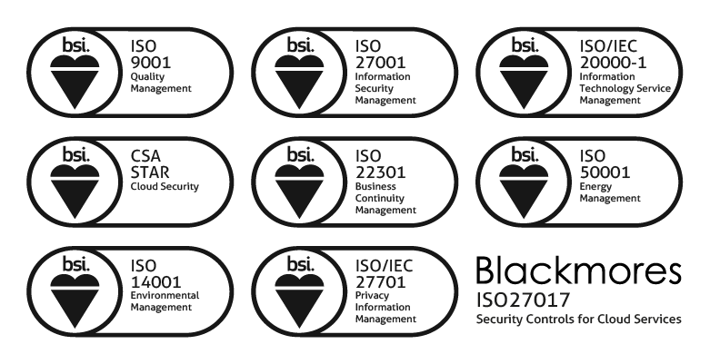
The Exponential-e Group
Our Stated
Mission Statement
October 2002
Mission
Accomplished
October 2017
Today we are…
Achieve the status whereby
Exponential-e 1.0 is formally acknowledged among our peers, competitors and clients as the most
advanced and innovative business technology enabler in the world.
A world-class company...
“Exponential-e is a
world-class IT services provider.”
_The British Standards Institute.
Sustaining the status whereby
Exponential-e 6.0 is formally acknowledged among our peers, competitors and clients as the most advanced and innovative business technology enabler in The World.
A ‘world-class company… ’

Slide 11


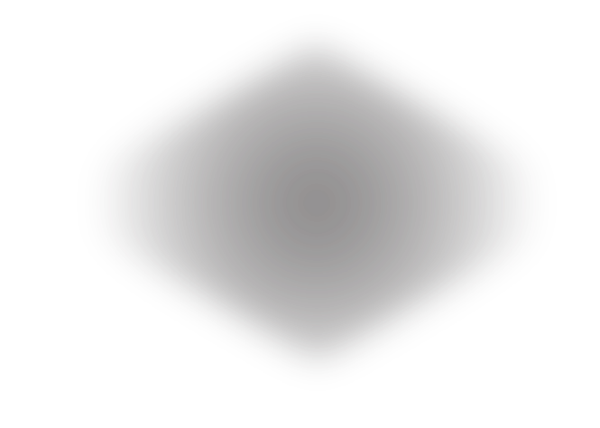






Partnership - Peace of Mind as a Service
All underpinned by
World-Class Managed Services to support your operations and your stakeholders
Committed to understanding
your business, your challenges and supporting you to reach your organisational goals
06
01
-100
85
+100
Our commitment to deliver
customer service excellence
Real-time ‘Live’ NPS
Industry leading support through technical innovation. Staying ahead of the product curve, bringing new services to life, throughout our partnership
Design solutions with the future in mind that meet your goals. Combine our collective knowledge, experience and expertise for a long-term partnership approach -
We are in this together!
Partnership
Principles
05
02
PROFESSIONAL SERVICES
CSOC 24/7
Migrate and on-board services with skill and control that exceeds the highest standards. Smoothly bring services into life
Underpinned by
commercial efficiency and contracts - with clear SLAs aligned to your priorities
NOC SERVICE DESK 24/7
04
03
MANAGED IT SERVICES
MULTI-CLOUD PLATFORMS
NETWORK PLATFORMS
FIBRE INFRASTRUCTURE
CCS FRAMEWORK: RM1557.14 G-Cloud 14, RM6200, RM3764.3, RM6116, RM1043.8, RM3825, RM6094, RM6190

Slide 12

















Inherently Secure - Full Stack
Our Technology
Customer’s Delight
Your Technology
Professional Services
Professional Services
Secure Telephone Systems
Support Services
Support Services
Secure Telephone Systems
CX Experience
AI/Automation
Multi-Cloud Platforms
Data Analytics
Network Platform
Desktop Agents
Fibre Infrastructure
CX Experience

Slide 13
EXPO.e’s Service Portfolio
Managed Network
Connectivity
UC
& CX
CNI
Cloud
Professional Services
DC
Cyber
Security
Managed IT

Slide 14
Our portfolio is your portfolio
Connectivity
Cloud
Expo-e Fibre
Fibre Access
Broadband
Cellular
Global reach with VPLS
MPLS
LAN / WiFi
Cloud Connect
International Access
WAN / VPLS
Voice Connect
Cloud Connect
4G / 5G LTE
Internet
Full inter-connectivity to public clouds (Amazon, Azure, Google)
Shared & dedicated private cloud
Public cloud – Azure CSP
Hyper-converged
infrastructure (VX rail)
Cloud Storage
VMWare HCI
Platform as a Service
Infrastructure as a Service
AWS Cloud
Online Back-up
Server Replication
Desktop as a Service
Azure Local
Microsoft Apps
SaaS
UCC & Contact Centre
Data Centre
Managed Network
Managed IT
UCaaS
Teams
Direct Routing
SIP Trunking
Collaboration Rooms
WLR
Call Reporting
Multi-channel Recording
In bound call Management
Contact Centre as a Service
Enterprise Contact Centre
Colocation
Shared Colocation
Smart Hands
Remote Hands
Network Monitoring
SD-WAN
Managed LAN & WiFi
HSCN
PCaaS
App Mgmt
Data Mgmt
Test / Rel Mgmt
Active Directory
SQLaaS
User Mgmt
Storage Mgmt
Server Mgmt
Peripheral Print
Mobile Mgmt
Cyber Security (full NIST coverage)
Professional Services
CNI
CSOC
SIEM
Centralised Firewall
Dedicated Firewall Management
SSE
SASE
DDoS Mitigation
End Point Threat Detection
VCISO
DLP
Cyber Security Consultancy
Cyber Security Audit
Vulnerability Scanning
Email Security
MFA
Incident Response
Cyber Vault
PAM
ITSM as a Service
Service Desk
Onsite Install
Break-fix Management
IT Delivery
Staff Augmentation
Server & Application Migration
Cloud Adoption and Migration - Azure, Hybrid & Dedicated
Server & Application Migration
EUD Refresh & Rollouts
M365 Consolidation and Migration - Zero Trust
Data Consultancy, Cloud Readiness, Automation
Automated Control
SCADA Networks
Ops Control Rooms
CCTV & Sec Comms
IDS Monitoring
OT Threat Intelligence
CNI Field Engineering
UCC & Contact Centre
Data Centre
Managed Network
Managed IT
UCaaS
Teams Direct Routing
SIP Trunking
Collaboration Rooms
WLR
Call Reporting
Multi-channel Recording
In bound call Management
Contact Centre as a Service
Enterprise Contact Centre
Colocation
Shared Colocation
Smart Hands
Remote Hands
Network Monitoring
SD-WAN
Managed LAN & WiFi
HSCN
PCaaS
App Mgmt
Data Mgmt
Test / Rel Mgmt
Active Directory
SQLaaS
User Mgmt
Storage Mgmt
Server Mgmt
Peripheral Print
Mobile Mgmt
Cyber Security (full NIST coverage)
Professional Services
CNI
• Automated Control
• SCADA Networks
• Ops Control Rooms
• CCTV & Sec Comms
• IDS Monitoring
• OT Threat Intelligence
• CNI Field Engineering
CSOC
SIEM
Centralised Firewall
Dedicated Firewall Management
SSE
SASE
DDoS Mitigation
End Point Threat Detection
VCISO
DLP
Cyber Security Consultancy
Cyber Security Audit
Vulnerability Scanning
Email Security
MFA
Incident Response
Cyber Vault
PAM
ITSM as a Service
Service Desk
Onsite Install
Break-fix Management
IT Delivery
Staff Augmentation
Server & Application Migration
Cloud Adoption and Migration - Azure, Hybrid & Dedicated
Server & Application Migration
EUD Refresh & Rollouts
M365 Consolidation and Migration - Zero Trust
Data Consultancy, Cloud Readiness, Automation

Slide 15

























































































Group Customers & Verticals
Healthcare
Defence
Central & Local Gov
Blue Light
CNI
4G / 5G LTE
Internet
Full inter-connectivity to public clouds (Amazon, Azure, Google)
Shared & dedicated private cloud
Public cloud – Azure CSP
Hyper-converged infrastructure (VX rail)
Cloud Storage
VMWare HCI
Charity & 3rd Sector
Vendor & SI Partners
Hospitality
Travel
Financial Services
Professional Services
Legal Services
Retail
Channel Partners
Media & Sport

Slide 16


























































Our Technology Capabilities
Connectivity & Network Managed Services
Cloud & Prof. Services
Cyber Security
Unified Communications & Customer Experience

Slide 17






Support and Management – Service Organisation
Current EXPO.e Service Centre
Calls
Emails
Portal
E-Bonding
Alerts
Service Desk
Service Management & Client Relations Team
ITIL Service Managers
Change & Problem
Incidents
Broadband
Network
2ND / 3RD Line
Security
2ND / 3RD Line
DC Team
UCC
2ND / 3RD Line
Cloud & Managed Services
2ND / 3RD Line
Network & Security Core
UCC Core
Cloud Core

Slide 18














Service Desk Operations
Proactive Monitoring
Proactive Monitoring
Comprehensive Management tools
Incident Management
Problem Management
Capacity Management
Asset Management
Service Optimisation
Service Optimisation
Utilisation and Capacity Trending
Configuration
Change Management
Release Management
Highly Accredited
Peace of Mind
Peace of Mind
Enterprise Grade Support Platforms
Board Level Escalation
Managed Service
24 / 7 x 365
Fault find and fix
Knowledge base
Disaster Recovery

Slide 19




Support and Management - Voice of the Customer
Delivering Peace of Mind-
as-a-Service
NPS is a loyalty and satisfaction metric developed in 2003.
Every interaction with our Service Desk measured.
Quick, simple feedback (5 seconds).
Fully integrated to our ServiceNow system so no need for a lengthy survey.
Committed to calling back every customer that has provided Red or Amber feedback - within an hour.
Live feedback system - shared across all teams, at all times based on a 3-month rolling average.
Live score on Exponential-e’s website. This updates every time feedback is received.
-100
85
+100
Our commitment to deliver
customer service excellence
Real-time ‘Live’ NPS
Rolling 3 month average. Industry average: 17
Knowledge
22%
Collaboration
13%
60%
Speed
5%
Advice
Not at all likely
Neutral
Extremely likely
0
1
2
3
4
5
6
7
8
9
10
Detractor
Passive
Promoter
%Promoters - %Detractors = NPS (Net Promoter Score)

Slide 20
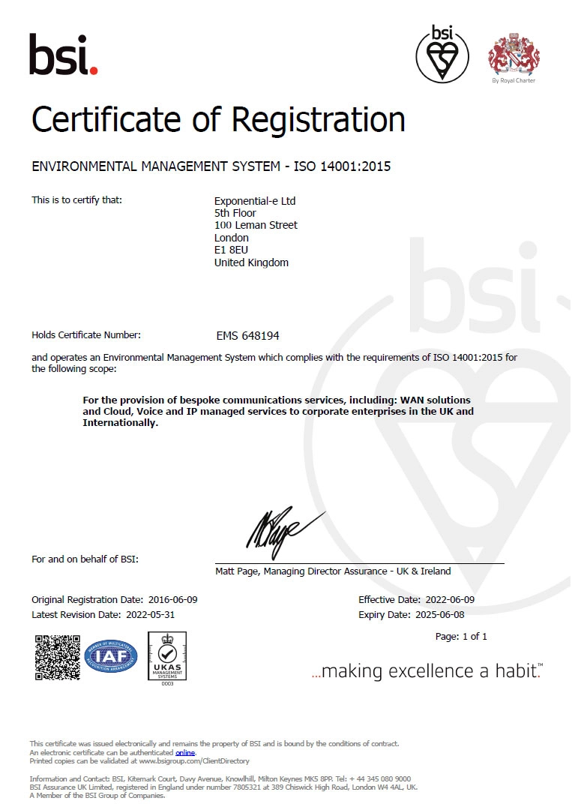
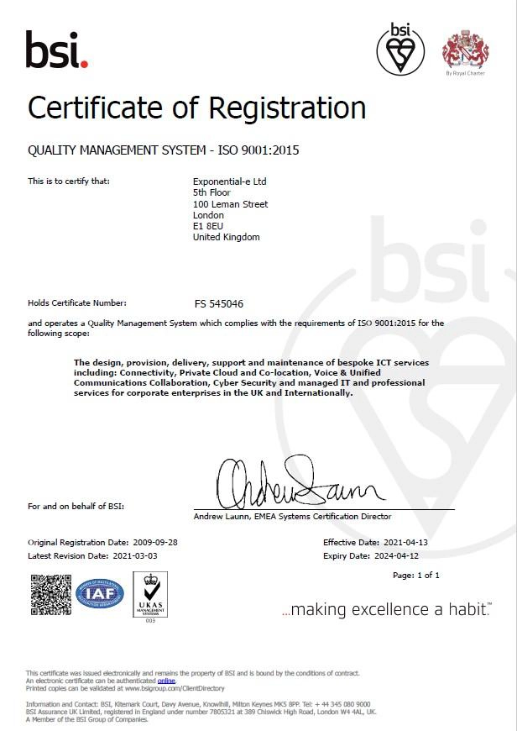
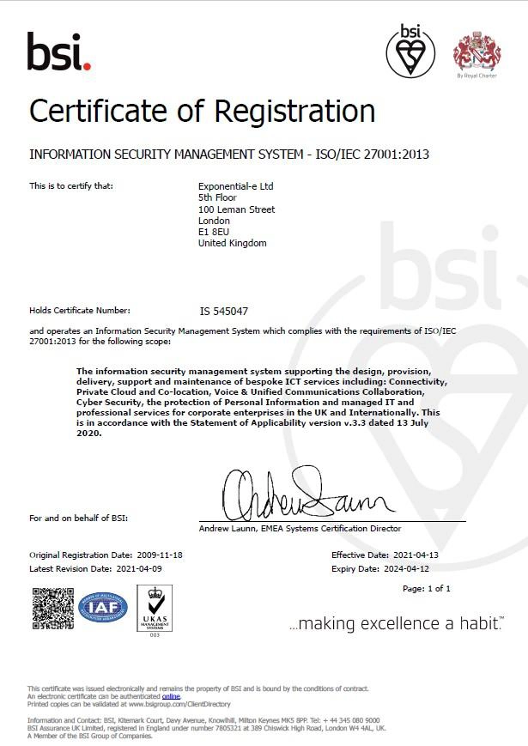
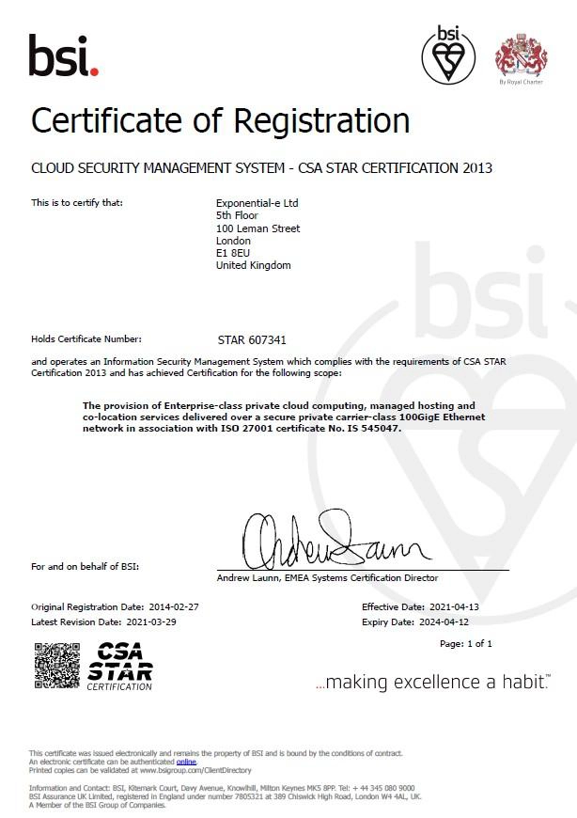
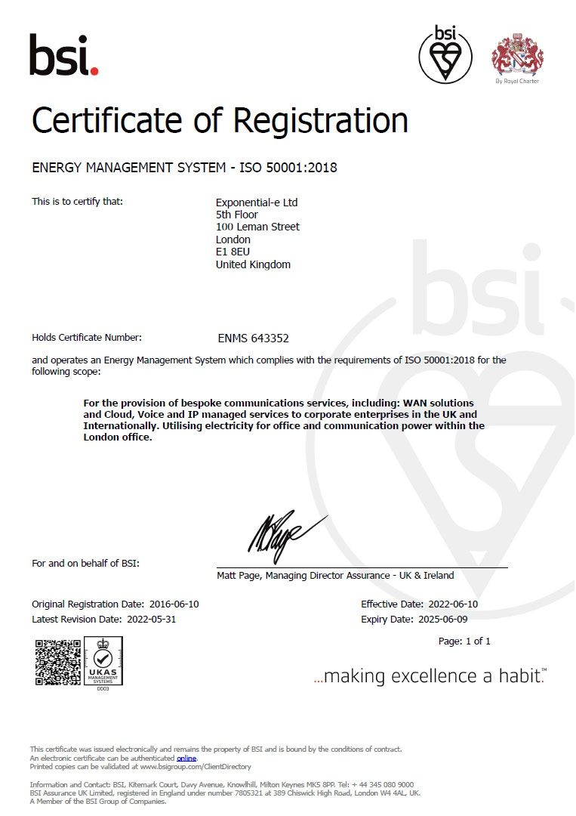
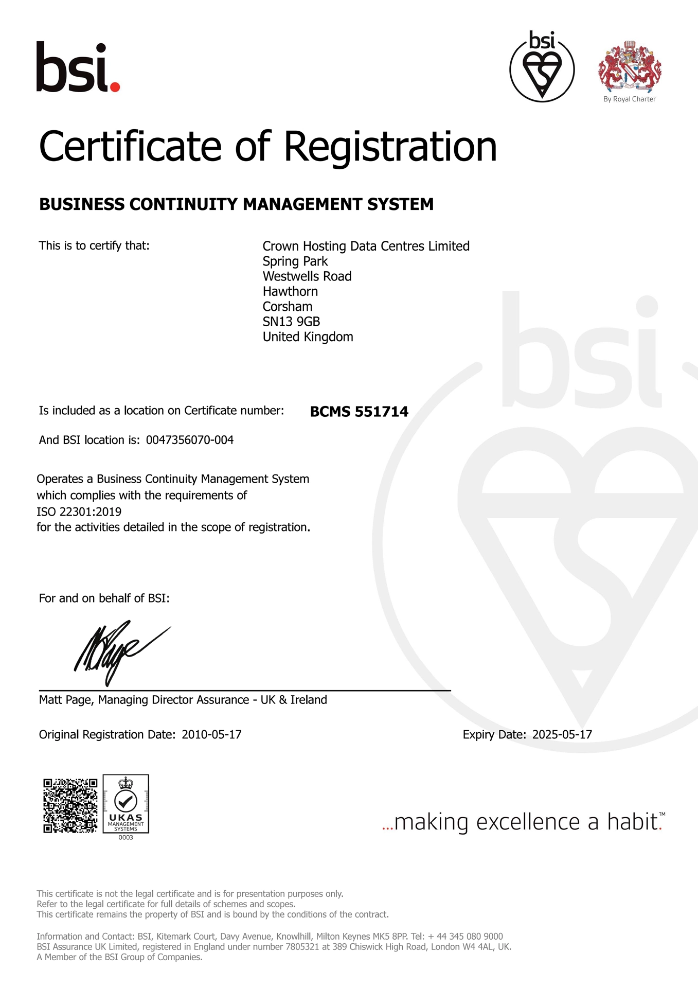
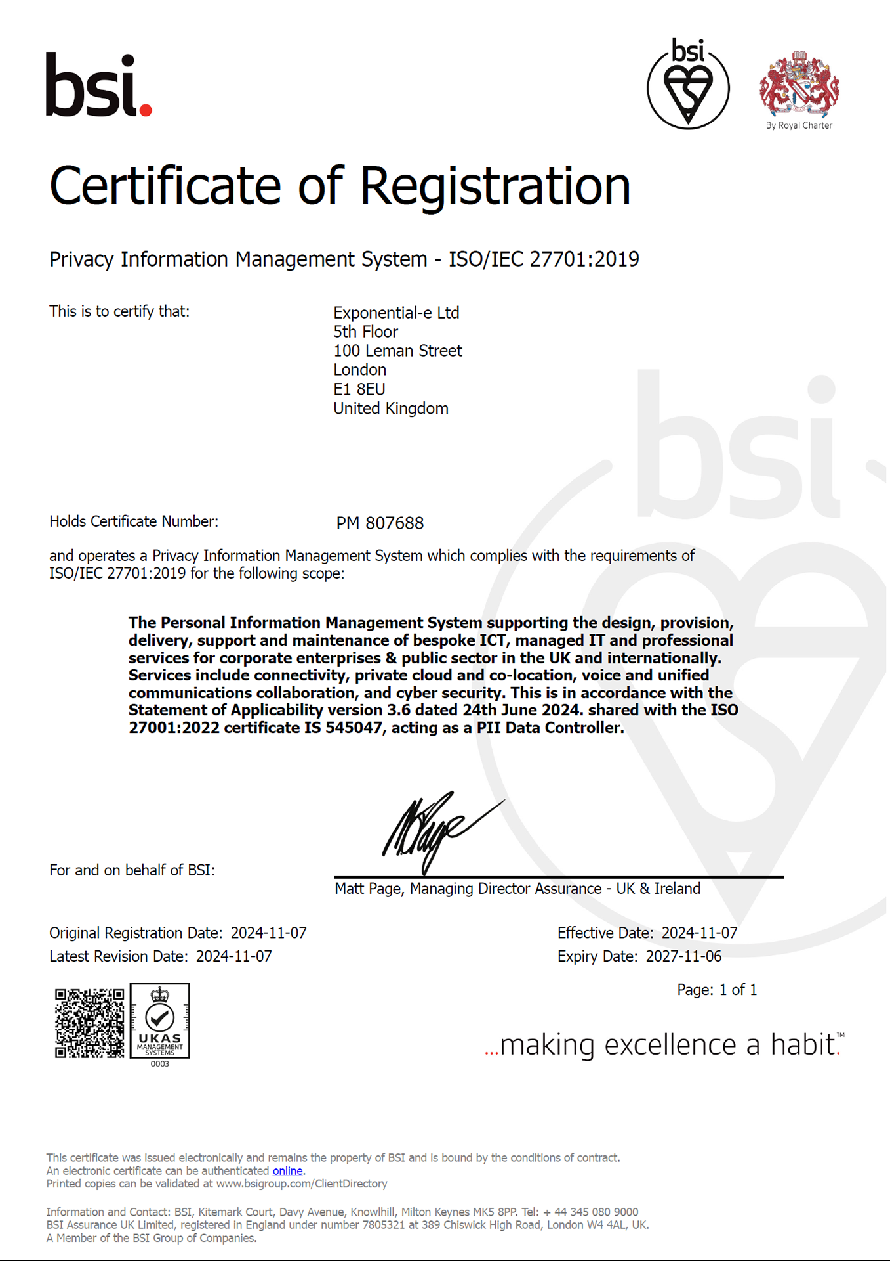
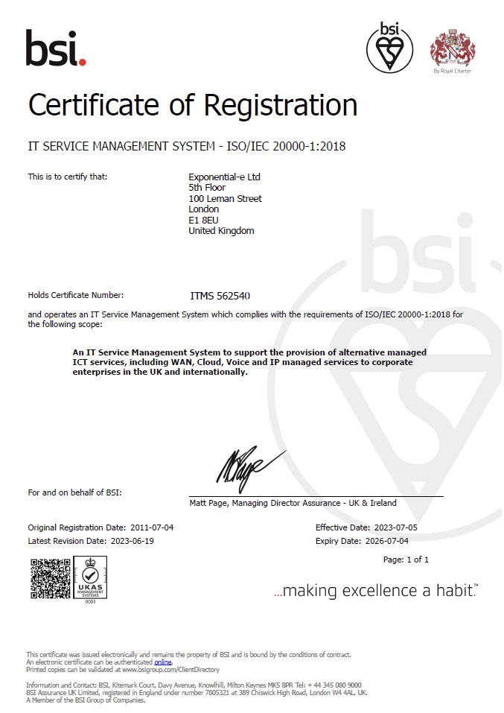









ISO14001
Environmental Management
ISO9001
Quality Management
ISO27001
Information Security
CSA Star
Cloud Security
-100
85
+100
Our commitment to deliver
customer service excellence
Real-time ‘Live’ NPS
Rolling 3 month average. Industry average: 17
ISO50001
Energy Management
ISO22301
Business Continuity
ISO27701
Privacy Information Management System
ISO20000
IT Service Management
ISO27017
Private Cloud Security
Approved Supplier: RM6200
Artificial Intelligence DPS
Approved Supplier: RM1557.14
G-Cloud 14
Approved Supplier: RM3764.3
Cyber Security Services 3 DPS
Approved Supplier: RM6116
Network Services 3
Approved Supplier: RM1043.8
Digital Outcomes (DOS) v6
Approved Supplier: RM3825
HSCN DPS
Approved Supplier: RM6094
SPARK DPS
Approved Supplier: RM6190 Technology Services 4

Slide 21








Procurement Vehicles & Vertical Alignment
Blue
Light
Central Government
CNI
Defence
Education
Health
Local Government
Blue Light
Central Government
CNI
Defence
Education
Health
Local Government
RM 6116
RM 6116
RM 6116
RM 6116
RM 6116
RM 6116
RM 6116
RM1043.8
RM 6116
RM 6116
RM 1043.8
RM 6116
RM 6116
RM 6116
DOS Outcome
DOS Outcomes
DOS Outcome
DOS Outcome
DOS Outcomes
DOS Outcomes
DOS Outcomes
RM3764.3
RM 6100
DOS Outcome
RM 3764.3
RM 6100
RM 6100
RM 6100
RM6190
RM6190
RM6190
RM6190
RM6190
RM6190
RM6190
RM 6100
G-Cloud
RM 6094 Spark DPS
RM 6100
G-Cloud
G-Cloud
G-Cloud
G-Cloud
G-Cloud
Network Rail SQS
G-Cloud
G-Cloud
G-Cloud
G-Cloud
RM 6116
RM 6095
Gigabit Capable
Network Rail SQS
RM 6116
JISC Web Filtering
RM 3825
RM 6095
Gigabit Capable
RM1043.8
RM 3764.3
Cyber Security Services 3
RM 6094 Spark DPS
RM 1043.8
Patient & Healthcare Communication
RM 6094 Spark DPS
G-Cloud
DOS Outcomes
Aurora
DOS Outcomes
DOS Outcomes
DOS Outcomes
RM3764.3
RM 3764.3
RM6094 Spark DPS
DOS Outcome
RM 3764.3
Cyber Security Services 3
G-Cloud
RM6094 Spark DPS
RM 6094 Spark DPS
RM 3825
RM 6094 Spark DPS
RM 3825
HSCN DPS
DOS Outcome
Patient & Healthcare Communication
Aurora
RM 6094 Spark DPS
RM 6094 Spark DPS

Slide 22
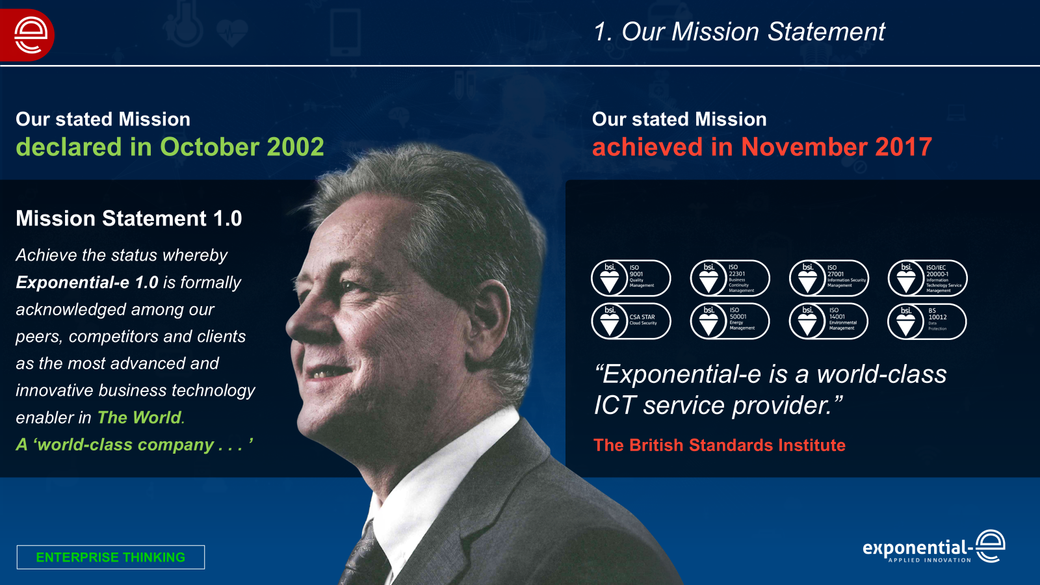
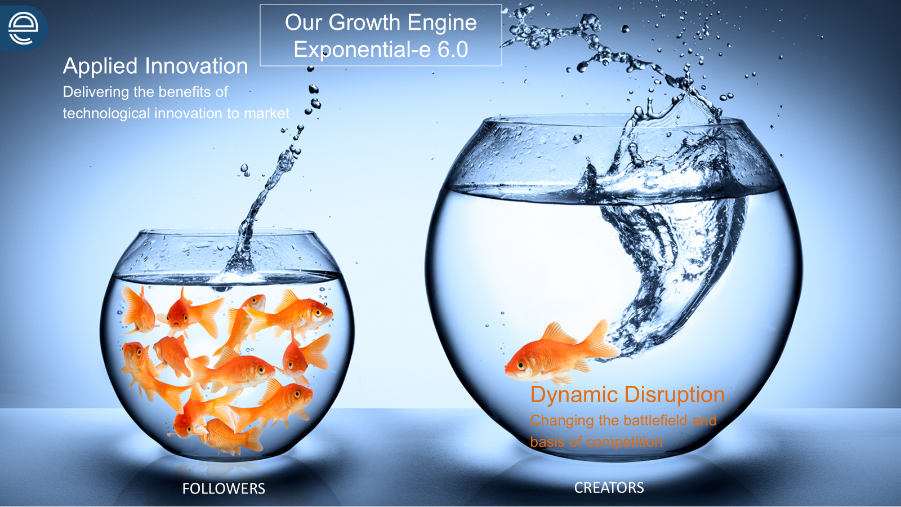
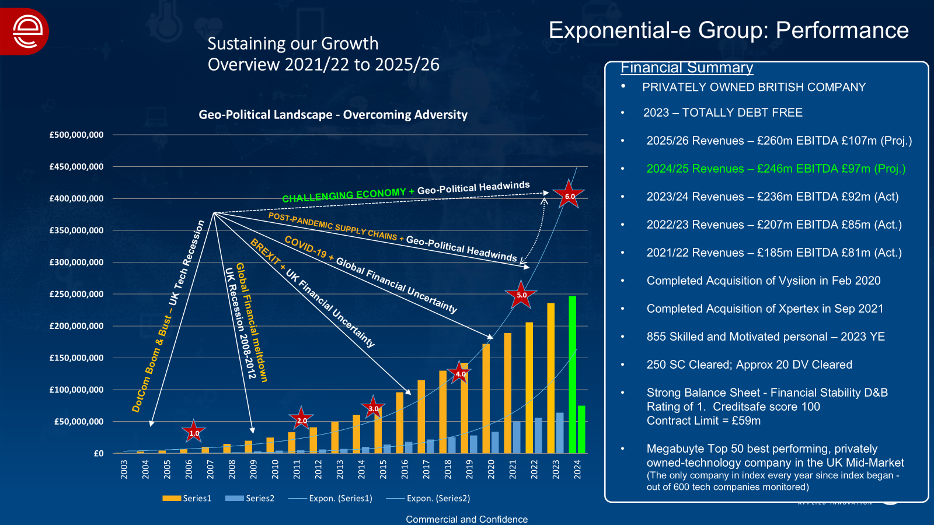
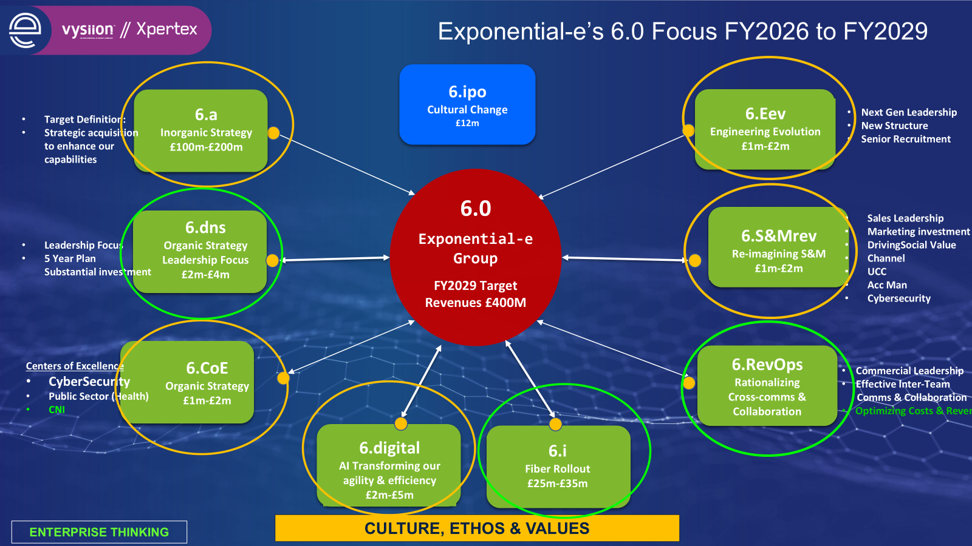
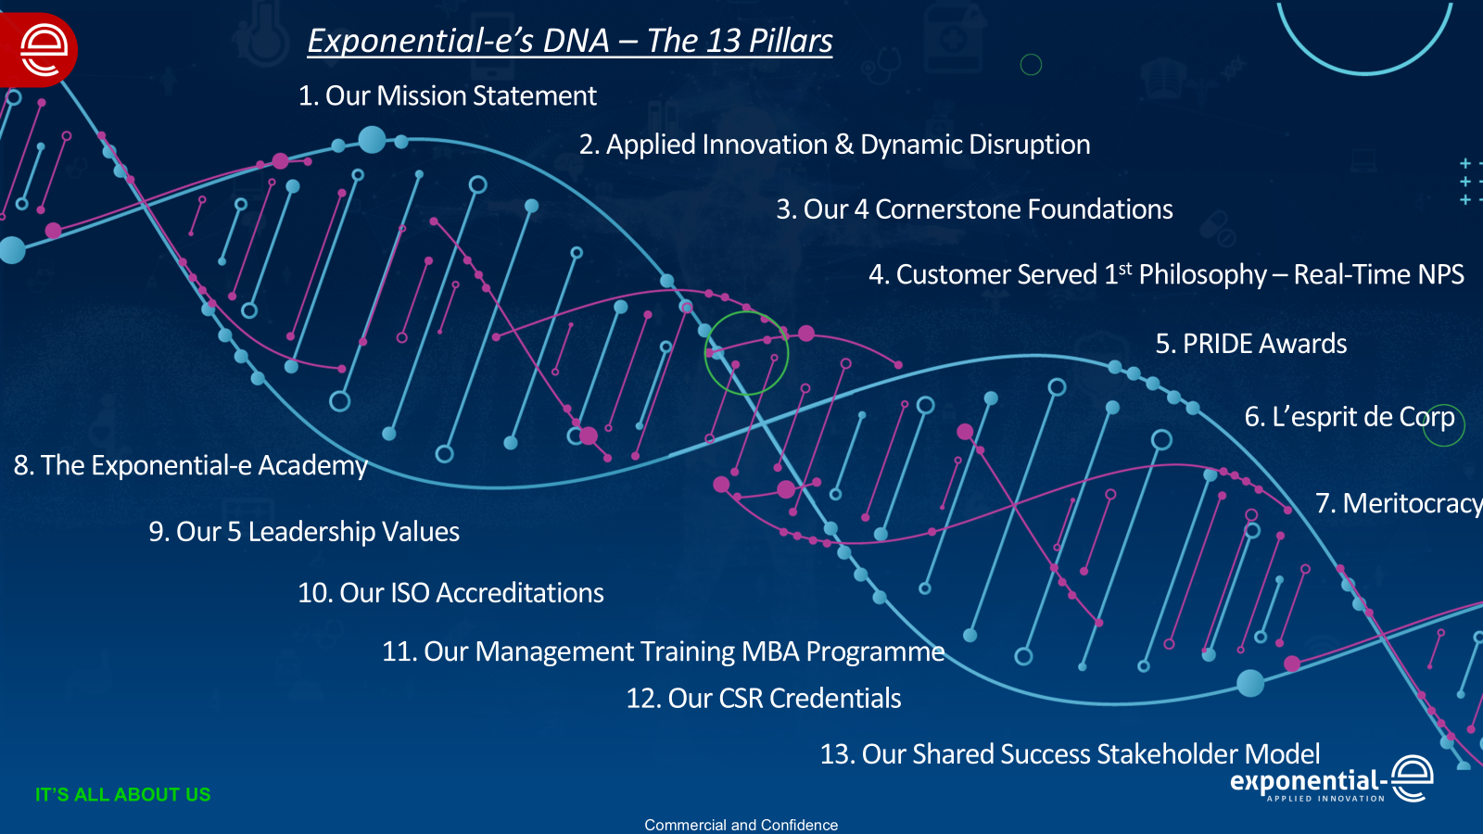
Our Culture, Ethos & Values
Trust, Integrity, Respect, Equality, Fairness & Transparency
“ Culture eats strategy for breakfast!”
Peter Drucker – Business Consultant

Slide 23









Human Touch Provisioning & Service Delivery
How our service differentiates itself from the rest
Evolution of SNOW
SNOW used for both Provisioning and Support which means any transition is more seamless as the systems are aligned offering many hidden benefits
Dedicated PM aligned to partner
Named escalation matrix with DDI
Welcome call
Tailored SNOW dashboard showing orders in the system and where they're at in the process
Access to a live data dashboard being made available for partners in the coming months
Provisioning flowchart
Escalation pathway to Director of Service Delivery
Automated ordering solution being introduced to bring down ordering from 3-5 days down to 1

Slide 24
The Partner Program
Be Unstoppable.

Slide 25
Mission
Our mission is to serve our channel community with unwavering
dedication, providing them with margin-rich solutions complemented by world-class platinum-grade customer service

Slide 26

Our Channel Vision - EXPO.e
Dedicated Marketing Investment
Governance, Accreditation and Frameworks
Enable Channel
Be easy
to do business
Rebrand for
new Channel identity
New brand
Look and feel
01
Working with new and existing vendors to increase MDF investment and improve engagement across the group.
Combine capability Driving unique solutions / margins
20% increase for
inbound lead-gen with more focus and resource on LinkedIn & AdWords PPC
07
08
Discounts and Incentives
02
06
Reaffirming our commitment and focus
09
05
Targeting key regions
with campaigns,
events and memberships across the group,
Solutionize /
Money-makers
03
Always on nurture campaigns for our targeted verticals
04
2025 and Beyond
Strategic Collaboration – Public and Private Sectors
Partner Hub and Portal
Enablement team
Dedicated virtual team 100+ people
Platinum Service
Commitment to Net Promotor Score
Solutionize / Money-makers – Military Grade Solutions
Take advantage of 754 technical certificates / qualifications
Improving our brand awareness by increasing our PR, personalised content and LinkedIn Ads.
Increased Investment
Marketing and Sales
Updated high
quality content available to you

Slide 27





Our Culture
Our Goals
Be your agile, responsive partner
Teamwork for effective collaboration
Ensure seamless transition
Provide future-proofed innovation services
Deliver best
value for money
Trust
Collaboration
Agility
Transform
Our Values
To deliver outstanding value, partnerships and quality of care with transformative communication

Slide 28


Vision and Commitment
5. World-class Platinum Service
for all partners
1. Strategic collaboration
to achieve collective objectives
4. Resource-rich approach
to become your trusted advisor delivering Peace of Mind as a Service
2. Enable channel with innovative solutions to simplify supply chain
3. Combine collective capability to maximise revenue and margin
Notes:
.

Slide 29













Strategy and Go to market
Utilise our Governance
Accreditations, Certifications & Frameworks - Driving continuous improvement and open opportunity.
Revitalised
Partner Hub
Central place to find
our pricing tools, marketing and training.
Every partner is Platinum
World-class customer service, from first contact, throughout the life of the contract and beyond.
Easy to do
Business with
Ensure we are approachable, adaptable and accountable.
Customer Longevity
Stickiness to support customer retention and displace competition with existing and new customers.
Reseller, Referral, Carrier
Flexible models available to all partners.
Building sustainable Pipeline
to exceed targets and
build end to end solutions together.
Focused Approach
Public / private sector, Regional / National,
with dedicated support, marketing and enablement to work with you.
Deliver the highest conversion rates
Provide “dedicated win”
teams to support partners and win more business together.
Solutionize / Money-makers
Together grow and
maximise revenue
and margin - Identify £100k FYR opportunities.

Slide 30
Let’s Solutionize™ Together
Be Unstoppable

Slide 31

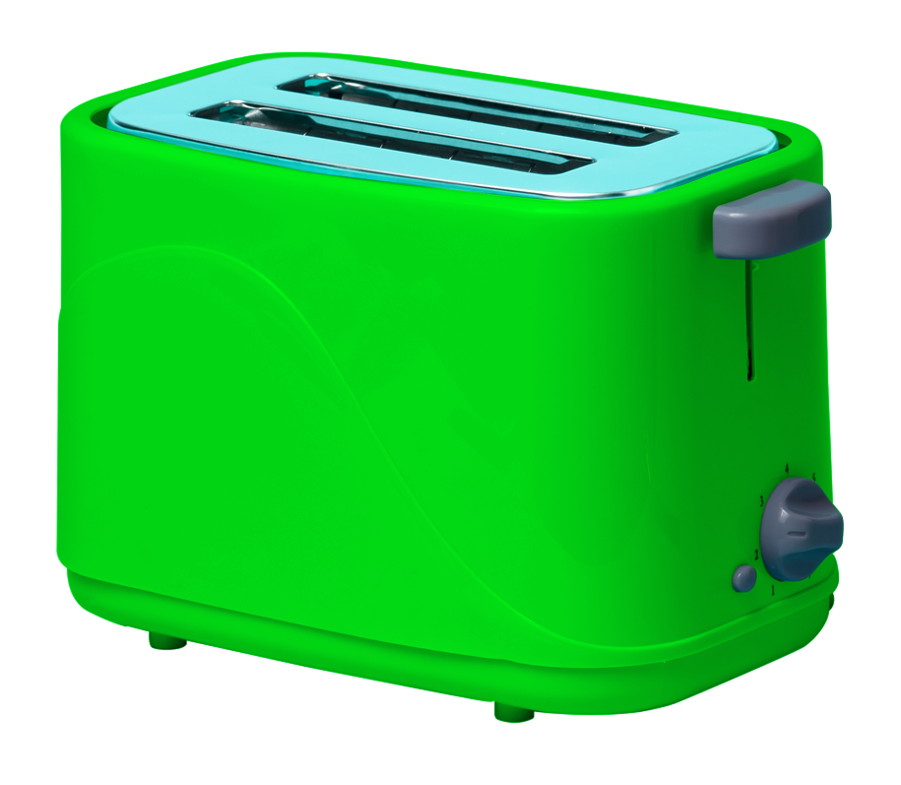

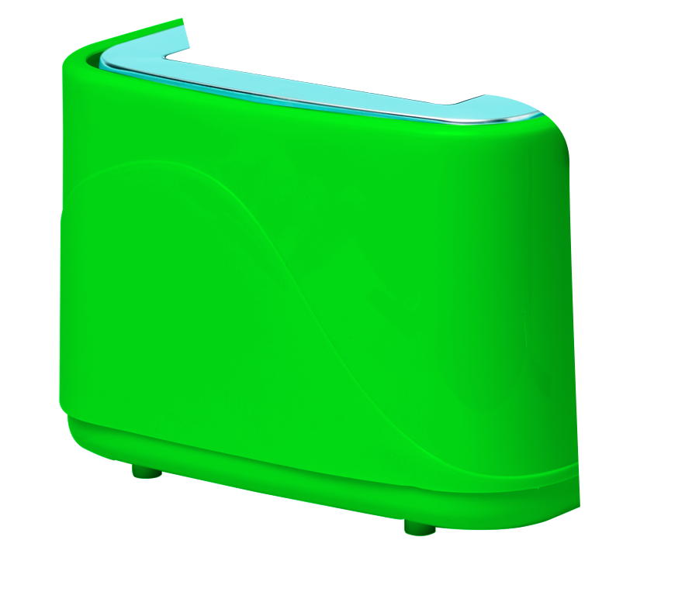



Tech is being
Commoditised…
If we don’t solutionize™
we’re toast.
Be unstoppable. The Exponential-e Group Channel Partner Programme
www.expo-e.uk | 0203 993 3374

Slide 32






Advantages of Solutionizing
Expand Market Reach
Competitive Differentiation
Customer Retention and Loyalty
Upselling and Cross-Selling Opportunities
Increased Value Proposition
Revenue/Margin Growth

Slide 33



Solutionized Partner Tool Kit
Strategy
Strategic collaboration, focused approach, vertical, public/private
Enable channel with innovative solutions to simplify supply chain
Combine collective capability to maximise revenue and margin. Flexible routes to market, resell/refer. Money maker focus, target larger opportunities
Resource-rich approach
to become your trusted advisor delivering Peace of Mind as a Service. Achieving high conversion rates.
Sales & Marketing
Events, Workshops, Roundtable, Hospitality
Online Content, white label, datasheets
Email, presentation, blog templates
Account Management
Prospecting/pipeline growth
Solution specialist, Solution Overlay
Bid support, full or hybrid
Proposal templates/support
O&D team support
Solutionized Support
Working together
Demonstrate how to combine our technologies with yours - offering unique winning solution!
Sales
Discovery & qualification
Support call out day sessions
Commercial
How to increase margins
Building additional value and new revenue streams with your customers
Technical
Cornerstone specific
Solutions and overlay
Operation NOC and Support delivery
Enablement
Partner Hub engagement
Making it easy to do business with us
Delivering consistent enablement strategy &support building pipeline and margin growth
Agree critical success factors and report and tailor via regular meetings
Channelise product / solution materials
Channel partner training programme
MDF
Sponsorship
Service Management

Slide 34





Money-makers
ITSM
as a Service
SD-WAN
& SASE
Data Centre
& Cloud
Infrastructure
as a Service
Cyber
Security

Slide 35
What is ITSMaaS from EXPO.e
EXPO.e’s ITSM as a Service delivers a fully configured IT Service Management (ITSM) platform, powered by ServiceNow, hosted on an individualised customer domain. Designed around each customer's unique needs, it leverages our internal expertise to ensure streamlined implementation processes and ongoing management.
A comprehensive solution, powered by ServiceNow, that integrates both ITSM and ITOM capabilities.
A fully configured and defined ITSM software platform that leverages our internal expertise to optimise the implementation process and ongoing management.
Our solution offers domain separation for data, processes, and interfaces, making the offer suitable to businesses of all sizes, facilitating a personalised customer configuration, while maintaining strict data privacy.
EXPO.e’s ITSM as a Service powered by ServiceNow is a versatile, robust solution designed for immediate deployment and flexibility.
It balances quality and cost-effectiveness, enabling organisations to elevate their IT infrastructure efficiently and effectively.
The service includes significant system upgrades, professional services for configuration and development, and a robust service suite, reflecting our dedication to advanced technology and customer service excellence.

Slide 36
SD-WAN & SASE
EXPO.e’s connectivity portfolio brings together a comprehensive range of leading-edge solutions, designed, delivered, and managed by leading experts, supported by robust SLAs, and built on our self-owned, enterprise-class network.
The result is optimal control and scalability, reduced operational costs, and an accelerated path to the Cloud, with the highest standard of cyber security inherent in the design of every solution.
An industry-leading
SD-WAN solution
Drawing on EXPO.e’s years
of experience as a UK pioneer in software-defined connectivity - delivered as a fully managed service.
Secure Access Service Edge (SASE)
Combining leading-edge
networking and zero-trust cyber security in a Cloud-based solution, to provide optimal control, protection, and visibility.
Managed LAN and WiFi
Intelligent connectivity
and a centralised, highly intuitive user interface, for maximum control and visibility.
24 / 7 Support
Proactive support from EXPO.e’s own UK-based NOC.

Slide 37






Data Centre & Cloud Solutions
Colocation + cloud platforms, delivered with EXPO.e’s service assurance
Hybrid foundations – from racks to cloud
Data Centre Services
Cloud Solutions
Colocation
(space + power)
Cross connects
Public cloud enablement
Managed private cloud
Hybrid
Platform
Remote / Smart Hands
Secure access & compliance
Backup & disaster recovery
Cloud connectivity
EXPO.e value wrap (applies to both)
Assured outcomes
Private connectivity
Secure by design
24/7 Managed service
Backup & DR options

Slide 38




IaaS with EXPO.e
Public Cloud + Managed Private Cloud
Core cloud building blocks, delivered with EXPO.e’s peace of mind as a service
Public Cloud IaaS
Connectivity+ approach
Compute
Virtual machines + scale-ready designs
Virtual Data Centre
Dedicated Resource Pools + self-service
Networking
VPC/VNet, VPN, private connectivity
Backup and DR
Managed backup, replication, RPO/RTO options
Resilience
Multi-zone/region design options
Security Edge
Segmentation, firewalls, load balancing
Security + Ops
IAM, encryption, monitoring + automation
Managed Operations
24x7 monitoring, patching, ITIL processes
EXPO.e value wrap (applies to both)
Secure connectivity
Governance + control
Resilience options
Managed service
Optimisation

Slide 39
NIST – Our Cyber Resiliency
Capabilities
Data Discovery and Classification
Identify
  Assists in developing an organisational understanding to managing cybersecurity risk. Enables an organization to focus and prioritize its efforts, consistent with its risk management strategy and business needs.
Governance Risk And Compliance
Backup and Replication Solution
Immutable backups
Air Gapped Backups and Clean Rooms
Risk Management
Asset Management
Endpoint Protection/NGAV
NGFWs/WAFs/Layer 7 Load Balancers
Recover
  Identifies appropriate activities to maintain plans for resilience and to restore any capabilities or services that were impaired due to a cybersecurity Incident. Supports timely recovery to normal operations to reduce the impact from a cybersecurity incident.
Protect
  Appropriate safeguards to ensure delivery of critical infrastructure services. Supports the ability to limit or contain the impact of a potential cybersecurity event.
Email Security Solution
Data Loss Prevention
NIST Cybersecurity Framework
Privileged Access Management(PAM)
Security Service Edge/Secure Access Service Edge (SASE)
Key Management Solution (KMS)
Awareness Training including Phishing investigation service
Managed eXtended Detection and Response
Digital Forensic and Incident Response
ICT Continuity Testing
Red Teaming/Purple teaming
Cyber security operations centre
Vulnerability Management Solution
Respond
  Appropriate activities to take action regarding a detected cybersecurity incident. Supports the ability to contain the impact of a potential cybersecurity incident.
Detect
  Defines the appropriate activities to identify the occurrence of a cybersecurity event. Enables timely discovery of cybersecurity events.
NIDS/HIDS
Exposure Management System
SIEM
Threat Intelligence Solutions
End Point Detection and Response Solution
Penetration Testing
Identify
  Assists in developing an organisational understanding to managing cybersecurity risk. Enables an organization to focus and prioritize its efforts, consistent with its risk management strategy and business needs.
Data Discovery and Classification
Governance Risk And Compliance
Endpoint Protection/NGAV
NGFWs/WAFs/Layer 7 Load Balancers
Risk Management
Asset Management
Backup and Replication Solution
Email Security Solution
Data Loss Prevention
Recover
  Identifies appropriate activities to maintain plans for resilience and to restore any capabilities or services that were impaired due to a cybersecurity Incident. Supports timely recovery to normal operations to reduce the impact from a cybersecurity incident.
Protect
  Appropriate safeguards to ensure delivery of critical infrastructure services. Supports the ability to limit or contain the impact of a potential cybersecurity event.
Immutable backups
NIST Cybersecurity Framework
Privileged Access Management(PAM)
Security Service Edge/Secure Access Service Edge (SASE)
Air Gapped Backups and Clean Rooms
Key Management Solution (KMS)
Awareness Training including Phishing investigation service
Managed eXtended Detection and Response
Cyber security operations centre
Vulnerability Management Solution
Respond
  Appropriate activities to take action regarding a detected cybersecurity incident. Supports the ability to contain the impact of a potential cybersecurity incident.
Detect
  Defines the appropriate activities to identify the occurrence of a cybersecurity event. Enables timely discovery of cybersecurity events.
Digital Forensic and Incident Response
NIDS/HIDS
Exposure Management System
ICT Continuity Testing
SIEM
Threat Intelligence Solutions
Red Teaming/Purple teaming
End Point Detection and Response Solution
Penetration Testing
Notes:
New Addition

Slide 40
Our Capabilities & Wider Portfolio
Be Unstoppable

Slide 41
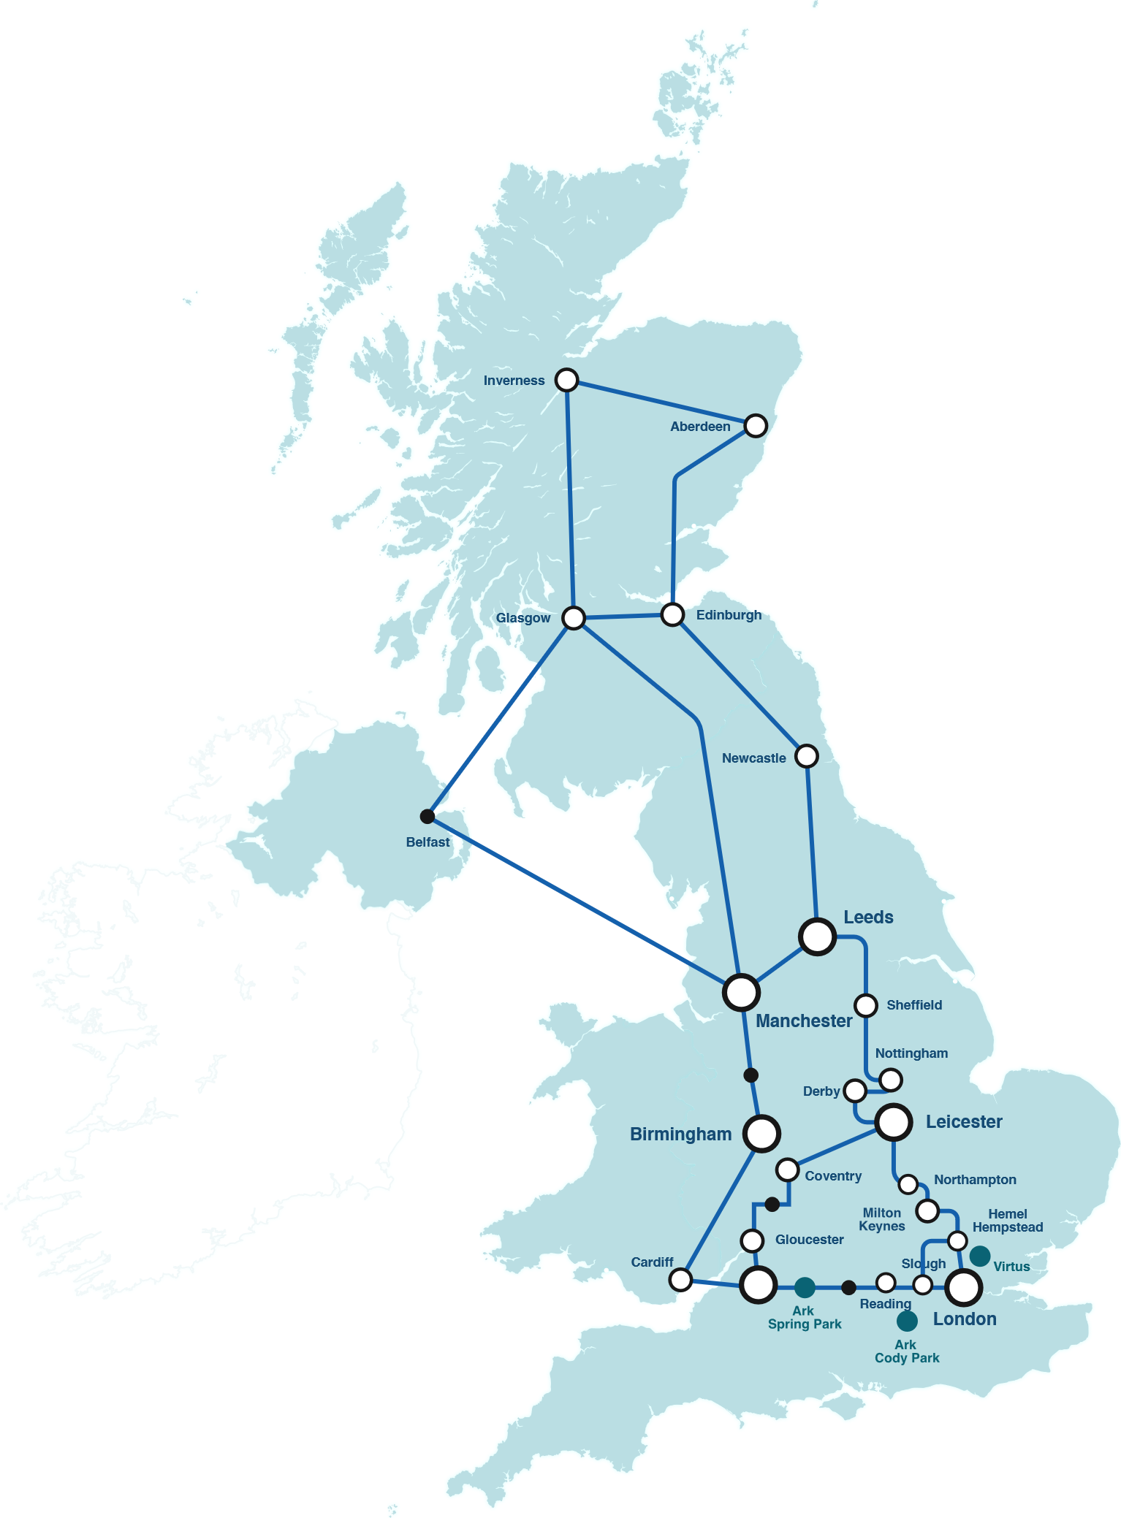
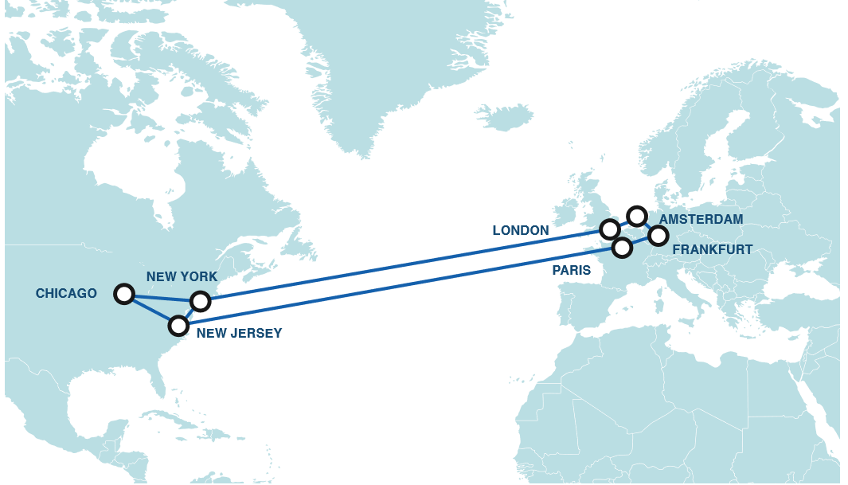














EXPO.e £120m Infrastructure Investment
Exponential-e ‘s £120m investment:
Our fully owned and managed high capacity, next generation carrier-class network
with full UK & International reach…
International Reach
170
Towns & Cities
6
Internet Gateways
39
Data Centres
15,000
Customer Circuits
1/3rd London
212
PoP’s
2000+
Kilometres Fibre
180+
3rd Party NNI’s
6
UK City Metros
300+
Internet Peers
200K
OnNet Postcodes

Slide 42









Our Capabilities
End-User Engagement
Cloud
Management
Software-Defined Tech
Multi-Cloud
Capability
Digital
Transformation
Cyber Security
Unified Comms
and Contact Centre
Network Reach
Migration Skills and Tools
Professional Services
Managed IT Services
Managing Legacy Systems

Slide 43
Why EXPO.e
Customer Service Quality
Customer served 1st philosophy since 2003
Service culture begins in Academy
3,000 customers - 96% Reference-ability
Real-time ‘live’ Net Promoter Score = 80. Consistently scoring high on an Index ranging from -100 to 100.
Voice of the customer - Continuous improvements program
Board level escalation
Applied Innovation
Levering technology for the benefits of the customer
First movers in Ethernet (2002) & VPLS (2006)
World-first with APM (2010) 100GigE VPLS Network (2012)
Innovative approach keeps clients at leading edge
Cyber Security Operations Centre and Cloud Management Platform
Multi Vendor Global SD-WAN service
Technical Capabilities
100 GigE business only Network
Reputation built on the delivery of high performance Networks
212+ PoP’s reaching into 39 Data Centres
Multiple services delivered securely at Layer 2
Built and manage our own Cloud, Voice-UCC and Cyber Security Platforms
Trusted Partner
9 x BSI / ISO standards, as well as the highly coveted Cloud Security Alliance STAR.
UK Service Desk offering 24 / 7 Fault, Find and Fix Pro-active 1st, 2nd and 3rd line support.
Carrier-class Infrastructure for resilience / reliability.
Financial stability - D&B 1 Credit rating.
2024 / 2025 £260.6m and EBITDA £105.2m (Group).
Our Group has over 70+ years of combined experience, delivering customer excellence.

Slide 44
Success Stories
Be Unstoppable

Slide 45















Our Partners

Slide 46


Success Stories
Having the right supplier is just as important as listening to customers. We like people that are honest, responsive and proactive, EXPO.e exceed across all of these areas.
William Linard
Head of Sales, Luminet
Notes:
https://youtu.be/Xn9YYrbOF7A

Slide 47

Success Stories
The most important thing at the outset of any new partnership is establishing trust between teams. Once you've built a strong rapport and are working towards shared goals, the technological innovations follow naturally.
Terry Faria
Telecommunications Manager, Quiss Technology.
Notes:
https://youtu.be/NKlNLnhvheA

Slide 48

Success Stories
It's the shared values that have really been the foundation of our relationship with EXPO.e, as well as their willingness to do things a bit differently.
Robb Thaw
Marketing Manager, Natilik.
Notes:
https://youtu.be/SVy3oGHl_d0

Slide 49
Onboarding Checklist
TASK | Completed
NDA Signed | ü
Channel Deck presented to C-Level / Sales Managers & Sales Team
MRA / MPRA signed
Set frequency of meetings with Partner Sales Teams
Set up access to Partner Hub
Ensure access to all portals - CPL / UC / SNOW / LogicMonitor
Enablement session arranged / Material for all portals to be shared
Introductory incentives

Slide 50
Partner Enablement
Be Unstoppable

Slide 51
What is EXPO.e Enablement and how will it benefit you
Make it easy for your Account Managers to work with us
Partner Hub
Consistent strategy aligned with your objectives
01
09
02
Training requirements and delivery
Help you grow pipeline and margins
08
03
07
04
Understand if there are areas where you won’t need our support
Focus on Money-makers, UC & ServiceNow as a Service
06
05
Focus on finding the gaps where we can support
Support with joined up marketing approach

Slide 52
Training and Onboarding
Training
Sales
  Discovery & qualification
  Run call out day sessions
Commercial
How to increase margins with EXPO.e solutions
Building additional value and new revenue streams with your customers
Technical
Cornerstone specific
Solutions and overlay
Operation NOC and Support delivery
Onboarding
Tailored strategy for your business
Structured plan to meet your growth objectives
Focus on new margin rich revenue streams
Enablement planning
Devise bespoke training program
Maximise the Partner Hub
Our Toolbox is your Toolbox - Find the gaps for growth
Our resources are your resources - maximise our resources for you
How to engage

Slide 53


Success Factors
Agree and track defined approach to drive success
Regular pipeline and closed business
06
01
Success Factors
Consistent onsite visits and engagement with all Account Managers
05
02
Find the gaps - focus on Money-makers and quick wins
04
03
Identify, create and evolve plan for training requirements for team
Partner Hub engagement

Slide 54

Partner Hub - Partner Registration
Notes:
https://www.youtube.com/watch?v=j6SaMfR7G_I

Slide 55

Partner Hub Live Demo

Slide 56
2002
2004
2006
2008
2010
Internet over Ethernet
The foundation of our business: our carrier-class Fibre Network.
Secure low latency 100GigE VPLS homogenous purpose-built Infrastructure
Core foundation delivering:
Your application is as good as your network
Your data is as good as your network
Your cloud is as good as your network
Intelligent Internet Algorithm
World-first innovative connectivity algorithm to maximise speed and minimise latency for our global financial trading customers.
The UK's most secure carrier Network
Multiple services / true Layer 2 / 3 services anywhere
Delivering efficiency and enhanced secure data management
Worlds first Virtual Private LAN (VPLS)
Offering the next level generation of secure data and application transfer
Launch of Smart Internet
Launch of our Business-only carrier-class Internet service.
World first bandwidth management tool from the Cloud
Manage your application across
your network
Your Cloud is only as good
as your network
"The complementarity of Next Generation Networks and virtualisation projects”

Slide 57
2011
2012
2013
2014
2015
Exponential-e broadcasts
Royal Wedding
Broadcasting the Royal Wedding
to North America was only possible with Exponential-e Network and support teams.
Core Network upgrades to 100 GigE
Exponential-e invested
heavily in our Cloud and Data Centres, expanding our core Network to 100GigE.
Core Network investments
Secure Cloud and Data Centres
Launch of our “Clean side of the firewall” Resolving enterprise data security and privacy issues.
Launch of own Private Cloud
& Data Centre
Seamless interoperability for Cloud and Network.
Launch of DaaS
& SD WAN
Launch of Desktop as a Service allowing greater workplace flexibility and remote working. Launch of SD Cloud/WAN- flexible and scalable WAN solutions.
Cloud and Network Innovation Resolves Enterprise Issues with Cloud Adoption
Award Winning Year
Awards and accolades from The London Stock Exchange 1000 Companies to inspire Britain, Investec 100 Mid-Market, Megabuyte Top 50.

Slide 58
2020
2019
2018
2017
2016
Acquisition of Vysiion
(112 Engineers)
Project delivery, edge to core technologies
UK Field Engineering Team
24 / 7 x 365 NOC, and Data Centre Services Team
Reactive and Proactive Tech Resolution Team
Data Loss Prevention
Advanced IAM (Identity Access Management) Solutions
GRC Services
Cloud DRaaS
Platform as-a-Service
Public Cloud VDI as-a-Service.
DDOS service across our infrastructure
Cyber Security Operations Centre (CSOC)
Cloud Management Platform
SD-WAN / Cloud
One Owner-Extension of our Customer Served 1st Philosophy
BS10012-PIIS.
Exponential-e approved as HSCN, Stage 3 CNSP, since 2018
BS10012-PIIS standard for data management
24 / 7 UK based Cyber security operations centre (CSOC)
The Product Innovation Continues
The creation of our Exponential-e
Cyber Security product portfolio.
Developments in a world-first: SD-Cloud.
Launch of our Cyber Security Product portfolio
Expansion to the ARK
Offering our customers secure, energy efficient Managed Data Centre space. As well as launching market disrupting Cloud products-S4 Cloud Storage, Cloud Sync.
Further strategic investment into secure energy efficient management data centre
Cas-Telecommunication

Slide 59
2025
2024
2023
2022
2021
CNI toolbox - cyber / compliance for critical national infrastructure
Cyber security and compliance for critical national infrastructure, optimising the availability of mission-critical services across the UK.
Ransomware remediation
Next-generation disaster recovery and business continuity, allowing critical infrastructure to be restored in weeks rather than months.
*50+ DV team with 00’s of Security Cleared people
*Further core Investments into our Cyber Infrastructure
Biggest Cyber Vault solution sold in Europe
50+ DV team with xx SC
5.0 DX Mission
5idx, 5i, 5g
Acquisition of Xpertex
Expo Cyber
SOC 2 Type 2
List X facility

Slide 60
Background History
Founded in 2002 as an Ethernet-Only Carrier / Services Provider - Bootstrapper with £400K start-up capital
Organic growth to 2020 Revenues £142m EBITDA £38.5m
Feb 2020 acquired Vysiion - an Engineering projects / installations / CNI / Data Centre & Cybersecurity management company
Sept 2021 acquired Xpertex - Intelligence Services Cybersecurity company
Combined Group 2022 / 23 Revenues £206m; EBITDA £81m
With our commitment to customer service excellence, we invest 95% of our EBITDA back into people, technology and R&D
Today, we have 3,000 clients, 820 employees & operating to management standards with 9 ISO accreditations - recognised as a World-Class IT Service Provider by BSI
And an exceptionally high ‘LIVE REAL-TIME NPS’ score = 78 (Sept 2023) which is over four times higher than the industry average
For 21 years, we built a reputation for designing, delivering and supporting bespoke and complex Network / Cloud / IT / UCC projects to deliver customer outcomes
We have invested £120m building a homogenous Layer 2 Ethernet network with reach throughout UK & internationally, with further investment in our Cloud architecture and Microsoft Teams infrastructure. We call this our ‘non-stop compute platform’
‘We treat your business as if it were our business’ assuring we deliver our clients ‘Peace of Mind-as-a-Service’ backed by full stack SLA’s

Slide 61
The Exponential-e group has over 65 years of experience, credentials and capabilities in delivering critical infrastructure to
both the public and private sectors.
The combined skills and expertise of the 3 companies now make ‘military-grade’ solutions more accessible and available to our partners underpinning critical partners customer solutions.
Exponential-e Group
x820 people
x450 engineers
Exponential-e Ltd
Exponential-e
Infrastructure, cloud architecture, solutions delivery, long experience in corporate cyber services 24 / 7 CSOC
Founded October 2002
Vysiion Ltd
Xpertex Ltd
Vysiion
Security-Cleared staff, LIST-X accreditation & track record in delivering Defence & CNI solutions
Acquired February 2020
Xpertex
Security-Cleared staff & track record in delivering ‘Information Assured’ solutions into the Intelligence & CNI sectors
Acquired September 2021

Slide 62










About Us
850+
Full time employees
120
Service desk engineers
102
Delivery personnel
239
Engineering Personnel
£206m Turnover 22/23
8000
End users supported
300
Provide a service desk to over 300 Channel Partners
17,500
Circuits Managed
>3,000
Clients
45,000
Mailbox migrations
170
Microsoft Certified Engineers
35,000
End Points Managed
Notes:
Insert a ‘New Slide’ or select ‘Layout’
Exponential - Light Background

Slide 63
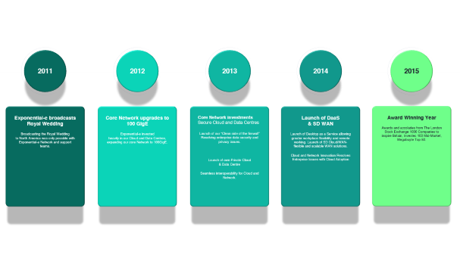
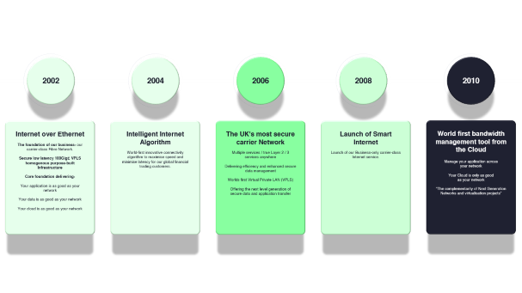
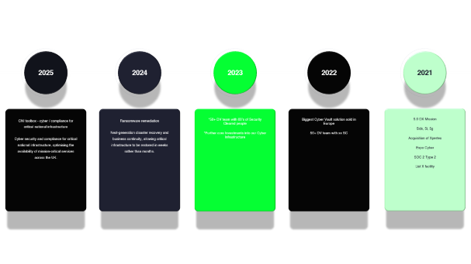
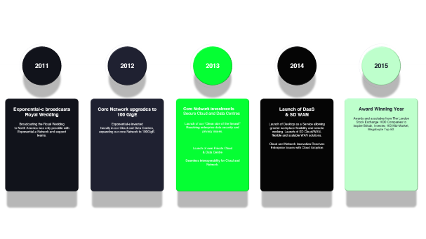
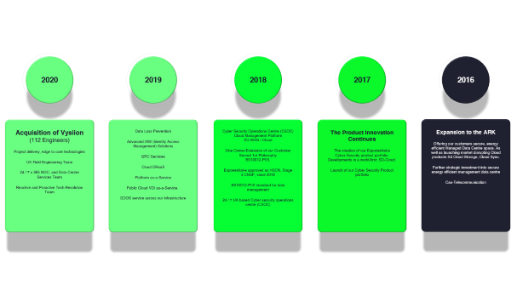
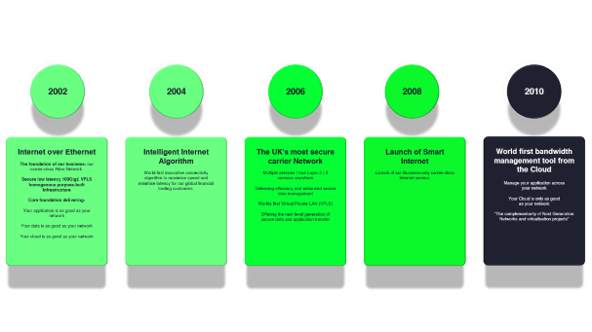
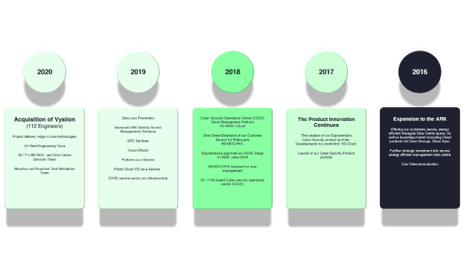
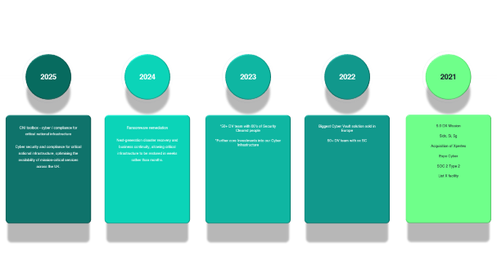
Exponential-e - A History of Innovation

Slide 64
Our History
2004
Launch intelligent
algorithmic IP routing - UK’s lowest latency network & our Service Creation Platform
2010
Web-based Bandwidth Management and controls
service launched
We bundle in DDoS
services into our internet
and WAN solutions
2023
We breakthrough the £100m
sales order threshold to finish the FY22 / 23 financial year at
£206m Revenues
2017
We launch S4 - UK’s lowest
priced Object Storage service
Invest to build out our network capabilities with connection to HSCN Network
2019
We launch a range of Cyber-Security solutions along with our 24/7 CSOC Service
We announce we are now accredited with 9 ISO’s
2013
Multi-million investment in
our data centers to offer Software-Defined Data Center and launch major initiative entitled ‘Your Cloud is Only as Good as
Your Network’
2002
Exponential-e launch
UK’s first dedicated, business-only Ethernet network with our Service Creation Platform
2008
We launch ‘Smart Wires’
which extends the capability of
our Service Creation
Platform
2018
We launch our Software-
Defined Digital Platform (SD-DP) and world’s 1st ‘live, real-time Net Promoter Score (NPS). We win 60% of HSCN Greater London connectivity contract
from NHS Digital
2021
We launch 1st Digital
Pathology Solution in the UK. Reduces time to receive pathology test results from 21 days
to 2 days.
2015
Award winning Year:
Selected by London Stock Exchange as one of UKs Top 1000 companies to inspire Britain;
Investec Top 100
Megabuyte’s Top 50
Tech companies list
2012
Core network upgrade
to 100GigE allows us to launch UK’s first 10GigE internet service throughout the UK
2006
We launch the first
VPLS Network in Europe
2011
Utilising Broadcast
technology, we deliver the live streaming TV pictures to 120million viewers of the Kate & William Royal Wedding from
Westminster Abbey
2016
First UK company to offer GPU servers on demand from the Cloud
We also launch advanced Business Continuity & Disaster Recovery services
2020
We launch our TEAMS
Gateway Platform and launch our multi-vendor (5) international
SD-WAN solution options
2022
We launch Ransomware
Defender - a Ransomware remediation service
Exponential-e complete the
build-out of our core dark fibre network around London - the
first part of our £130M UK
fibre investment
roll-out plan
2014
Worked with Alcatel-Lucent
to help build advanced SD-WAN service called Nuage
Launch of our ‘Digital
Toolbox’ to great acclaim

Slide 65
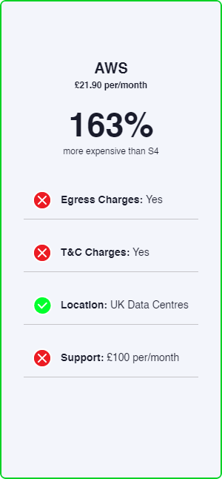
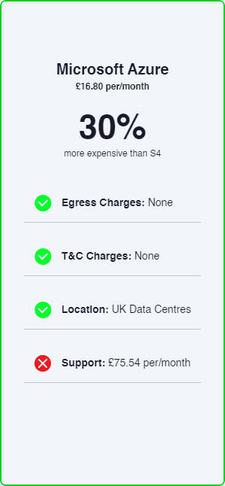
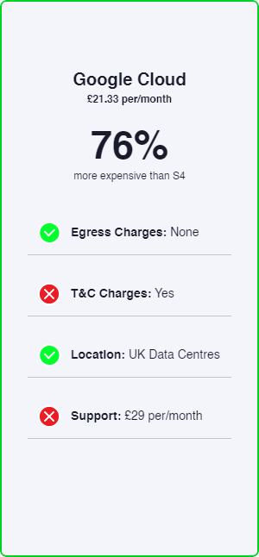
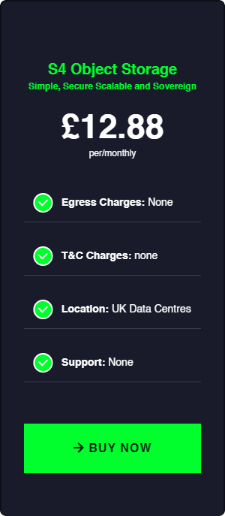
S4 Cloud Storage
Simple
Storage can be complex. S4 simplifies administration through single namespace management and universal accessibility.
Secure
With data encrypted at-rest and in transit, S4 gives complete security, plus all the cost-efficiency and scalability benefits of multitenancy storage.
Scalable
Hardware-agnostic,
Cloud enhanced scalability lets customers grow raw capacity while sustaining high-performance, on any infrastructure.
Sovereign
With S4, customers
don’t have to worry about data sovereignty: data will never leave our UK-based, privately-owned Network and Data Centres.

Slide 66
Disaster Recovery as-a-Service
EXPO.e's DRaaS model encompasses offsite backup and replication for both physical and virtual systems, combining Zerto’s leading-edge software-defined replication & recovery automation technology with our self-owned, enterprise-class network - delivered as a fully managed service
Stress-free Restoration Process
Critical systems restored in seconds, via Predictable Recovery Point Objectives (RPO) and one-click failover.
Disruption-free Deployments
No downtime required during the installation
of the Zerto Virtual Manager and
replication engine.
Full Control & Visibility
A highly intuitive online portal provides the customer with fully centralized management of their DR process.
Guaranteed Data Integrity
Near-zero data loss should DR protocols need
to be initiated, with automatic failover.
A Comprehensive Service Wrap
Additional capabilities around data centre moves, application migration and hybrid Cloud projects open the door to numerous add-on services.
Effortless Integration
A hardware, storage and application agnostic, providing customers with the freedom to integrate Zerto with their existing systems.
A Fully Managed Service
EXPO.e’s certified Cloud specialists provide hands-on guidance to streamline and optimize the disaster recovery process.
Everyone’s Our Platinum Partner
24 / 7 support from EXPO.e’s UK-based
Service Desk.

Slide 67
Managed CSOC
EXPO.e’s Managed CSOC allows your customers to take a proactive approach to cyber security while minimising the resulting burden on their own IT teams.
EXPO.e’s fully certified cyber security experts work to identify any potential breaches and ensure the appropriate actions are taken. There are numerous elements to this, including:
Real-time
Cyber Security Monitoring
Operating 24 / 7 x 365 to proactively identify any potential threats and issue automatic alerts - all based on the very latest threat intelligence.
The Unified Security Management (USM) Anywhere Platform
Manage the entire security ecosystem through a fully centralized, highly intuitive
platform.
An Advanced Persistent Database
Fully integrated with the security ecosystem, a comprehensive breakdown of the latest threats, updated by the end users.
Automated Categorization of Devices and Assets
Streamline compliance with corporate cyber security policies.

Slide 68
Unified Communications & Contact Centre
In partnership with EXPO.e, you can facilitate flexible, remote working practices for your customers, increasing their recruitment options and driving creative collaboration.
This, in turn, will offer insights that help build deeper customer relationships and open the door to integrating AI and machine-learning into their business operations.
Quality Voice & Video
High-quality voice and video calls, powered by our resilient core Network, eliminating the effects of jitter, latency and packet-loss.
Credible Comms
Offer your customers peace
of mind, with our optimally secure, fully PCI-DSS compliance platform, which boasts industry-leading 9 ISO accreditations.
Platinum Service Quality
Proactively managed
voice services and support, with end-to-end SLA and exceptional service quality.
UCC Dedicated Portal
EXPO.e make it easy for you to do business with us and manage your customers through our automated self-service UCC Portal.

Slide 69
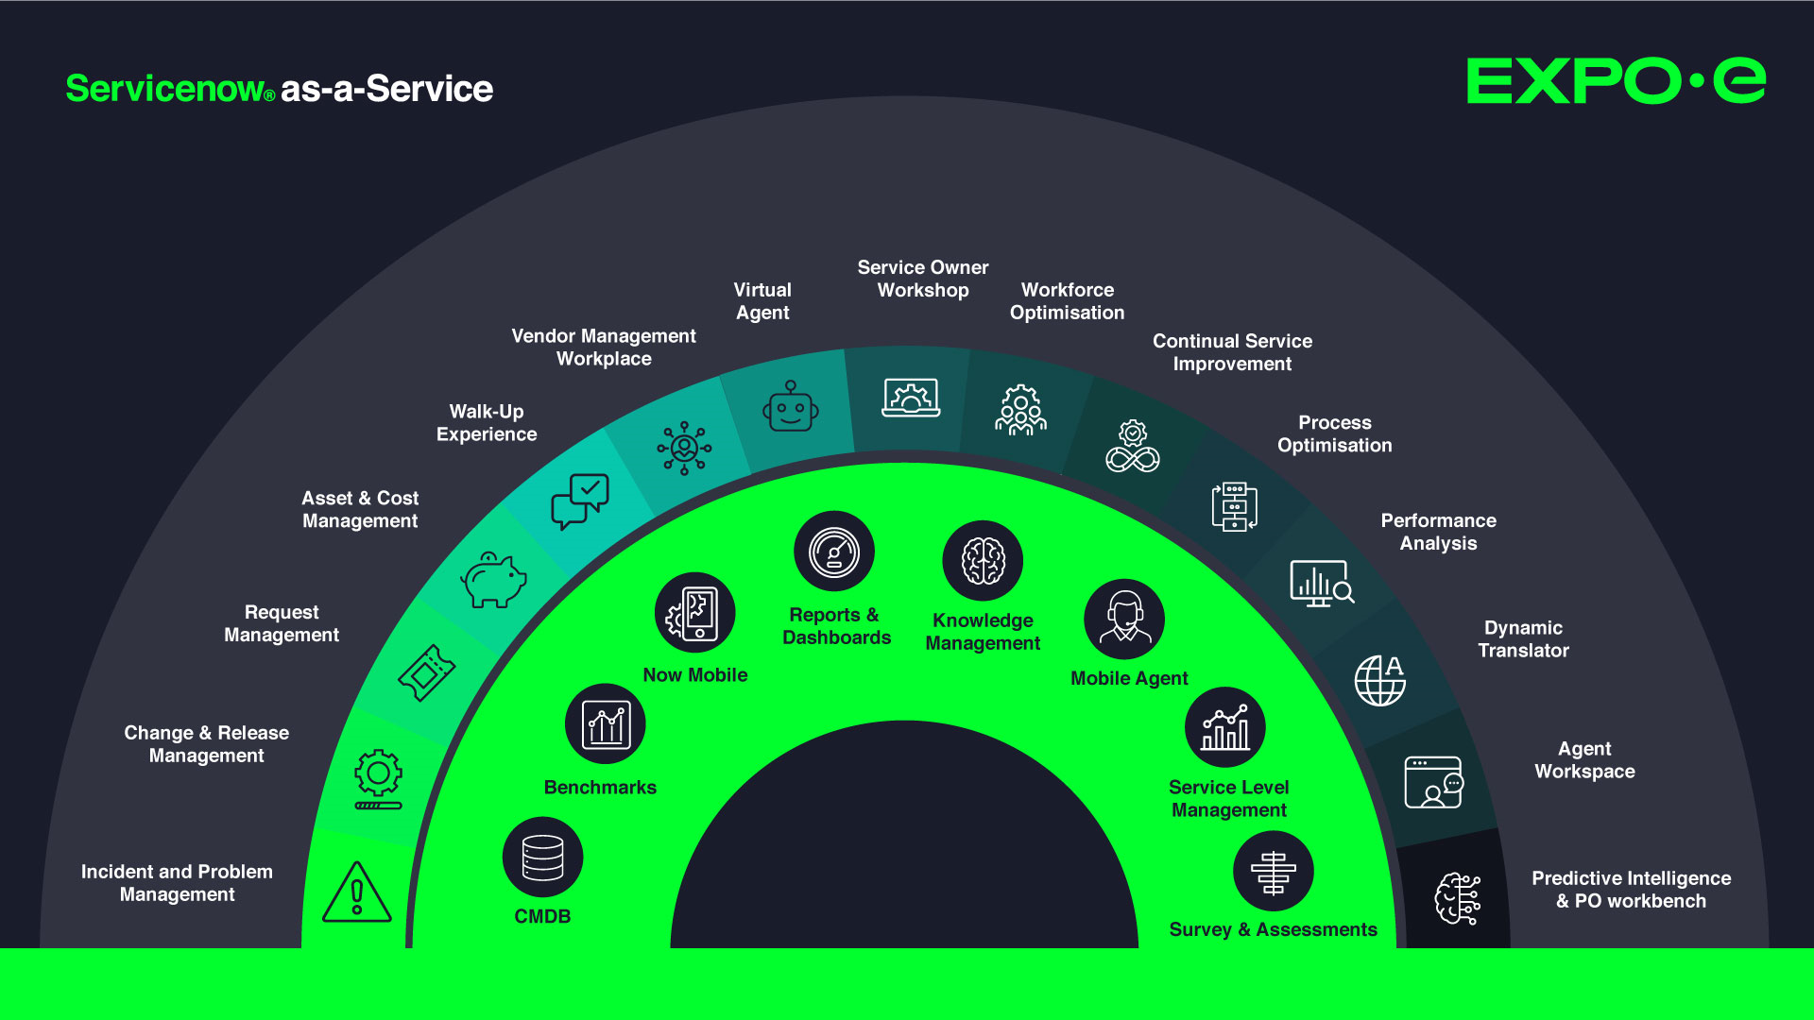
Simple sales messages

Slide 70
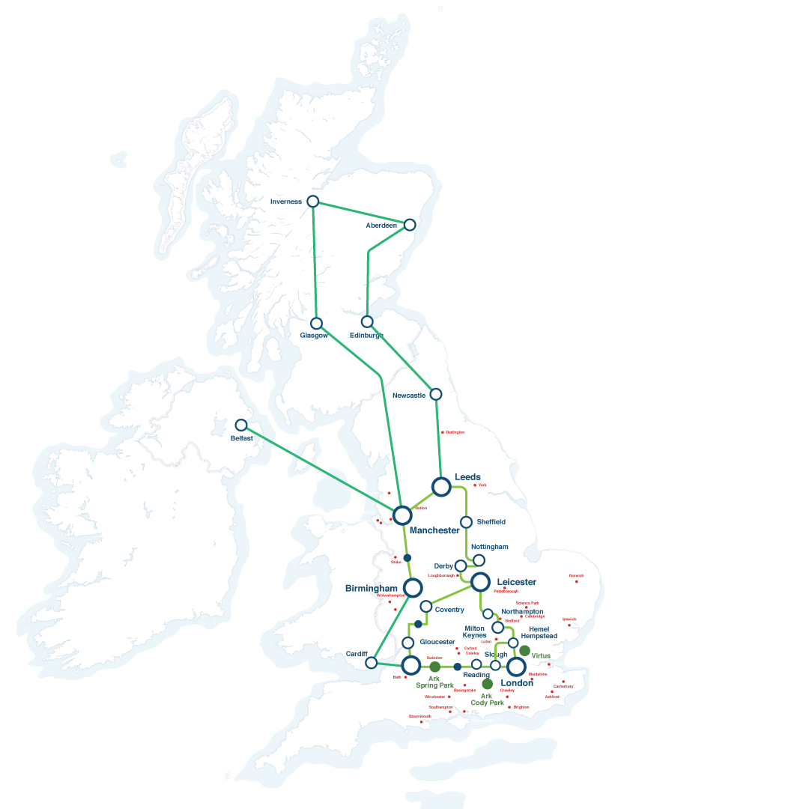






EXPO.e £120m Infrastructure Investment
International Reach
Fully owned and managed high capacity, next generation Cloud, UC / Teams / Collaboration and Security network.
Geographically resilient data centres
Multiple tier 1 carrier interconnects delivered across diverse private fibre
Carrier grade, market leading unified communications platform, providing collaboration and SIP trunk services, delivered across multiple DCs
Microsoft Teams Direct routing platforms, delivered across multiple DCs
Contact Centre as a Service (CCaaS)
Carrier Grade SBC infrastructure, protecting our UCaaS / CCaaS platforms
International PSTN carrier services
Self-service customer provisioning portals
Proactive fraud management and monitoring
Auto fraud detection and blocking
Connect
to US East Coast
180+
NNI
Connect
to US East Coast
Connect to
Amsterdam & Frankfurt
Connect to Paris

Slide 71
Our portfolio is your portfolio
Connectivity
Global reach with: VPLS
MPLS
MONEY MAKER – SD-WAN & SASE
Ethernet
Broadband
LAN & Wi-Fi
4G / 5G LTE
Internet
Full inter-connectivity to public clouds (Amazon, Azure, Google)
Cloud
Shared and dedicated private cloud
Public Cloud - Azure CSP
Hyper-converged infrastructure (VX Rail)
Cloud Management
MONEY MAKER - S4 Object Store
Storage-as-a-Service Citrix DaaS – Hybrid Apps and Desktops
GPU for render & HPC
Cloud Network Peering (AWS, Azure, Google)
MONEY MAKER
- Unified Communications
UCaaS powered by Cisco Webex
Teams Calling as a Service
Contact Centre as a Service
Collaboration as a Service
Contact Centre for Microsoft Teams
Hosted telephony
Business Continuity and Disaster Recovery
MONEY MAKER - Disaster Recovery as a Service
Continuous Server Replication
Secure Backup – Shared & Dedicated
Data archiving & Long-Term Retention
M365 Backup
CyberVault (air gapped immutable backup)
Professional services
Cloud Adoption and Migration - Azure, Hybrid & Dedicated
Server & Application Migration
EUD Refresh & Rollouts
M365 Consolidation and Migration - Zero Trust
Data Consultancy, Cloud Readiness, Automation
Managed Services
Service Desk
MONEY MAKER – Service Now as a Service
Infrastructure Management
O/S Management windows / Linux / VMWare / Hyper-V / 0365
Patching/ Backup / Monitoring Services
EUC - PCaaS, White Glove Imaging & Deploy
Security
MFA
PAM
Endpoint Protection and Security
End-to-end encryption
Single-sign-on portal management
SIEM
Perimeter Firewalls
MONEY MAKER – Managed CSOC
Managed DDOS and Ransomware Protection
Threat Monitoring and Intelligence
Vulnerability Remediation

Slide 72
Service Portfolio
Expo-e Fibre | Fibre Access | Broadband | Cellular | International Access | WAN / VPLS | Voice Connect | Cloud Connect
Network Monitoring | SD-WAN | Managed LAN & Wi-Fi | HSCN | SIP Trunking | UCaaS | Teams Direct Routing | Collaboration Rooms
Colocation | Shared Colocation | Remote Hands | WLR | Call Reporting | Multichannel Recording | Inbound Call Management | CCaaS
PaaS | IaaS | Azure Cloud | AWS Cloud | Cloud Storage | Online Backup | Server Replication | Enterprise Contact Centre
DaaS | VMWare HCI | Azure Local | Microsoft Apps | SaaS | App Management | Data Management | Test / Release Management
PCaaS | Active Directory | SQLaaS | User Management | Storage Management | Server Management | Peripheral Print | Mobile Management
CSOC | SIEM | Centralised Firewall | Dedicated Firewall Management | SSE | SASE | DDoS Mitigation | End-point Threat Protection
VCISO | DLP | Cyber Security Consultancy | Cyber Security Testing | Cyber Security Audit | Vulnerability Scanning | Email Security | MFA
Service Desk | On-Site Install | Break-Fix Management | IT Delivery | Staff Augmentation | Incident Response | Cyber Vault | PAM
ITSMaaS | Automated Control | SCADA networks | Operation Control Rooms | CCTV & Security Comms | IDS Monitoring | OT Threat Intelligence | CNI Field Engineering
Connectivity Services | Managed Network Services | DC Services | UCC & CC Services | Cloud Services | Managed IT Services | Cyber Security Services | Professional Services | CNI Services

Slide 73
EXPO.e Heritage
Multiple ‘solutions’ to channel, as part of our ‘bundle’ approach:
Smart WAN & Smart Internet Commercial Offers. DC Connect. Voice Connect Update. Disaster Recovery as a Service
Launch of Channel Program
Applied Innovation
Service excellence and technologies to our partners.
Multiple ‘solutions’ to channel, as part of our ‘bundle’ approach:
Smart WAN & Smart Internet Commercial Offers. DC Connect. Voice Connect Update. Disaster Recovery as a Service
Investments
Core Network upgrades to 100GigE.
Investments
Cloud, Security and Data Centre, expanding on our core Network to 100GigE.
2012
2006
2012
2012
Underpinned by our core foundations
Customer Service Quality
Applied Innovation
Technical Capabilities
Your Trusted Advisor
Launch of our own Private Cloud
Data Centre – Seamless
Interoperability of Cloud & Network
Company Turnover: £25m
Channel Approx: £8.75m
Channel Virtual Team Approx: 35
2006
2013
2010
Launch of DaaS and SD-WAN
Desktop as a Service,
SD-Cloud / WAN flexible and scalable WAN solutions
Launch of VPLS Network
Worlds-first Virtual Private LAN (VPLS) Multiple services - True layer 2 / 3 services anywhere.
Launch of DaaS and SD-WAN
Desktop as a Service,
SD-Cloud / WAN flexible and scalable WAN solutions
Your Cloud is only as good
as your Network.
The complementarity of Next Generation Networks and virtualisation projects.
2014
2006
2014
2008
Launch of Voice Connect
Launch of Service Creation Platform
Allowing partners to create their own best of breed solutions across platforms.
Company Turnover: £77.3m
Channel Approx. £27m
Channel Virtual Team Approx: 70
Launch of Smart Internet
Business only carrier-class internet service.
2007
2015
2008

Slide 74
EXPO.e Heritage continued
Launch of UCC Solution for Channel
With the HCP (Hosted Communication Platform) APP
(the channel version of UC-One)
Record Channel Year
Framework as a Service
Highest money-maker deal ever sold
Multiple large partner solutions
Acquisition of Xpertex
Track record in delivering
‘Information Assured’ solutions into Intelligence, Public Sector, CNI, and Corporate markets.
2015
2022
2021
Expansion to the ARK
Secure, energy efficient managed Data Centre space.
Disrupting Cloud products
S4 Cloud Storage.
50+ DV team with 00’s of Security Cleared people
*Further core Investments into our Cyber Infrastructure
Acquisition of Vysiion
Project delivery, edge to core technologies. UK Field Engineering Team. 24 / 7 x 365 NOC, Data Centre Services team.
2016
2023
2020
Product Innovation Continues…
Cyber Security product portfolio and developments in SD-Cloud.
Ransomware remediation
Next-generation disaster recovery and business continuity, allowing critical infrastructure to be restored in weeks rather than months
Launch of Cloud Management Platform - Public and Private Cloud platform.
Enablement Team Established
Launch of SASE Solutions.
2017
2024
2020
Launch of Cyber Security Operations Centre (CSOC)
24 / 7 UK based Cyber Security Operations Centre (CSOC).
CNI toolbox - cyber / compliance for critical national infrastructure
Cyber security and compliance for critical national infrastructure, optimising the availability of mission-critical services across the UK.
Company Turnover £172m
Channel Approx. £45m
Channel Virtual Team Approx: 100+
2018
2025
2020

Slide 75
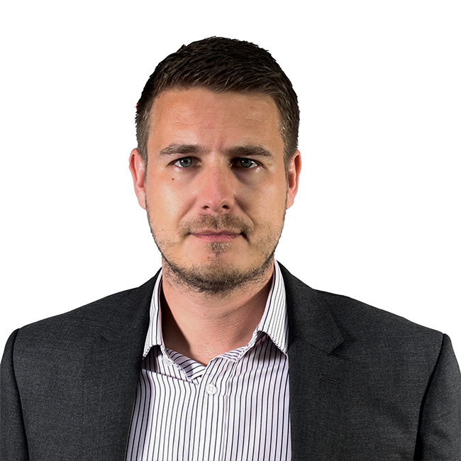


Delivery Within a Service Management Framework
Peer-to-peer relationships, and long-term partnerships
Performance Reporting, Capacity Planning
Continual Service Improvement Plan
(CSIP)
Your Aligned Client Service Architect
Client Service Delivery Manager acting as the voice of SMS within Exponential-e​
​
Your main point of contact for anything service related​
​
ITIL qualified​
Service Catalogue Management
End-to-End SLA Management
Governance Structure
Change Enablement

